Slide 1
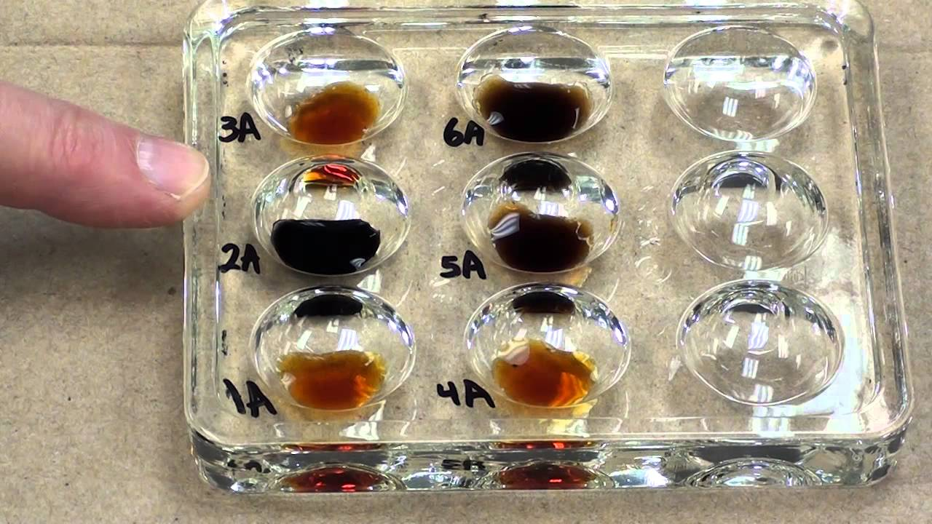
Year 8 Digestion of Starch Practical

Slide 2
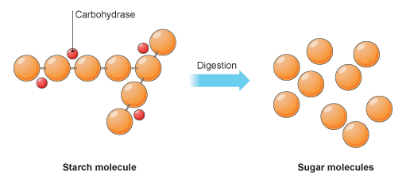
Digestion of Starch using Amylase
Amylase
Iodine turns black
Iodine stays brown
Learning objective: To determine the effect of temperature on the digestion of starch

Slide 3
Digestion of Starch using Amylase
Four groups
Groups 1 & 3 at room temperature
Groups 2 & 4 at body temperature
Starch turns iodine black!
2 drops of iodine
Groups
1 and 3
Groups
2 and 4
5ml starch suspension
0.5ml amylase
Placed in beaker
5ml starch suspension
0.5ml amylase
Placed in hand

Slide 4
Results
Time | Colour of iodine at room temperature (beaker) | Colour of iodine at body temperature (hand)
1 | Black | Black
2 | Black | Black
3 | Black | Black
4 | Black | Black
5 | Black | Black
6 | Black | Brown
7 | Black | Brown
8 | Black | Brown
9 | Black | Brown
10 | Black | Brown
11 | Brown | Brown
12 | Brown | Brown

