Slide 1
Data Processing and Presentation
Using
Excel 2007

Slide 2
Contents
Entering data
Processing Data
Generating a line graph
Adding error bars
Using the Data Analysis add -in

Slide 3
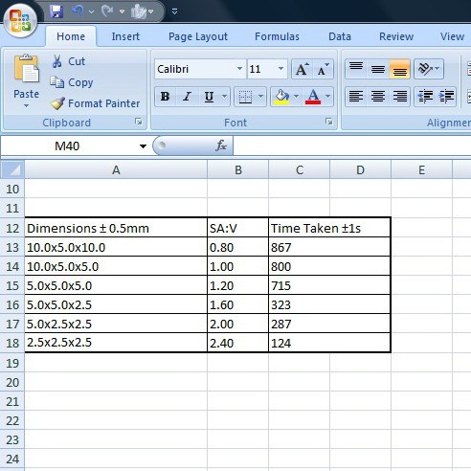
Entering data
Excel is designed for processing data and it is much easier to process your data this way than entering it into a table in Word. Finished tables can be copied and pasted into your laboratory report.
Data should be presented as clearly as possible.
Include the uncertainties.
Add the cell borders.
Be consistent with the number of decimal places. This may require formatting the cells. . . .

Slide 4
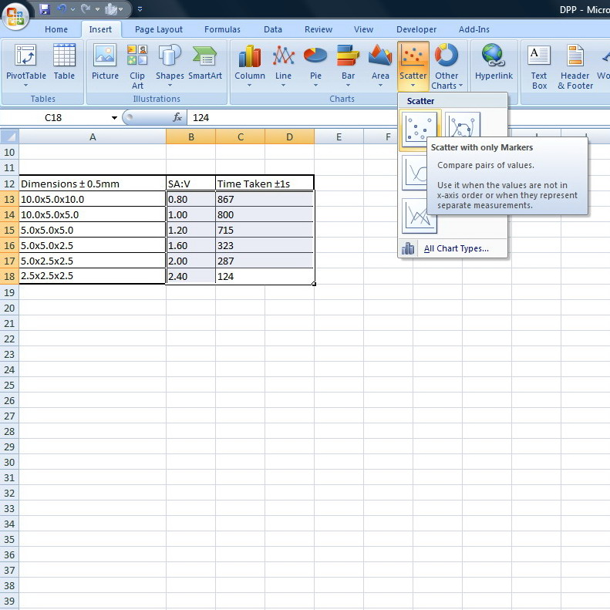
Generating a line graph
Select the data that you want to plot.
Left click [Insert].
Choose [Scatter with only markers].
This is because we will be adding a trendline.

Slide 5
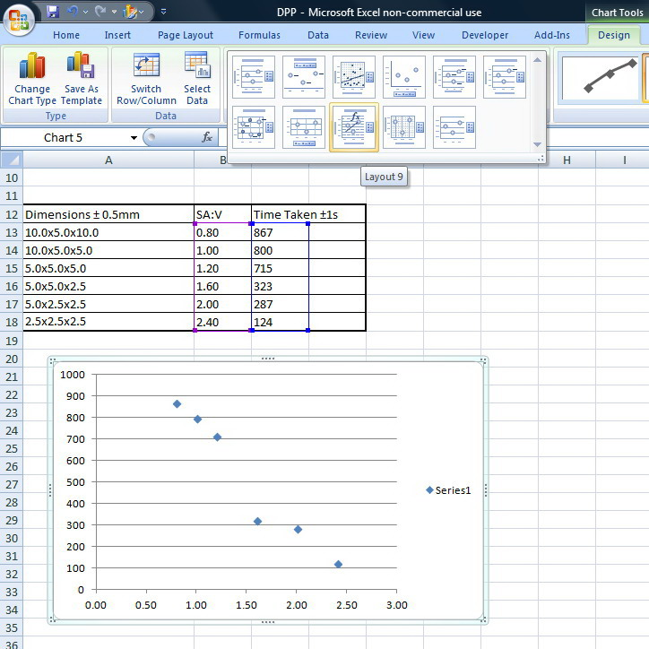
Choosing the chart layout
Left click the bottom right corner of [Chart Layout].
Here we are choosing layout 9.
With this option, the trendline is added automatically and it allows us to label the axes and add a title.

Slide 6
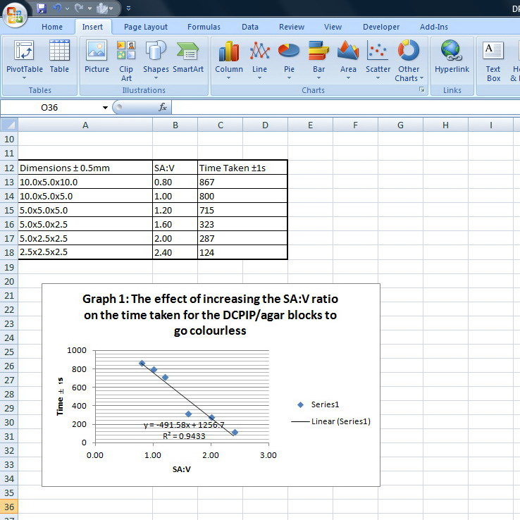
Adding a title and axes labels
The title should indicate the relationship shown by the graph.
Axes labels should include the units and uncertainties.
Experience and logic tells me that this should not be a straight line as, according to the graph, above a SA:V ratio of around 2.8:1 the time taken for the blocks to go colourless would be zero and this is clearly not the case, so I need to format the trendline . . . .

Slide 7
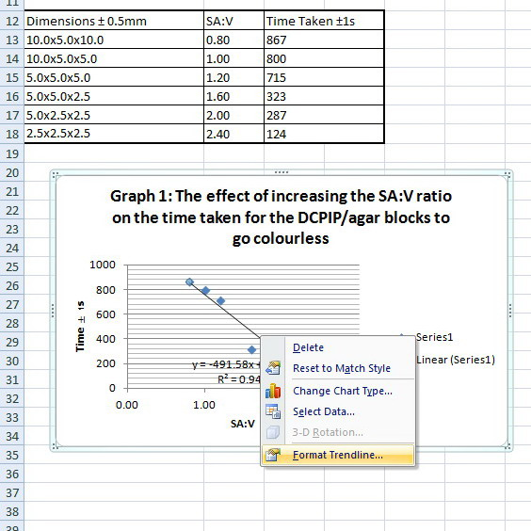
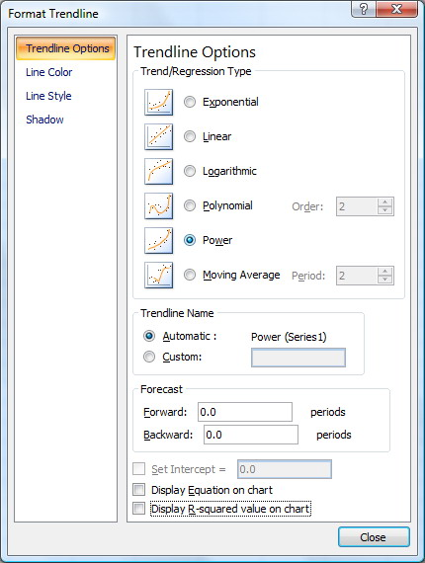
Formatting the trendline
Right click on the trendline and choose the most appropriate option. Here it is the power option.
I will also deselect the last two check boxes as these features are not required on this occasion.
You can also change the line colour and style.

Slide 8
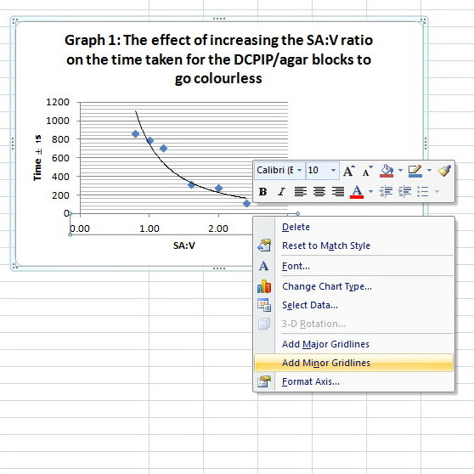
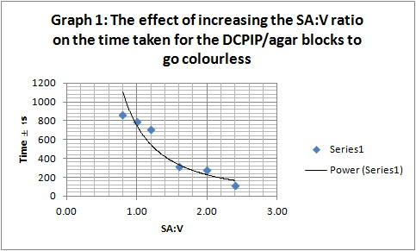
Adding the minor gridlines
Right click on the axes. Click on [Add Minor Gridlines]
If you wish, do likewise to add the major gridlines
Further formatting of the axes can be done.

Slide 9
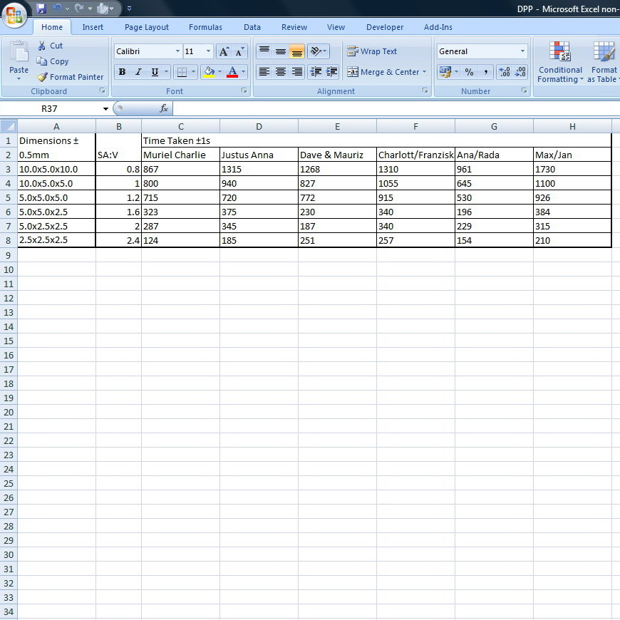
Data from multiple trials
All six pairs of students followed the same procedure so we have six trials.
We need to calculate the means and use these for a second graph.
We can determine the standard deviations. The rough rule of thumb is that we need 30+ values and they need to show a normal distribution but we will overlook these points in this instance.

Slide 10
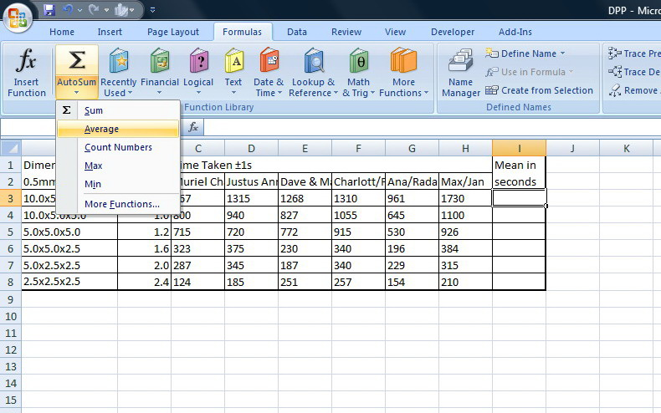
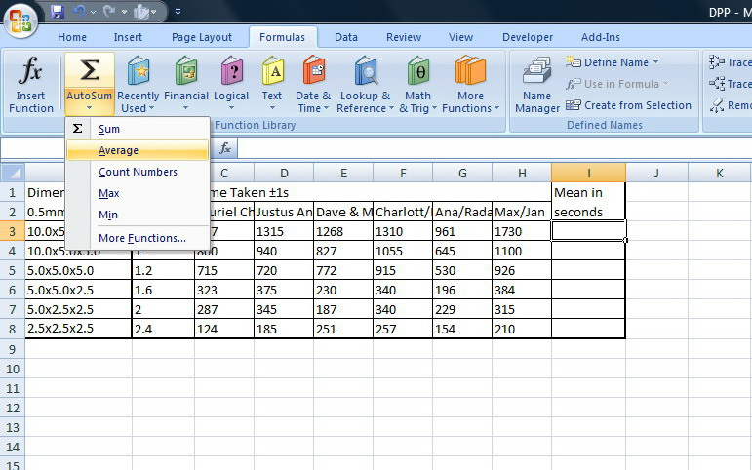
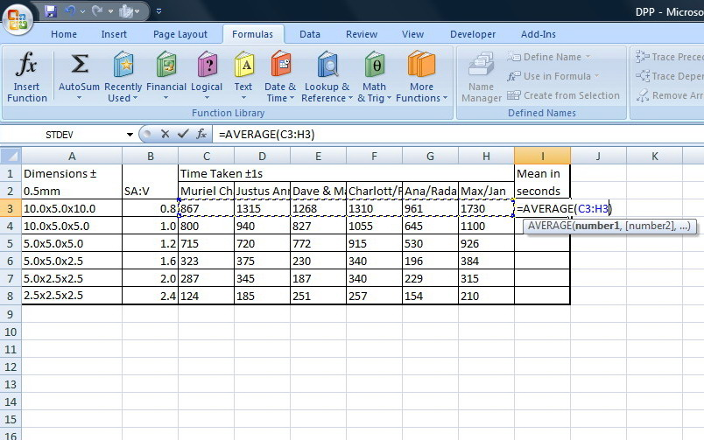
Determining the mean values
Add an additional column with borders.
Select the cell where you wish to insert the mean. Then select the [formulas] tab followed by the [AutoSum] button and click on [Average]. Select the six values.
Then press [enter].
Format the cell to zero decimal places

Slide 11
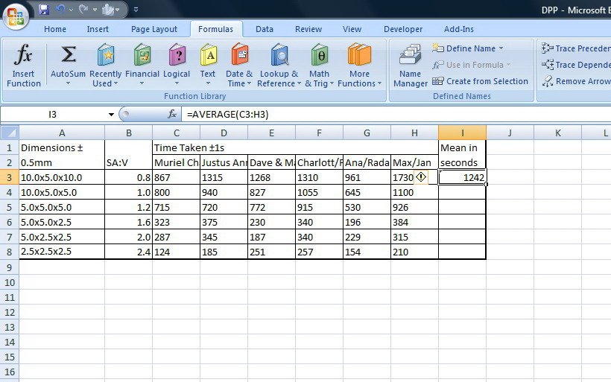
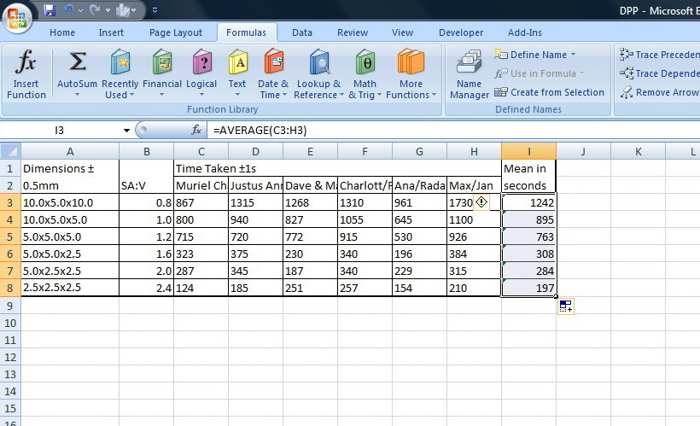
Determining the mean values
Left click on the bottom right of the cell and drag to the bottom of the column.
The mean values will appear – as simple as that!
Next we need to plot a graph for the mean values. This is the same procedure as followed in slide 4 . . . .

Slide 12
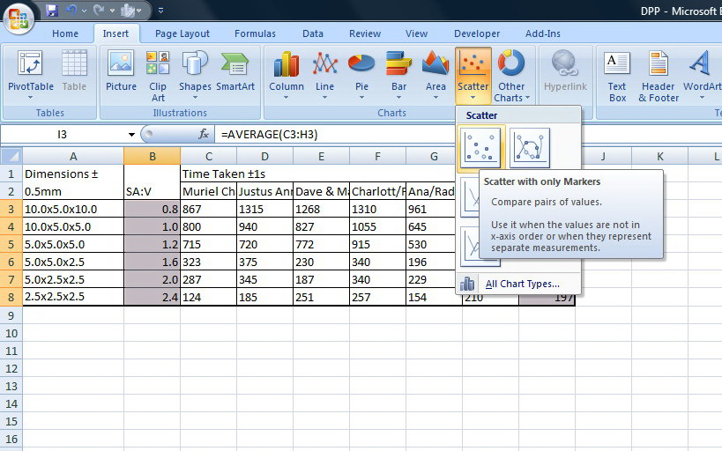
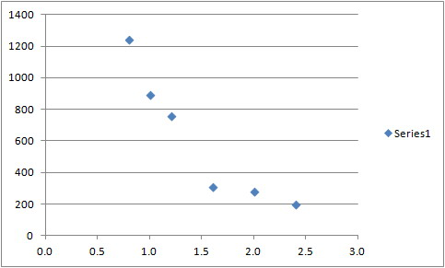
Generating a line graph
Select the cells containing the data to be plotted on the graph (coloured here to help you identify them).
Left click [Insert].
Choose [Scatter with only markers].
Next we need to choose the chart layout and edit the title/axes labels as in slides 5-6.
You may also wish to modify the grid lines . . . .

Slide 13
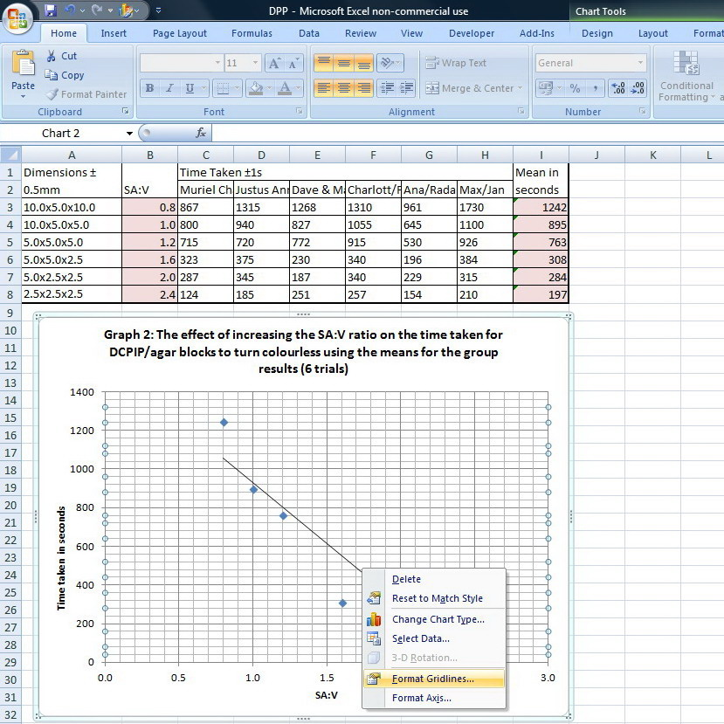
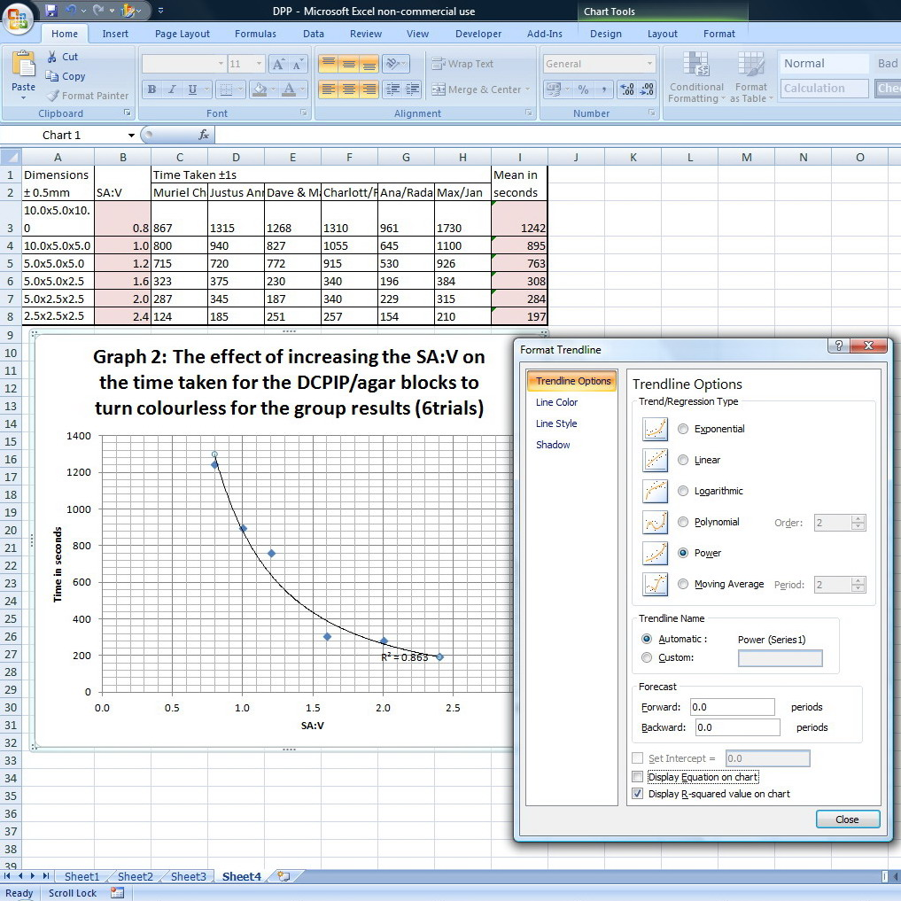
Formatting the trendline
We need to format the trendline as in slide 7.
The R2 value tells us the degree of correlation, which should be higher for the mean values which is one of the reasons why we carry out multiple trials.

Slide 14
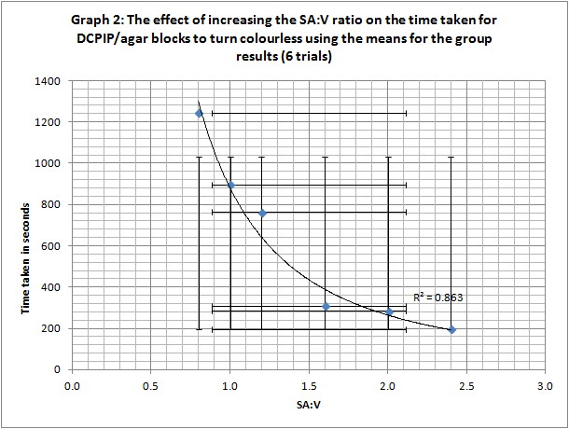
Adding error bars
If we add error bars to the current graph, this is what happens. This is clearly not right.
We want error bars showing the standard deviation for the data corresponding to each SA:V.
We must add a data series for each SA:V and then add the error bars.
ERROR!

Slide 15
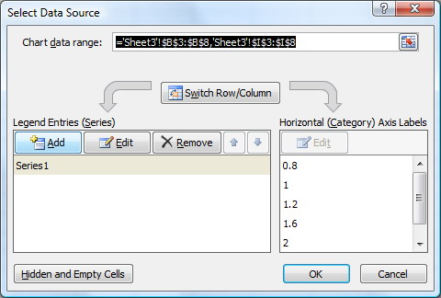
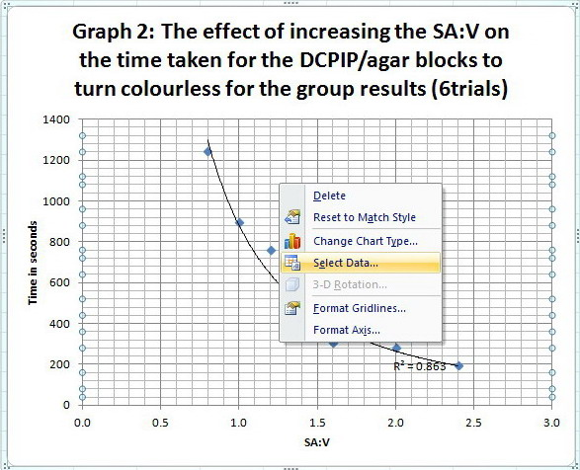
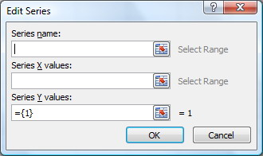
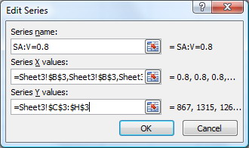
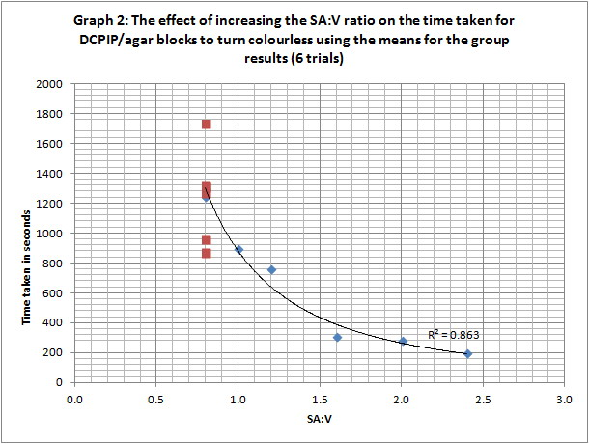
Adding data series to an existing graph
Right click on the graph and left click [ Select Data]
On the data source box, left click [Add]
Enter a series name and select the X and Y values.
You will need to click the cell for the X value six times (O.8 in cell B3 in this example). Alternatively enter 0.8,0.8,0.8,0.8,0.8,0.8.
In this example the Y values are in cells C3:H3 (refer to slide 9)

Slide 16
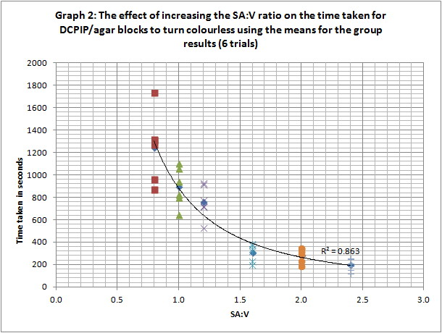
Adding data series to an existing graph
Repeat for the other SA:V values.
This produces the graph shown left. Excel automatically chooses the markers though the shape and colours can be changed. I am not going to worry about this at present as I will remove the markers once the error bars have been added.

Slide 17
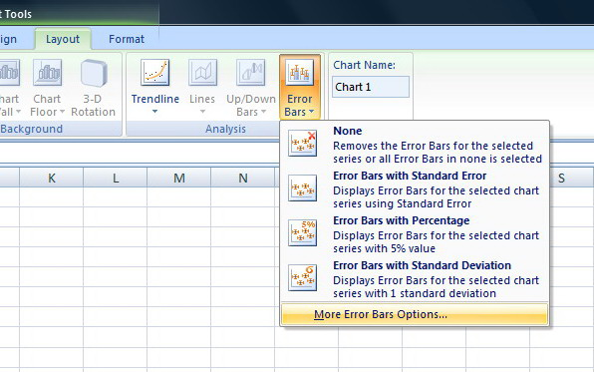
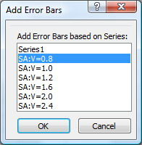
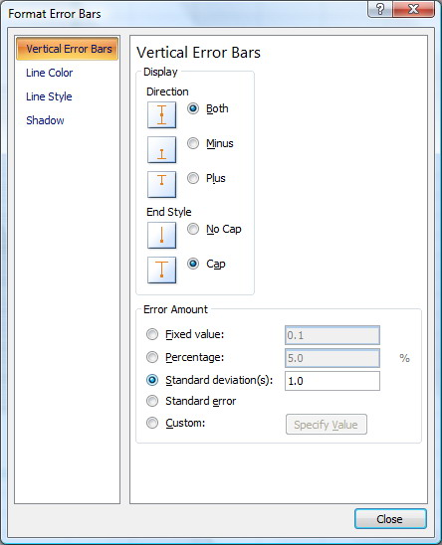
Adding the error bars
Select the [layout] tab.
Click on [Error Bars] and select [More Error Bars Options].
Select [SA:V=0.8] and left click [OK].
Check the [Standard deviation] button and close. You can change the style of the error bars using this dialogue box.

Slide 18
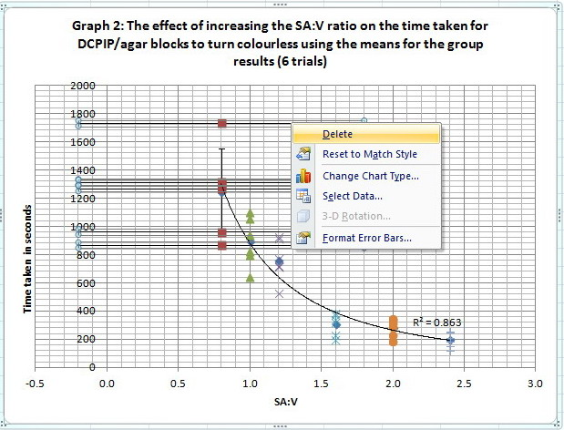
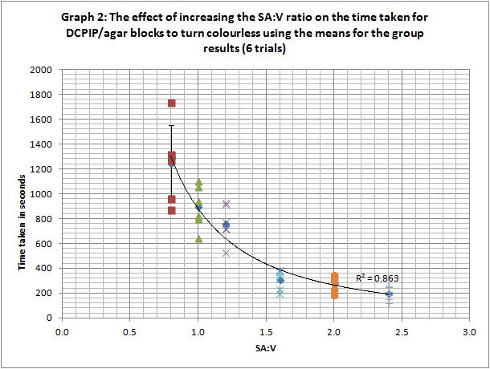
Deleting the unwanted horizontal bars
Right click on a horizontal error bar and select [delete].
The next step is to remove the markers. To do this, right click on any one of the markers for the data set . . . .

Slide 19
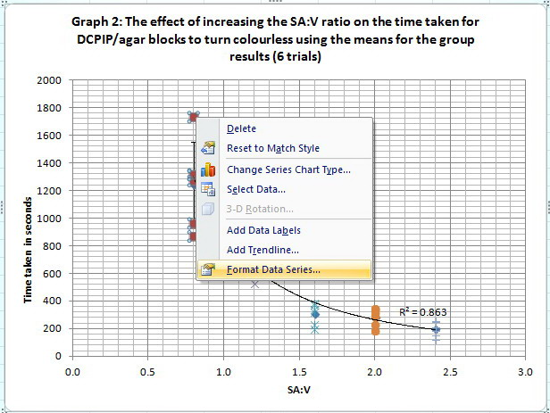
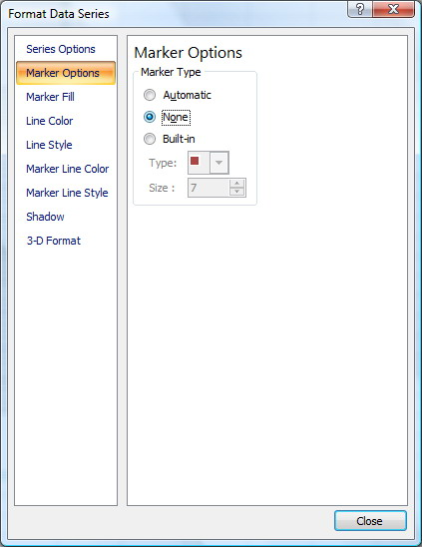
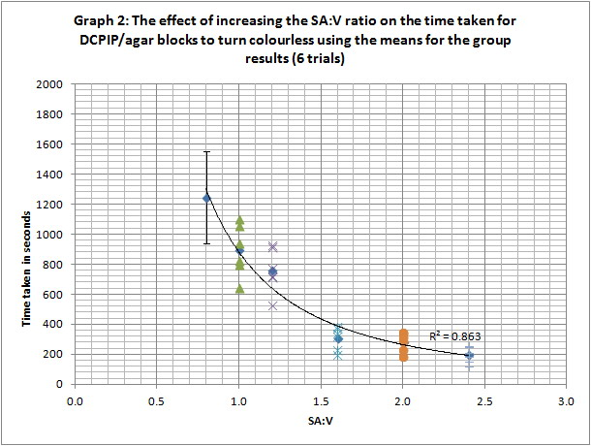
Deleting the unwanted horizontal bars
Select [Format Data Series….]
Select [Marker Options]
Check the [None] button and click [close]
This removes the markers, but leaves the error bars.
The steps in slides 17 and 18 can be repeated for the other data series to produce . . . .

Slide 20
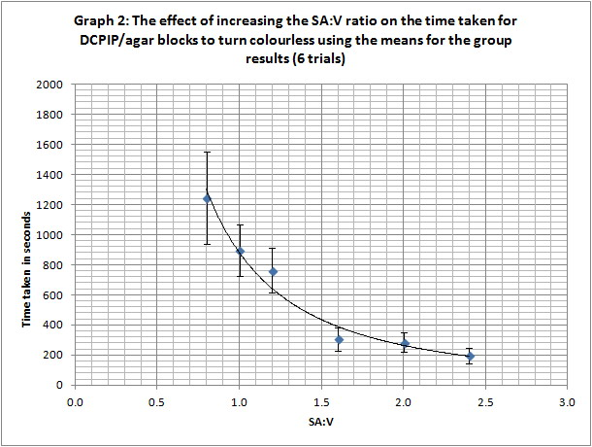
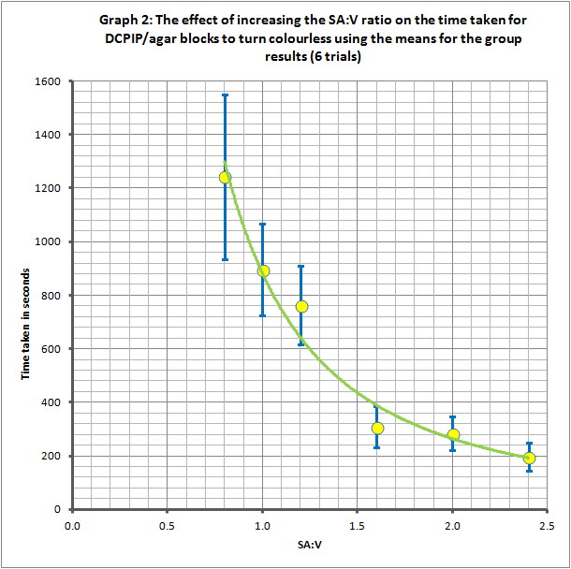
END PRODUCT
Or after tidying up and a little further editing . . . .
These instructions are for using Excel 2007. This is because the school computers have Excel 2007installed and it is also the version that I use. Later versions of Excel may differ. Furthermore, there may be other ways of obtaining the same end result. If you know an easier way, please share it!

Slide 21
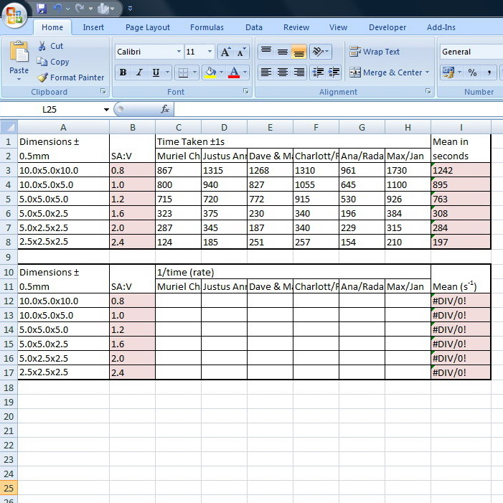
Further data processing.
The initial aim of the experiment was to investigate the effect of surface area to volume ratio on the rate of diffusion. The time taken for the blocks to go colourless is inversely proportional to the rate of diffusion. Therefore we need to calculate 1/time for each value and produce a further graph.
First, copy and paste the first results table, change the headings and delete the data.

Slide 22
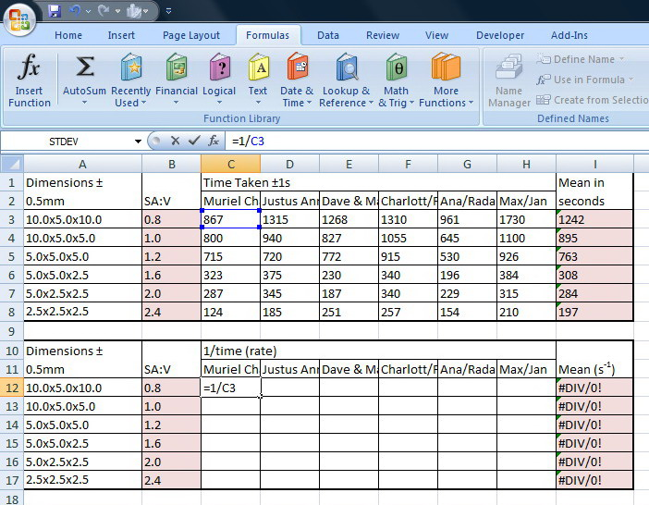
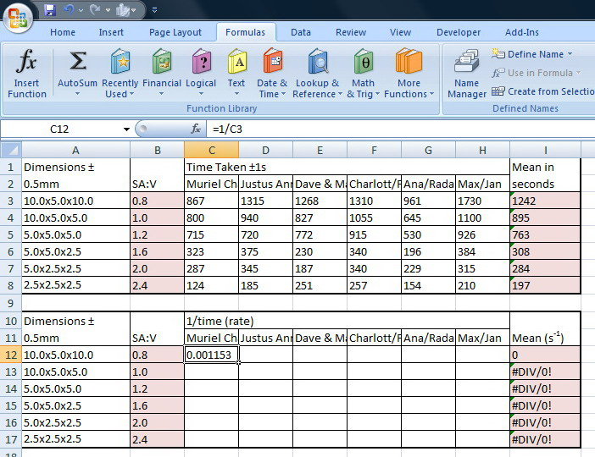
Further data processing.
Select the first empty cell in Table 2. Left click the formulas bar and enter 1/C3.
Then press [enter]. The value for 1/time appears in the correct cell (C12). You will notice that it is a small decimal fraction. This can dealt with by either converting the time into minutes (not minutes and seconds) or using exponentials. More about this later.

Slide 23
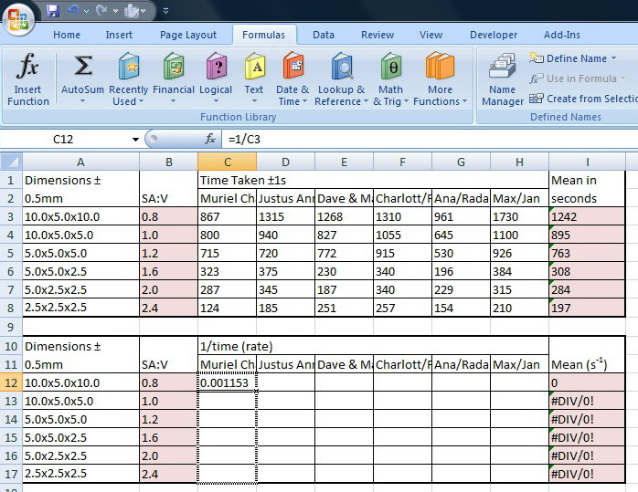
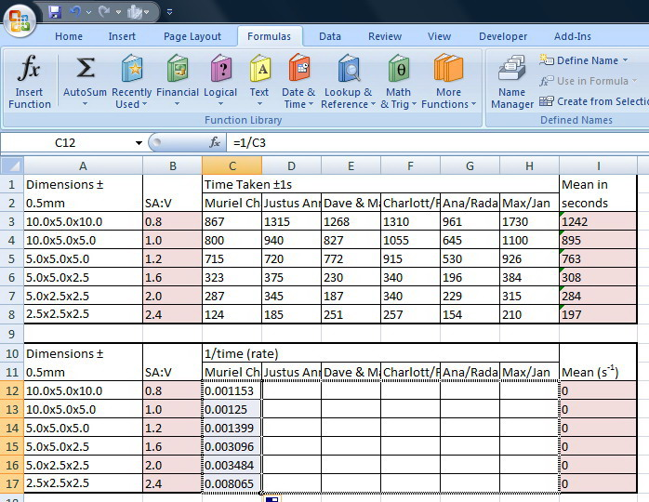
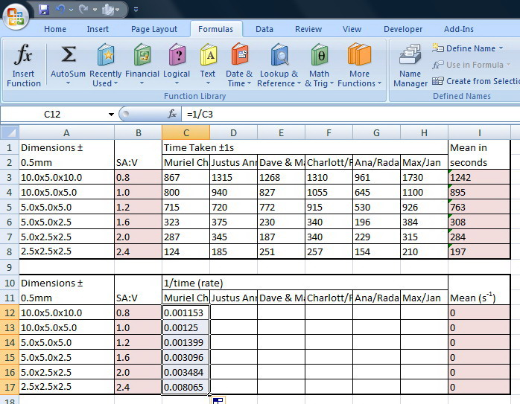
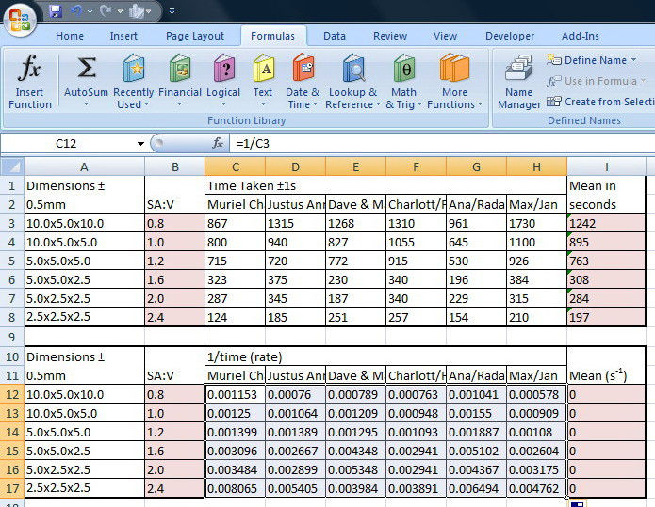
Further data processing.
Click on the bottom right of cell C12 and drag to the bottom of the cell.
Then press [enter]. The value for 1/time appears in the correct cell. You will notice that it is a small decimal fraction. This can dealt with by either converting the time into minutes (not minutes and seconds) or using exponentials. More about this later.
Furthermore the mean values appear as zero. This is because the cells need formatting.

Slide 24
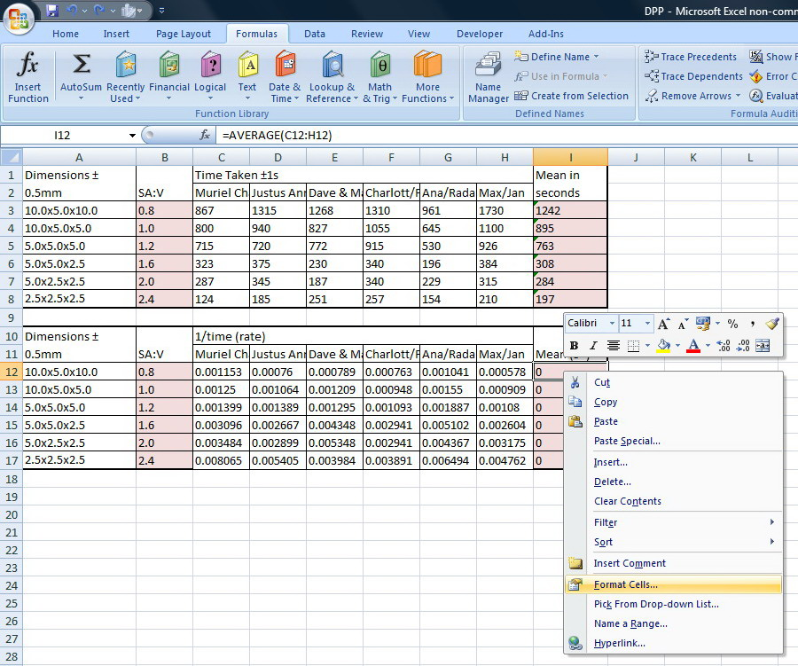
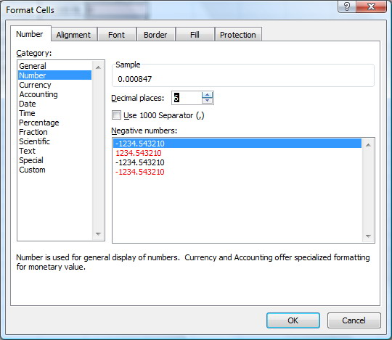
Formatting numerical values in cells
Right click on the cell containing the first of the mean values and select [Format cells].
Change the number of decimal places to the number required (here 6). Click [OK].
Dragging the corner of the cell downwards from the bottom right corner will change the properties of the other cells in the column.

Slide 25
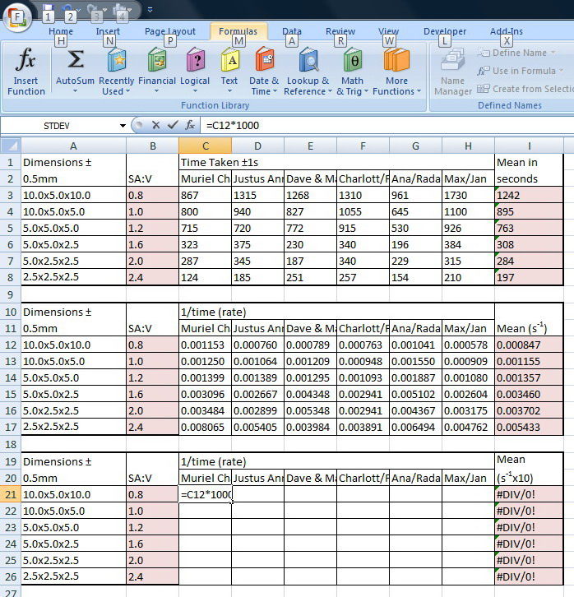
Using an exponential
The number of decimal places is cumbersome. You can make a copy of the table, remove the data and using the formula bar, multiply the values by 1000. However, you must ensure that you enter x103 in your table and axis label.
You may want to reformat the cells to change the number of decimal places.
You can now use the data to produce a third graph following the same procedure as in slides 12-20.

Slide 26
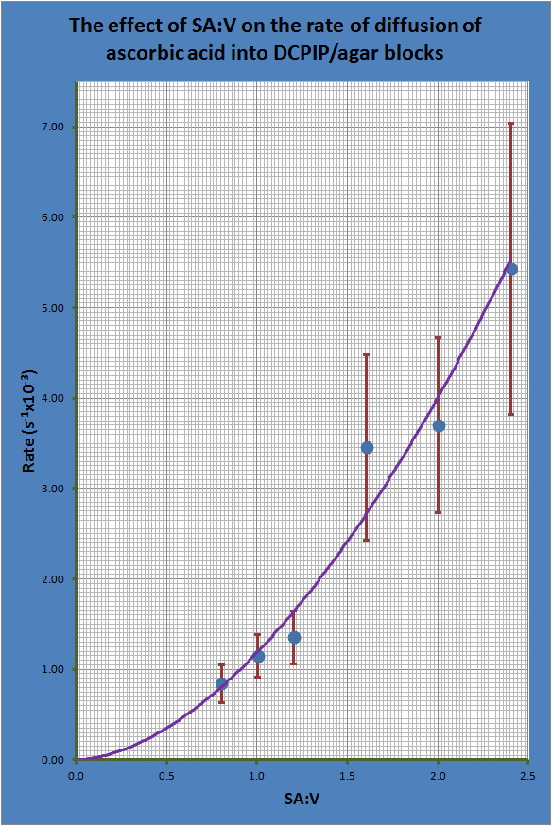
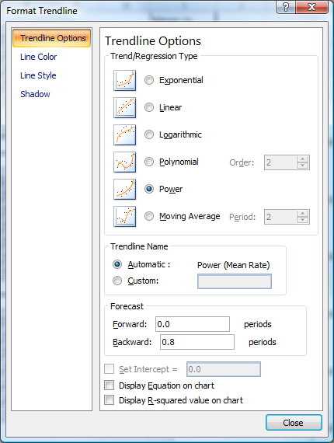
Extrapolating the curve (Forecast function)
It is possible to extend the curve beyond the data range. Here I am going to extend backwards to where the theoretical SA:V ratio is zero (this would be a DCPIP/agar cube of infinite size!). You can extrapolate forwards too.

Slide 27
Final Conclusions
Things to keep in mind . . . .
The purpose of any data processing is to assist in the interpretation of data. The last graph (previous slide) clearly show that the rate of diffusion into the blocks increases exponentially as the SA:V ratio increases.
Always remember the purpose of your investigation and any interpretation of the results must be made in a biological context.
Shrink results tables to a single page. Place them on a separate page if you need to. Consider whether they fit the page best in portrait or landscape. A results table should not be split between two pages though separate table may be placed on different pages.
Always explain how you have mathematically processed the data, including any formulae. (You do not need to explain the steps followed on Excel).
Data processing can be very time consuming and you may not know how to do what you want to do. There are many useful tutorials on Youtube and online forums.
This slide links to a Youtube clip shows you how to plot a column chart of several means and then how to apply 95% confidence limit error bars to each individual mean.

Slide 28
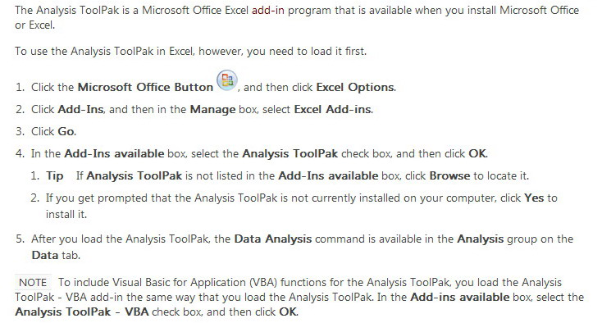
Final Conclusions
Using the Data Analysis Toolpack
This is a very useful add-in but you may need to enable it in Excel. From the office.microsoft.com . . . .
Screenshots follow on the next slides.

Slide 29
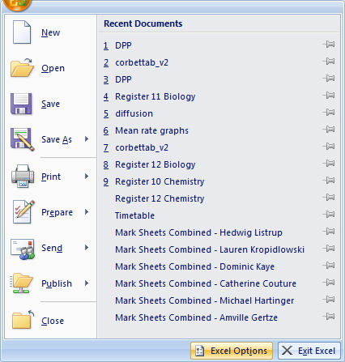
Final Conclusions
Using the Data Analysis Toolpack
1. Click the Microsoft Office Button , and then click Excel Options.

Slide 30
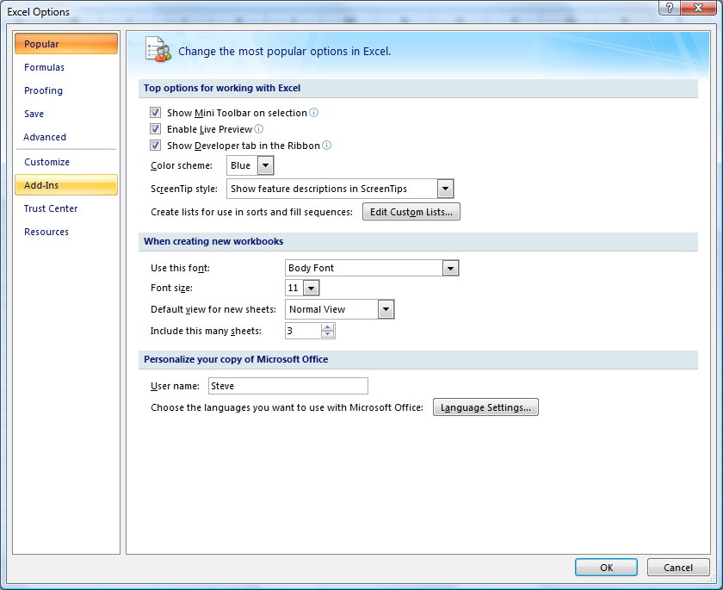
Final Conclusions
Using the Data Analysis Toolpack
2. Click Add-Ins, and then in the Manage box, select Excel Add-ins.

Slide 31
Final Conclusions
Using the Data Analysis Toolpack
3. Click Go.
4. In the Add-Ins available box, select the Analysis ToolPak check box, and then click OK.

Slide 32
Final Conclusions
Using the Data Analysis Toolpack
5. After you load the Analysis ToolPak, the Data Analysis command is available in the Analysis group on the Data tab.
We can now use this to help us to add error bars to graphs as well as provide us with a full data analysis . . . .

Slide 33
Final Conclusions
Using the Data Analysis Toolpack
Lets use data for the same experiment. Select the data and go to [Data Analysis]
Choose [Descriptive Statistics] and click [OK] – The box below will appear . . . .

Slide 34
Final Conclusions
Using the Data Analysis Toolpack
In this instance the data series are arranged in rows and the labels (SA:V values) are in the first row so it is necessary to check the boxes accordingly. Then select the input range by dragging the cursor across the cells containing the data but not the headings.

Slide 35
Final Conclusions
Using the Data Analysis Toolpack
Then choose the output box.
Select what you want from the check boxes at the bottom. Here I am choosing Summary Statistics and confidence level for Mean at 95%. Click [OK] and “Hey presto!”

Slide 36
Final Conclusions
Using the Data Analysis Toolpack
Hold down the [control] and select the means. Then insert the graph of your choice.
You will notice that the x-axes is incorrect so se need to edit the data series.
We can go into [Design] and change the [Chart Layout].

Slide 37
Final Conclusions
Using the Data Analysis Toolpack
I have chosen layout 1 this time.
We now need to add the error bars. Left click on the [Chart Area] not the [Plot Area]. Check the [Custom] option and left click [Specify Value].

Slide 38
Final Conclusions
Using the Data Analysis Toolpack
Select the cells containing the standard deviation values in the data analysis for both the positive and negative error values. This gives ± one standard deviation.

Slide 39
Final Conclusions
Using the Data Analysis Toolpack
It is a bit annoying that the horizontal error bars also appear but these are easily deleted. Finally add a trendline (The power option is the best in this instance)
Do not forget to indicate that the error bars show the standard deviation. The other common alternatives are standard error or 95% confidence limits.
You can make cosmetic changes to the markers and bars, but the most important thing is clarity.

Slide 40
Good Luck!

