Slide 1
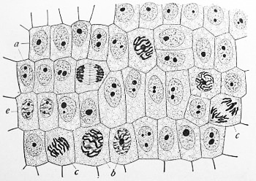
Mitosis
Haileybury Astana Year 12 IB Biology

Slide 2
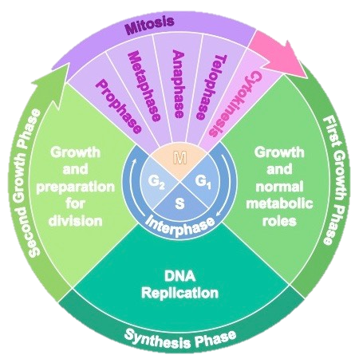
The Cell cycle
Remember: All cells originate from other cells!

Slide 3
Interphase
Normal appearance of non dividing cell
Includes the growth and synthesis phases
Nuclear envelope intact and the chromosomes are too threadlike to see

Slide 4
Prophase
Chromosome become visible
Centrioles move to opposite poles
Nucleolus disappears
Nuclear envelope disappears

Slide 5
Metaphase
Chromosomes arrange themselves on the equator
Spindle fibres have formed and are attached to the centromeres of the chromosomes

Slide 6
Anaphase
The spindle fibres tighten and separate the chromatids
Each chromatid has now become a separate chromosome
They are pulled towards the poles

Slide 7
Telophase
Nuclear envelope begins to reform
Cleavage of the cytoplasm begins

Slide 8
Cytokinesis
Two daughter cells produced
Chromosomes once again become threadlike
The chromosome number has been maintained and the two daughter cells are diploid

Slide 9
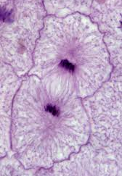
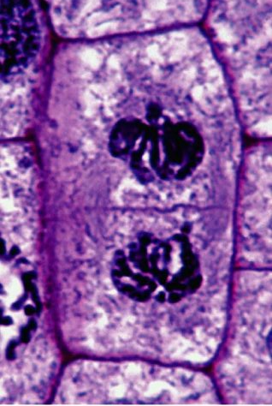
Cytokinesis

Slide 10
Cytokinesis

Slide 11
Details
The chromosome number is maintained
There is a single division
Occurs throughout the body where there is growth and repair.
Cancer (tumours) occur due to mutations and cells uncontrollably carrying out mitosis.
Mitosis is also used in asexual reproduction.

Slide 12
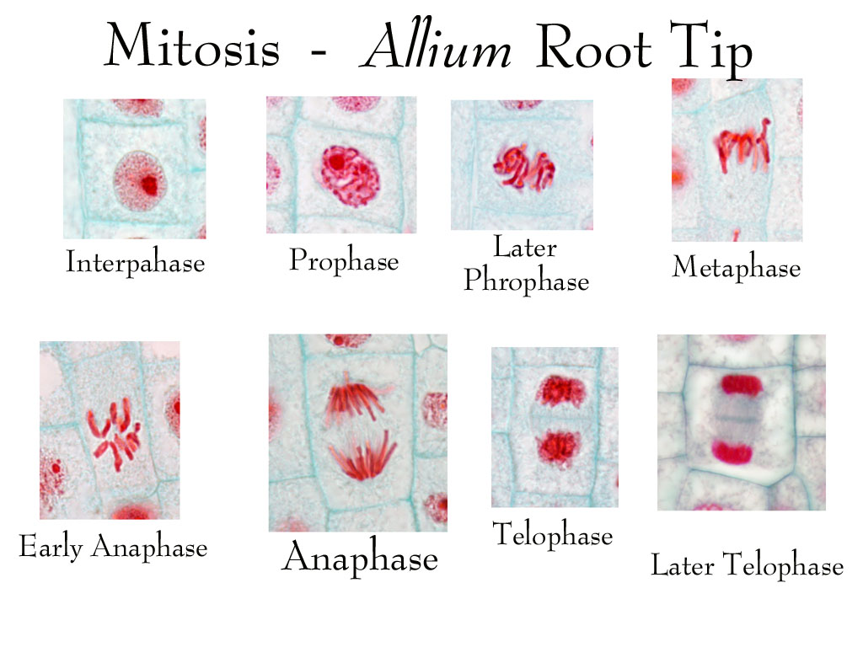

Slide 13
Which stage?

Slide 14
Which stage?

Slide 15
Which stage?

Slide 16
Which stage?

Slide 17
Mitosis is a part of the cell cycle
Mitosis is only one phase within the cell cycle!

Slide 18
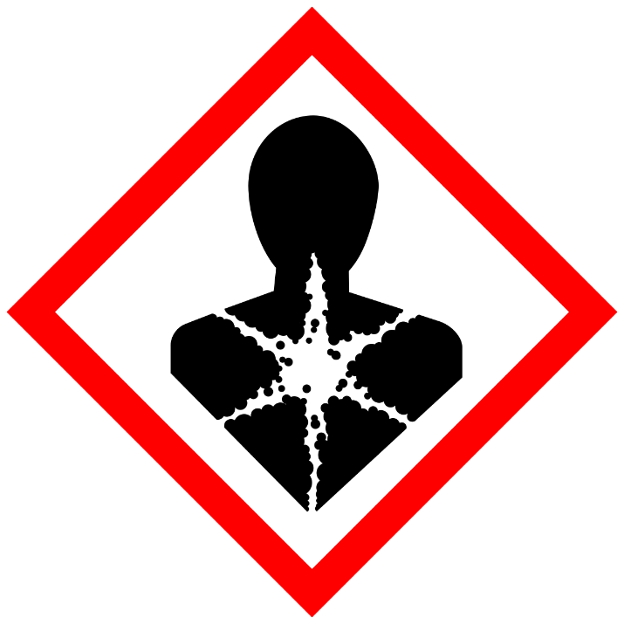
Cancer
Cancer is the uncontrolled division of cells
This can be the result of mutations
Things that cause cancer are known as carceinogens
A carcinogen is any substance, radionuclide, or radiation that promotes carcinogenesis, the formation of cancer. This may be due to the ability to damage the genome or to the disruption of cellular metabolic processes.

