Slide 1
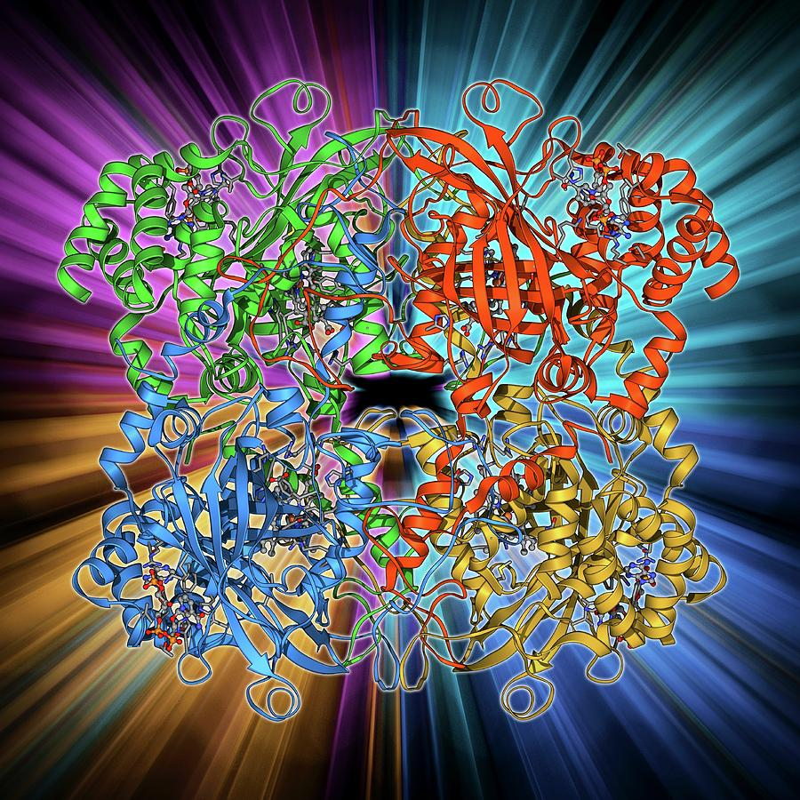
ENZYMES

Slide 2

Test on Tuesday 14 November
DIGESTION AND ENZYMES

Slide 3
Success Criteria
Learning
Intentions
Lesson 1.5.2
I will know I am successful if I can:
State that enzymes function as biological catalysts and are made by all living cells.
Know that enzymes speed up cellular reactions and are unchanged in the process.
State that the shape of the active site of enzyme molecules is complementary to a specific substrate.
Enzymes

Slide 4

Enzymes
Enzymes are biological catalysts – protein molecules that speed up chemical reactions and remain unchanged. They catalyse chemical reactions in living cell.
Watch the Amoeba Sisters Video

Slide 5
Enzymes: true or false?

Slide 6
Success Criteria
Learning
Intentions
Lesson 1.5.3
I will know I am successful if I can:
State that enzymes, and other proteins, can be affected by temperature and pH, which result in changes in their shape.
State that an enzyme works best in its optimum conditions.
Know that a change in shape will affect the rate of reaction and may result in denaturation.
Enzymes

Slide 7
Test on Tuesday 14 November
DIGESTION AND ENZYMES

Slide 8

What we should know…
Why do living cells require enzymes?
Can you state the chemical reaction that would take place with the enzyme:
  Amylase
  Lipase
Enzymes are specific. Can you explain this statement?

Slide 9
Temperature and Enzymes
Enzymes are affected by a change in temperature.
If the temperature is particularly low, the enzyme activity will be very slow.
As the temperature increases the enzyme activity increases, but only up to a certain point.

Slide 10
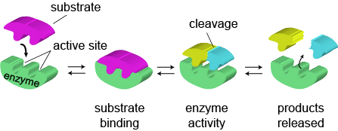
Enzymes
Allow chemical reactions to take place at low temperatures
Have an ACTIVE SITE
Enzymes are specific to a substrate
Enzymes can build molecules (anabolism) or break down molecules (catabolism)
Enzymes are unaltered and is used repeatedly

Slide 11
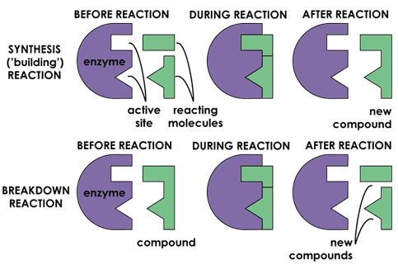
Enzymes
Allow chemical reactions to take place at low temperatures
Have an ACTIVE SITE
Enzymes are specific to a substrate
Enzymes are unaltered and is used repeatedly

Slide 12
Test on Tuesday 14 November
DIGESTION AND ENZYMES

Slide 13

Temperature and Enzymes
The temperature at which the enzyme works at its quickest is called the Optimum temperature.
Most human enzymes have an optimum temperature around 37ºC
The condition (e.g. temperature, pH) at which an enzyme works best is called it’s optimum.

Slide 14
Temperature and Enzymes
The active site of an enzyme is permanently altered due to high temperatures and the enzyme no longer works. The enzyme is said to be denatured.
Once the temperature is too high the enzyme (being a protein) is damaged and we say it has been denatured.

Slide 15
Test on Tuesday 14 November
DIGESTION AND ENZYMES

Slide 16

Temperature v Enzyme Activity
Optimum
temperature
Increasing
enzyme
activity
Increasing rate of Reaction
Enzyme
being
denatured
0
10
20
30
40
50
Temperature (ºC)

Slide 17

Video
Effect of temperature on the activity of catalase in liver
H₂O₂ →H₂O +O₂

Slide 18
Test on Tuesday 14 November
DIGESTION AND ENZYMES

Slide 19
Effect of pH on Enzymes
pH is a measure of how acid or alkali something is.
The pH scale goes from 1 to 14, with 1 being very acidic, 14 being very alkaline and 7 being neutral.
The shape of an enzyme can be affected by changes in pH and this will affect how well the enzymes work.

Slide 20
Effect of pH on Enzymes
Like temperature, enzymes have an optimum pH, i.e. a pH when they are most efficient.
The optimum pH varies from enzyme to enzyme.
Our digestive system has a range of pH’s as the food passes through it, and this creates ideal conditions for specific enzymes.

Slide 21
Effect of pH on Enzymes
100
80
60
Pepsin
Catalase
Enzyme Activity (%)
Lipase
40
20
0
0
1
2
3
4
5
6
7
8
9
10
11
12
pH

Slide 22
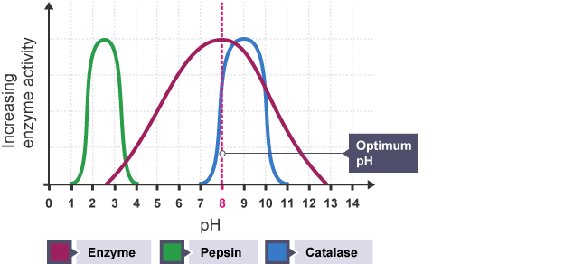
Optimum pH
The pH at which an enzyme works best is called it’s optimum pH.

Slide 23
Optimum pH
At a pH other than its optimum pH, an enzyme is denatured. If the optimum pH is restored, so is the enzymes activity. In this instance, denaturing of the enzyme is reversible!

Slide 24
Identifying enzyme terms

Slide 25
Test on Tuesday 14 November
DIGESTION AND ENZYMES

Slide 26


Slide 27
Q1
Which word describes the best temperature at which an enzyme works

Slide 28
Q2
Which word describes the change in properties of an enzyme at high temperatures

Slide 29
Q3
State the name given to the part of the enzyme molecule to which the substrate binds

Slide 30
Q4
State the factor that can reversibly alter the structure of an enzyme

Slide 31
Q5
Name a protease that works at a very low pH

Slide 32
Q6
To which group of biological molecules do enzymes belong?

Slide 33
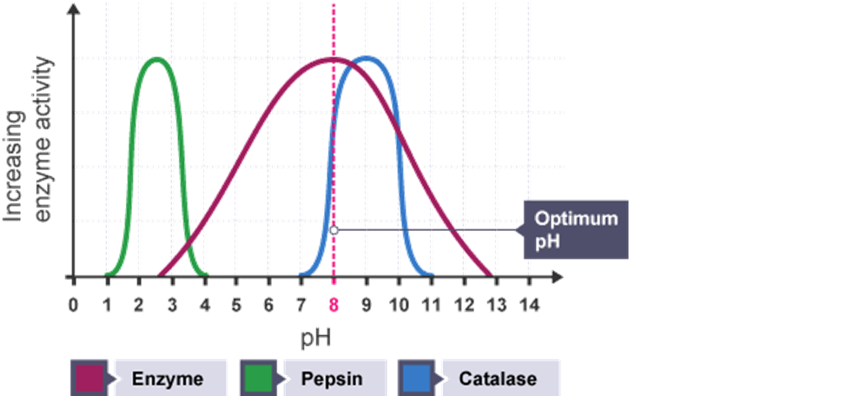
Q7
State the optimum pH of catalase

Slide 34
Q8
State the substrate of catalase

Slide 35
Q9
State the products produced by catalase

Slide 36
Q10
Are the reactions involved in digestion anabolic or catabolic?

Slide 37
Anwsers
Optimum
Denature
Active site
pH
Pepsin
Proteins
9
Hydrogen peroxide
Water and oxygen
Catabolic

Slide 38
Success Criteria
Learning
Intentions
Lesson 1.5.4
I will know I am successful if I can:
Carry out an investigation into the influence of temperature on enzyme activity.
Enzymes & Proteins

Slide 39
What we should know…
Can you name two factors that affect enzyme rate of reaction?
If temperatures are low, can you describe the activity of the enzyme?
If temperatures are too high (70°C), can you describe the activity of the enzyme?

Slide 40
Learning intentions
Determine the conditions required for the digestion of protein

Slide 41
Test on Tuesday 14 November
DIGESTION AND ENZYMES

Slide 42


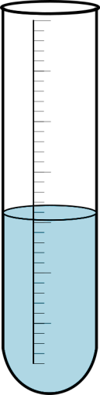
Investigating the action of pepsin on egg-white suspension
Label your tubes ABCD and initial.
Set up the experiment as shown.
Place in a water bath at 37°C.
Draw and the apparatus using a pencil and ruler.
After 10 minutes, collect your tubes and write down your observations.
A
4cm³ egg white
2cm³ pepsin
B
4cm³ egg white
6 drops 0.1M
hydrochloric acid
C
4cm³ egg white
2cm³ pepsin
6 drops 0.1M
hydrochloric acid
D
4cm³ Egg white
2cm³ boiled pepsin
6 drops 0.1M
hydrochloric acid

Slide 43
Experiment
Aim
To investigate if changing the temperature will affect the rate of enzyme activity

Slide 44
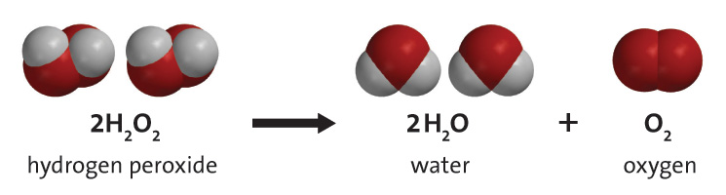
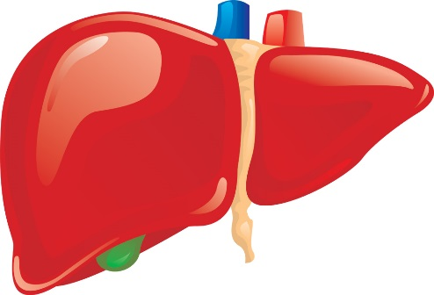
Learning objectives
State the reaction controlled by the enzyme CATALASE
Give a source of catalase
Investigate the effect of temperature on catalase

Slide 45
Test on Tuesday 14 November
DIGESTION AND ENZYMES

Slide 46
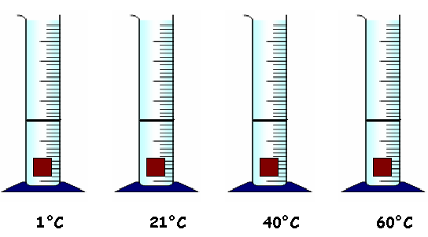
Method
Measuring cylinder
1 drop of detergent
10 cm³ of hydrogen peroxide solution
liver

Slide 47
Results
Temperature °C | Volume of froth produced cm³ 1 2 3 4 5 6
1
21
40
60
Average length of froth (mm)

Slide 48
Conclusion
As the temperature ____________ so did the rate of enzyme activity.
The temperature that gave the best rate of reaction was ______°C. This is known as the ____________ temperature.
However, when the temperature reached ______ °C the rate of enzyme activity started to decrease. This is due to the shape of the _________ _______ becoming ___________. When this happens, the enzyme is said to be _________.

Slide 49
Conclusion
From the results it can be concluded that pepsin promotes the digestion of _____________ best in ___________ _________ conditions, pH of ________. This is known as the _______________ pH.
The activity of pepsin decreases as pH _______________.
At a pH of __________ the enzyme has stopped working and has become _______________.

