Slide 1
Gaseous Exchange & Ventilation

Slide 2
Definitions
RESPIRATION
Gaseous Exchange
Ventilation
Respiration (which is often confused with breathing) is a set of chemical reactions that takes place in all living cells. It is the means by which we obtain useful energy from the food that we eat. Energy is produced in the form of ATP. The overall equation is:
C₆H₁₂O₆ + 6O₂ → 6CO₂ + 6H₂O
Gaseous exchange is the intake of oxygen and the excretion of carbon dioxide and water. This takes place across a respiratory surface. In humans, this is the lungs, or more specifically, the alveoli. In fish, it is the gills. In earthworms, it is the skin. In plants, the main respiratory surface are the leaves.
Ventilation is where the stale air, containing a lower concentration of oxygen and a higher concentration of carbon dioxide , is expelled and replaced with fresh air containing higher concentrations of oxygen and lower concentrations of carbon dioxide. This maintains the concentration gradient across respiratory surfaces.

Slide 3
The lungs
Copy and label the diagram of the lungs.
Suggest why the left lung is smaller than the right.
The pleural fluid acts as a lubricant around the lungs. Explain why this is important.
Suggest what happens when the diaphragm moves downwards.
The trachea is surrounded by rings of cartilage
Draw the rings of cartilage.
State the importance of these rings.

Slide 4
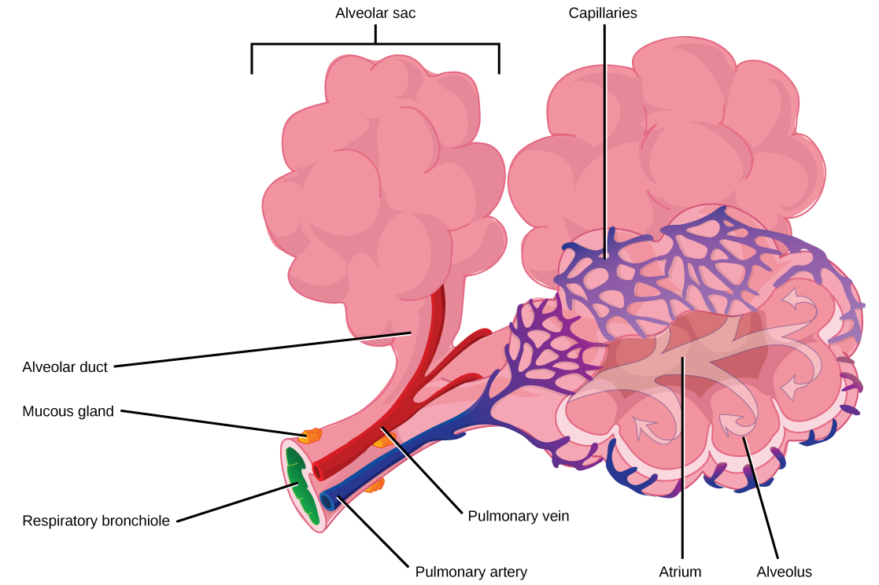
Gaseous Exchange
Alveolus

Slide 5
Gaseous Exchange
Draw the diagram and show the direction of the diffusion of carbon dioxide.
Suggest at which point, X, Y or Z, the rate of diffusion of carbon dioxide will be highest.
Explain why the cells lining the alveolus are flattened?
What is the surface area of the lungs?
Same as a chess board
Same as a table tennis table
Same as a tennis court
Same as a football pitch.

Slide 6
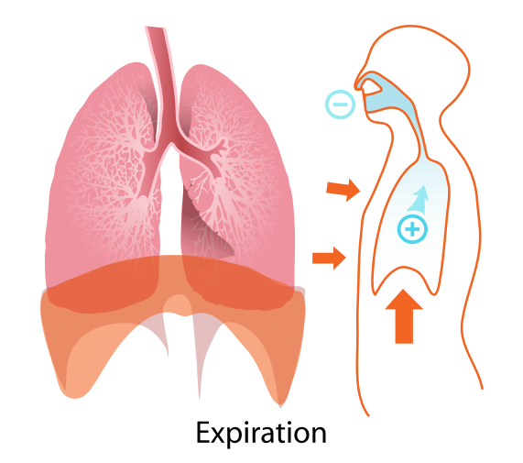
Ventilation
The external intercostal (rib muscles) contract.
This pulls the ribs outwards and upwards.
The diaphragm contracts.
The diaphragm moves downwards.
The volume of the lungs increases.
This results in a drop in pressure within the lungs.
Air pressure is higher outside of the lungs.
Air enters the lungs
inhalation
The alveoli are surrounded by elastic fibres with makes exhalation a largely passive process.
The internal intercostal contract when breathing is active or blowing up a baloon..
This pulls the ribs inwards and downwards.
The diaphragm relaxes.
The diaphragm moves upwards.
The volume of the lungs decreases.
This results in an increase in pressure within the lungs.
Air pressure is higher inside of the lungs.
Air is expelled from the lungs
exhalation

Slide 7
The trachea
Ciliated epithelial cell
Goblet cells produce mucus
The mucus traps dirt and bacteria
The cilia moves the bacteria up towards the throat where they are swallowed and digested
Smoking contains chemicals that stop the cilia from moving
Goblet cell
mucus

Slide 8
Comparison of inhaled and exhaled air
Now try a Test Bite
Gas | % in inhaled air | % in exhaled air
Oxygen | 20 | 16
Carbon dioxide | 0.04 | 4
Nitrogen | 79 | 79
Other | 1 | 1

