Slide 1
Intensive farming

Slide 2
Learning Objectives
Outline the features of intensive farming
Explain the use of chemicals in farming
Evaluate the benefits and environmental impact of intensive farming

Slide 3
Farm machinery

Slide 4
Pesticides

Slide 5
Fertilisers

Slide 6
Greenhouses

Slide 7
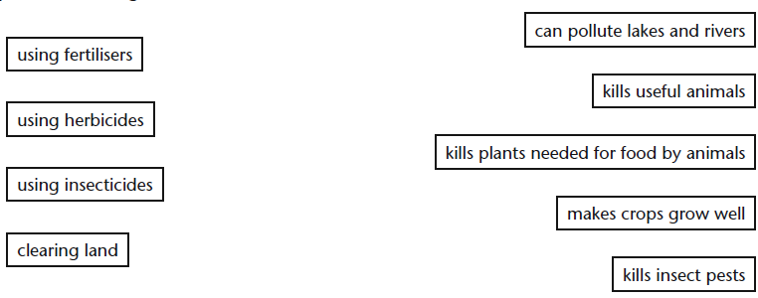
TASK
Draw lines to match the farming methods with their problems. You will not need all of the phrases on the right.

Slide 8
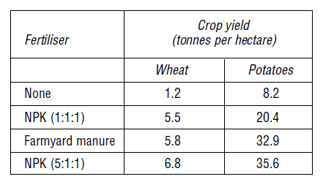
NPK fertilisers
N = Nitrogen P = Phosphate K = Potassium
1. Compare the yield of wheat when NPK (1:1:1) is used and no fertiliser is used.
2. About how many times bigger is the potato yield when NPK (1:1:1) is used than when no
fertiliser is used?
3. Using your results from questions 1 and 2, decide which crop benefits more from the addition of this fertiliser.
4. What is the difference between the composition of the two NPK fertilisers?

Slide 9
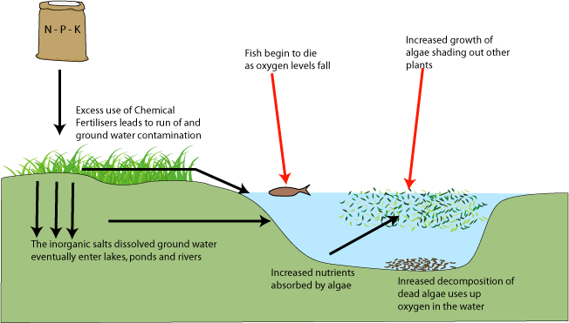
Eutrophication
Eutrophication is when the environment becomes enriched with nutrients. Fertilisers run-off into nearby water causing an increase in nutrient levels.

Slide 10
Presentations
Topic choice:
Farm machinery
Intensive farming
Use of fertilisers
Food production in greenhouses
Hydroponics
Use of Pesticides
Biological control
Farming and the environment
Lee/Harry
Kaitlyn/Clarissa/Katie
Nia/Oonagh
Cameron/Grant
Melissa/Natasha
Ross/Darren/Liam

Slide 11
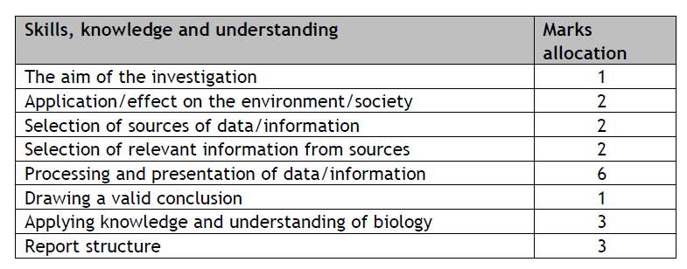
Assessment

