Slide 1
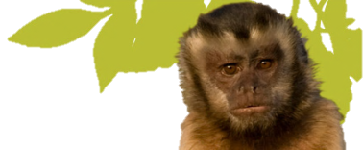
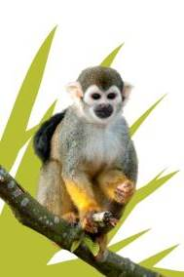
Measuring Behaviour
Notes:
Suggested running options
1. Have students read article before having this entire lecture.
2. Do background of lecture (slides 1-8), then have students read the paper, and then talk through the how to in the next session (slides 9-40) .
3. Can be broken into 3 sessions or more sessions if needed.

Slide 2
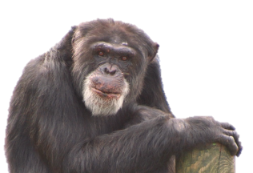
Learning Outcomes
Background
Define animal behaviour and discuss what causes it.
Understand why we study animal behaviour.
Measuring Behaviour
Understand how we study animal behaviour (research methods).
Create and categorise a portion of an ethogram of primate behaviours.
Create an activity budget from a video of primate behaviour.
Understand the concepts of latency, frequency and duration.
Use various techniques to record primate behaviour (scan/focal).
Recognise the problems of anthropomorphism in a behaviour study.
Notes:
Look out for the busy squirrel monkey pics in the top right corner. This means there is a linking activity for the students to do at home or as a class activity

Slide 3
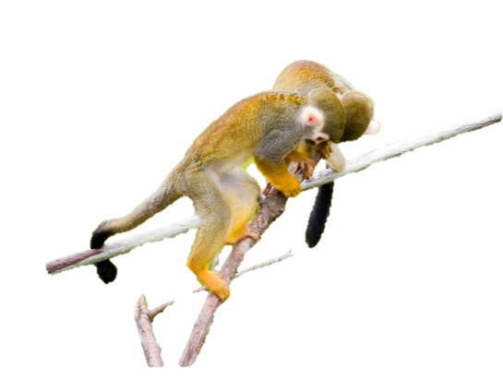
Student Activity
Notes:
When you see this symbol in the corner of a slide it means there is a student activity that can be done.

Slide 4
What is Animal Behaviour?
Animal behaviour - Is simply what the animal is doing, or how they are reacting.
Ethology – Is the study of animal behaviour.
‘Ethos’ – character
‘ology’ – the study of
Notes:
Behaviour - is very broadly defined as the way an animal acts. Any action an animal does, or any response to a stimulus is a behavior.
Ethology – The study of animal behaviour

Slide 5
What causes animal behaviour?
To some extent all behaviours are genetic
(i.e. a monkey will act like a monkey, and a bird a bird)
It is also a response to external/internal environments.
External environment – e.g. rain, heat, cold, other animals, etc.
Internal environment – e.g. hormones, disease, parasites.

Slide 6
External Environment
Factor/Stimuli | Behaviour response
Cold | Huddle together
Rain | Seek shelter
Predator seen | Hide
Internal Environment
Factor/Stimuli | Behaviour response
Hormones | Seek a mate
Disease | Rest
Notes:
External Environment ….Ask students what is the behaviour response? - - go find shelter when it rains, huddle together when its cold, interact with another animal
Internal Environment …. Ask students what is the behaviour response? – hormones - seek a mate, perform courtship behaviours, illness - rest

Slide 7
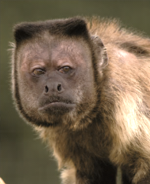
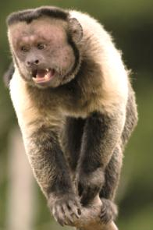
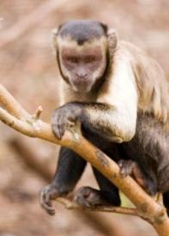
Why Study Animal Behaviour?
Analysing animal behaviour informs us about the evolution of how we think, act and interact .
Understand why animals behave the way they do.
Understand when an animal has a need and thus use this information to make changes for the animals’ welfare.
Notes:
Analysing animal behaviour informs us about the evolution of how we think, feel, act and interact individually and in groups.
Wild & Zoo - Understand why animals behave the way they do
Eg. Zoo - Brown capuchin, Maurice (top pic) take over by Popeye (second pic down) - At Edinburgh Zoo we had an elderly alpha male capuchin in the East group named Maurice, he was in his late 30’s (old for a capuchin) when Popeye a young male began to pick fights with him on a regular basis. Over time Maurice relented to Popeye’s aggression and let him become the alpha male of the group, and Maurice became a less dominant individual.
This type of behaviour would happen in wild groups of capuchins as well. The zookeepers were aware of this being a natural behaviour in this species so understood why the monkeys were behaving in this way.
Note of interest – The bottom photo is a pic of young Popeye before he took over the group. After his take over you see a distinct change in the structure of his face. Alpha males will have a prominent square head.
Zoo - Understand when animal has a need
We can use this behaviour information to make changes for the welfare of the animals (we’re going to look at an enclosure change study in the Living Links enclosure, and see how that change improved the welfare of the monkeys).
Capuchin example, we saw aggressive behaviours and competition over certain branched areas of the capuchins. What should we do? Ask students what they would do?

Slide 8
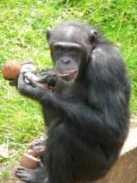
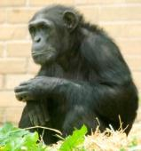
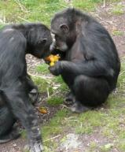
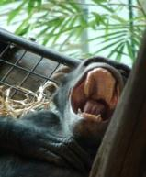
How to Study Behaviour
Formulate initial questions and make preliminary observations.
Formulate hypotheses and make predictions.
Choose behavioural measures and research design (methods).
Define each measure
Select the appropriate recording methods.
Practice the recording methods
Collect the data
Analyse the data
Draw some conclusions and return to step 1.
Notes:
Discuss each step briefly, then explain we will work through the whole process using an existing published study to see how it works in practice.
The main things you want to say on this slide are related to steps 1 – 4 (give brief examples/explanations)
Suggested ones
Formulate an initial question and make preliminary observations.
The question that you ask may stem from previous knowledge or observations of that animal or a similar species. (For example, you have heard that chimps use tools in the wild, do they use tools in zoos?) Top pic is of a chimp with cracked open coconuts, did she use a tool to do this? Well in a way she did as she would have thrown them against a hard surface to crack them open.
A period of preliminary observations allows you to become familiar with the species, their behaviours and their environment. This time will also allow you to shape your hypotheses and methods.
(For example finding the best locations to observe from, choosing to observe the whole group or just one etc)
Formulate hypothesis and make predictions.
After your initial observations, begin to think about making predictions from your initial questions.
A hypothesis is tentative explanation for an observation, phenomenon, or scientific problem that can be tested by further investigation.
Classic examples of hypotheses are if, then statements.
If the primates are stressed by the number of visitors then we will see an increase in scratching behaviours as the number of visitors increase.
General info = Primates have been known to scratch more when they are in stressful situations.
‘Dr Ross and his colleagues report in the American Journal of Primatology that among their chimpanzees, aggressive behaviour increased when the animals were placed inside holding areas. Chimps spent about 0.1% of their time being aggressive when they were in the enclosures. That rose to 0.5% when the animals were in the holding areas. The researchers also found that chimps scratched and groomed themselves much more. Scratching increased fourfold. Chimps spent 0.4% of their time in the enclosures having a scratch. That went up to 1.6% in the holding areas. Self-grooming, a gentler activity than scratching, increased from 12.3% to 17.4%. In contrast, time spent foraging for food dropped from 18.1% of the total in the enclosures to 10.5% of it in holding areas.’
http://www.economist.com/node/16963942
Choose behavioural measures and research design.
Design - Choose if you are going to do an observational or experimental study. Are you going to observe the animals without making any changes or are you going to alter their living conditions to test your hypotheses.
Measures - Ensure you choose measures that are relevant to your hypothesis.
While observing feeding behaviours you may/may not chose to include feeding location. This all depends on your hypotheses.
If you predict the chimps in Edinburgh zoo will spend more time feeding on the ground than up on the climbing frames it would be very important to note where they are feeding from in your observation records. However if your hypothesis is just looking at the amount of time one group of chimps feeds compared to another group the location may be irrelevant.
Define each measure
Create and categorise your ethogram. Be very specific in your definitions.
Chimp yawning/chimp screaming example.
If I were to say
_____ - a chimp opens its mouth wide and makes a sound.
Would you say this is a yawn or a scream or a call?
Answer – you could not be sure of what I meant unless I defined it further to say…Yawn - a chimp opens its mouth wide, while in a resting position and makes a quiet sound. You could even further define ‘resting position’ or refer to another term that you have already defined.
Create enclosure diagrams if necessary
Define times of day or weather categories if necessary.
To illustrate (steps 1-9) the scientific method we will use the paper – Living Together as an example to work through
Leonardi, R., Buchanan-Smith, H., Dufour, V., MacDonald, C. and Whiten, A. (2010). Living Together: Behaviour and Welfare in Single and Mixed Species Groups of Capuchin (Cebus apella)and Squirrel Monkeys (Saimiri sciureus). American Journal of Primatology 72:33-47.
Pg 22 & 23 Martin and Bateson- schematic of the process

Slide 9
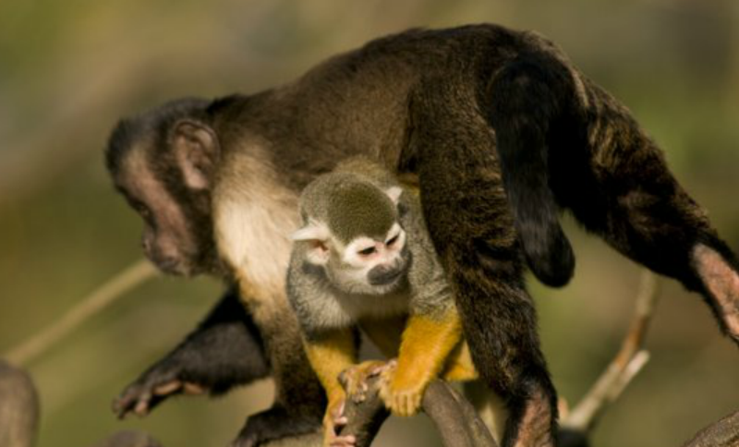
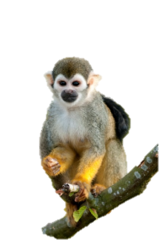
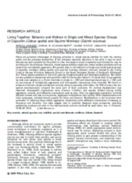
Studying a Mixed Species Exhibit
Notes:
The following section examples are loosely based on a study published by
Leonardi, R., Buchanan-Smith, H., Dufour, V., MacDonald, C. and Whiten, A. (2010). Living Together: Behaviour and Welfare in Single and Mixed Species Groups of Capuchin (Cebus apella)and Squirrel Monkeys (Saimiri sciureus). American Journal of Primatology 72:33-47.
The next slide is a brief introduction to the two species Brown capuchins and common squirrel monkeys.

Slide 10
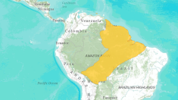
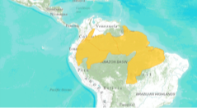
 | Capuchin Monkeys | Squirrel Monkeys
Taxonomy | Animalia, Chordata, Mammalia, Primate, Cebidae Cebus apella or Sapajus apella | Animalia, Chordata, Mammalia, Primate, Cebidae Saimiri sciureus
Size | 1.3 – 4.8 kg, with males being larger than females. | 0.55- 1.25kg, males and females similar in weight.
Habitat & Range | South American forests | South American forests
Diet | Mainly fruits and invertebrates, but also eat small animals and plants. | Mainly insects and fruits but also eat other parts of plants, and various small animals.
Notes:
Range maps from - http://www.iucnredlist.org/details/39949/0
See pdf for full discussion on squirrel monkeys and capuchins
http://www.living-links.org/wp-content/uploads/2012/05/SaimiriCebusspeciesComparison2012.pdf
Ecological Niche - The ecological niche involves both the place where an organism lives and the roles that an organism does in its habitat.
(definition from http://www.biology-online.org/dictionary/Ecological_Niche)
Communication
Capuchin Communication - http://www.living-links.org/wp-content/uploads/2012/05/CebusSIGNteachers.pdf
Squirrel Monkey Communication – http://www.living-links.org/wp-content/uploads/2012/05/SaimiriSIGNteachers.pdf
Social structure
http://pin.primate.wisc.edu/factsheets/entry/tufted_capuchin/behav

Slide 11
 | Capuchin Monkeys | Squirrel Monkeys
Social Structure | Group size ranges from 6-30. One alpha male and female and a variety of dominant-submissive interactions throughout the rest of the group. No linear hierarchy exists. | Group size 30-70. There are more adult females in a group than adult males. There is an alpha male and female and a variety of dominant-submissive interactions throughout the rest of the group. No linear hierarchy exists.
Ecological Niche | Forest living insectivore-frugivores that are arboreal and diurnal. They are also prey for cats, such as jaguars, birds of prey and crocodiles. | Forest living insectivore-frugivores that are arboreal and diurnal. They are also prey for cats, such as jaguars, birds of prey and crocodiles.
Communication | Capuchin monkeys have a wide range of vocalisations, but they also communicate with a variety of visual signals through facial expression and body language. Capuchin Communication - http://www.living-links.org/wp-content/uploads/2012/05/CebusSIGNteachers.pdf | Squirrel monkeys scream and give high pitched ‘peep’ and ‘twitter’ calls, they also communicate through facial expression and body language. Squirrel Monkey Communication – http://www.living-links.org/wp-content/uploads/2012/05/SaimiriSIGNteachers.pdf
Notes:
Brown Capuchin monkey - A clear alpha male and alpha female, but not a clear dominance hierarchy in the whole group, it is not linear like in baboons. You will have a variety of levels of dominant and submissive individuals in any given situation.
Common Squirrel monkey - Clear alpha male and female and then a loose non-linear dominance system through the rest of the group, similar to the brown capuchins (pers comm Dr Nicola Cladiere).
Ecological Niche - The ecological niche involves both the place where an organism lives and the roles that an organism has in its habitat.
(definition from http://www.biology-online.org/dictionary/Ecological_Niche)
Communication
Capuchin Communication - http://www.living-links.org/wp-content/uploads/2012/05/CebusSIGNteachers.pdf
Squirrel Monkey Communication – http://www.living-links.org/wp-content/uploads/2012/05/SaimiriSIGNteachers.pdf
Social structure
http://pin.primate.wisc.edu/factsheets/entry/tufted_capuchin/behav

Slide 12
1. Formulate initial questions and make preliminary observations
How do the primates react to living in a mixed species group?
How does living in a mixed group effect their behaviour and welfare?
Do they interact in a positive, negative or neutral way?
When and where should I study the primates?
How many primates can I study?
Notes:
Your initial questions may come from background reading, previous knowledge of a species or from discussions with other people working with the animals already.

Slide 13
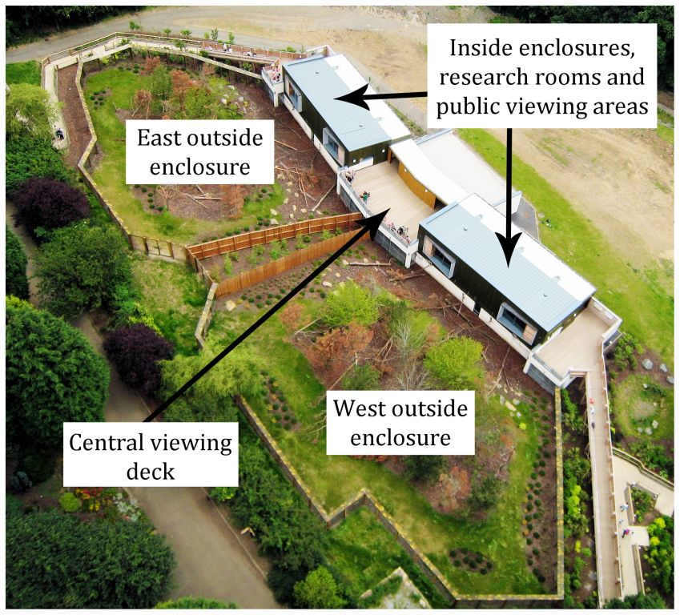
Notes:
When and where should I study the primates?
When – times of day and times of year

Slide 14
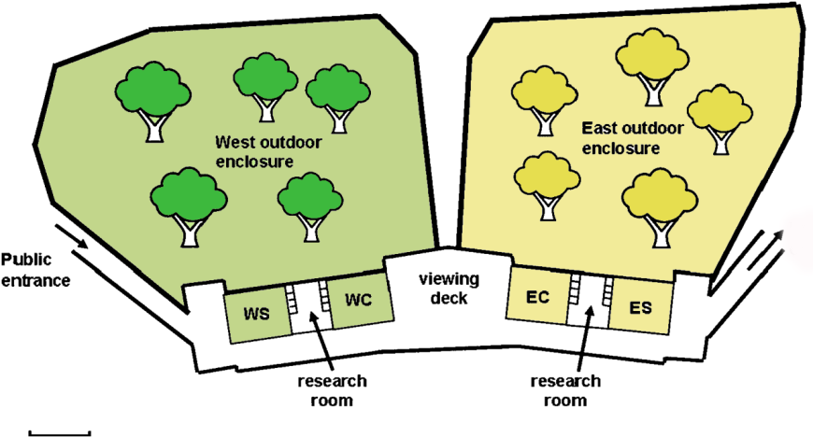
Study Site
5m
Notes:
Draw a diagram of your study site

Slide 15
Study Site

Slide 16
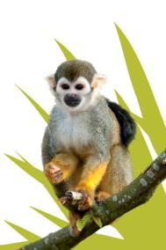
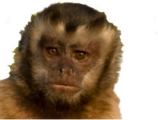
Study Subjects
WEST
EAST
Capuchins
3 adult females
2 young males
1 male infant
1 infant sex unknown
Total = 7
3.3.1
Sq. monkeys
1 adult male
3 young males
7 adult females
1 young female
3 male infants
Total = 15
7.7.0
Capuchins
1 alpha male
3 younger males
1 adult female
Total = 5
4.1.0
Sq. monkeys
1 alpha male
6 adult females
2 male infants
1 female infant
Total = 10
3.7.0
Notes:
Monkey numbers as they were at the time of the Living Together study (2008/9).
Capacity of Living Links is 60 squirrel monkeys and 40 capuchin monkeys
How many primates can I study?
Zoo notations for numbers of individuals in a group is presented as males . females . unknown sex
For example the West group of capuchins had 3.3.1 at the time of this study (2008/9) so 3 males, 3 females and 1 unknown sex.
East Capuchins – 4.1
West Squirrel monkeys = 7.7.0
East Squirrel monkeys = 3.7.0

Slide 17
2. Formulate Hypotheses
Squirrel monkeys will choose to associate with capuchins, however the capuchins will be dominant over the squirrel monkeys.
A change in the enclosure design will have a positive effect on the relationship between the two species.
Notes:
There were multiple hypotheses in the paper, however we will only focus on two of these for this lesson
The Hypotheses made are based on previous knowledge of the species.
To get to your hypotheses for this study you would have had to do some background research on mixed species exhibits and wild interactions. This information is in the Introduction section of the paper.
Notes – You would then use your existing knowledge, background research, initial questions and preliminary observations to formulate hypotheses.
If…..then….statements are a very good start.
Definition (Student version) - Hypothesis – a proposal intended to explain certain facts or observations
Collins World English Dictionary
hypothesis (haɪˈpɒθɪsɪs) — n , pl -ses 1. Compare theory a suggested explanation for a group of facts or phenomena, either accepted as a basis for further verification ( working hypothesis ) or accepted as likely to be true 2. an assumption used in an argument without its being endorsed; a supposition 3. an unproved theory; a conjecture [C16: from Greek, from hupotithenai to propose, suppose, literally: put under; see hypo- , thesis ]
American Heritage Medical Dictionary – hypothesis - A tentative explanation that accounts for a set of facts and can be tested by further investigation.
plur. hypotheses (heye- poth -uh-seez)
In science, a statement of a possible explanation for some natural phenomenon. A hypothesis is tested by drawing conclusions from it.

Slide 18
3. Choose behavioural measures and research design (methods)
Hypothesis 1 - Squirrel monkeys will choose to associate with capuchins, however the capuchins will be dominant over the squirrel monkeys.
Behavioural measure
Record species associations, and the direction of the associations.
Notes:
Hypothesis 1 - Squirrel monkeys will be the initiators of associations, however the capuchins will be dominant over the squirrel monkeys.
tested by
Comparing enclosure use (inside & outside, as well as height) when housed as single vs mixed species group, also the directions of the associations. (I.e. If squirrel monkeys were outside then would capuchins then go outside as well?).

Slide 19
3. Choose behavioural measures and research design (methods)
Hypothesis 2 - A change in the enclosure design will have a positive effect on the relationship between the two species.
Behavioural measure
Record species interactions before and after the change.
Notes:
Hypothesis 2 - A change in the enclosure design will have a positive effect on the relationship between the two species.
Tested by
Behavioural measures = Positive (affiliative) , negative (aggressive) and neutral interactions between the two species before and after the change.
Research design = Observational and experimental as the authors altered the conditions of their study groups.
Also included in this section is a bit about where and what you are studying – For zoo studies this would be Housing and Husbandry and the study subjects.

Slide 20
4. Define each measure Ethogram
Ethogram - A comprehensive list, inventory, or description of all the behaviours of an organism.
A complete ethogram of all the behaviour for one species is very long and so we will be creating portions of ethograms.
Notes:
Ethogram - An ethogram is "a comprehensive list, inventory, or description of the behaviour of an organism".

Slide 21
4. Define each measure (Behaviour Categories and Definitions)
Say what you see, not what you think !
Behaviour Category | Definition
Aggression | Chasing, biting, hitting or screaming at another monkey. May include threat displays, such as shaking branches or lunging at another.
Play | One monkey chases or wrestles with another, in a non-aggressive manner.
Resting alone | Lying or sitting away from the group
Resting together | Lying or sitting in contact with another monkey
Feeding | Searching for/manipulating/ingesting food
Moving alone | Locomoting across the ground or in the trees without another monkey.
Moving together | Locomoting across the ground or in the trees with another monkey.
Notes:
This is a portion of an ethogram which COULD relate to this particular study, NOT the one that was used, that one is more detailed.
Ask the students what behaviours may be ‘missing’ not included.
E.g. that may be of importance, vocalisations, facial expressions, courtship
Use the video (Design an Ethogram) to create a portionof a general capuchin ethogram for a study that wants to look at the variety of behaviours that capuchins do. (There is a teacher’s support spreadsheet document for this activity)
Never use the same word in your definition as the category of behaviour. Example, category term = sleeping, definition should not include the word sleep or sleeping. Sleeping – monkey is asleep.

Slide 22
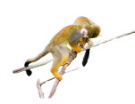
Design Part of an Ethogram
Living Links website - http://www.living-links.org/resources/materials-for-teachers/measuring-behaviour-lesson-plan/
Vimeo - http://vimeo.com/channels/livinglinks/45906210
Notes:
You can download the videos from vimeo if you wish to embed them into your power point for use in the classroom. However they were not embedded here, to keep the file size down.
Please note videos should be shown in the manner in which they were filmed and no video editing is permitted to the Living Links video files.
See the excel sheet in Teachers Guide for a description of the behaviours in the video.

Slide 23
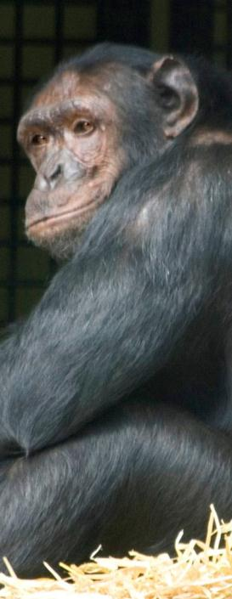
5. Select the appropriate recording methods
Focal
Observing one individual for a specified amount of time and recording their behaviour.
Example Use- A study looking at the number of aggressive interactions by a specified individual.
Scan
A group of individuals is scanned at regular intervals and the behaviour of each one is recorded.
Example Use – A study looking at enclosure use by an entire group of animals.
Notes:
picture of a dominant male chimpanzee Qafzeh
Focal provides detailed information about an individual (or several individuals if observed consecutively) as they are kept constantly under observation for a certain period of time and their behaviour recorded. So if you were interested in general activity and number of aggressive interactions then this would be fine.
Scan sampling is when you record the behaviour of all individuals in consecutive order at any one period of time (e.g. every 10 minutes). It is good for determining the general activity (or location) of a group, but may miss short events such as aggression that do not occur on the predetermined scan
An example that can be used in class, is to determine how many students are alert and paying attention and/or yawning. Scan would be good to get % of those alert, but likely miss any yawns. Only focals would reliably catch yawns (if they occur at all in such an interesting class) as rare and short duration events.
EXAMPLES
FOCAL
If you were doing a dominance study, and you were most interested in observing the dominant male in the group, and how the others interact with him, then you may just want to study his behaviours for the entirety of your study.
Or you may want to study all the males in the group, but you still wish to do it in a focal sampling method. You would focal one individual for an observation set then move on to the next one.
SCAN
You may wish to know what all the individuals, male and female are doing in the group. How are they interacting with each other or the enclosure. In this case you would scan and record all behaviours of the group. Depending on your question and hypothesis, identifying individuals may/may not be important to you (i.e. males/females, young/old etc)
There are pros and cons for each type of method. You may discuss these with the class.
Cons of methods
Focal Problem - Individual disappears from view
Scan Problem - might not catch all behaviours if the group size is large
– different types of scans (individual is either recorded or not)
Pros of methods
Focal pro – You will be able to obtain a good picture of one individuals behaviour and is ideal for recording animal states.

Slide 24
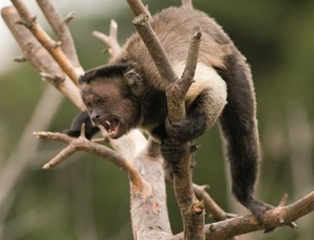
What kind of data do you want to record?
State
Behaviours that occur for an extended duration.
Examples - Lying, walking, foraging, sleeping.
Events
Behaviors that are short in duration and generally counted rather than timed
Examples - Fighting, yawning, sneezing, vocalising.
Notes:
Decide what is important to your hypotheses. The animals’ states? Or events?
Many examples can be used to illustrate the differences between States and Events
Ask students to give you examples before you click ahead for them to appear.

Slide 25
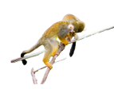
Let’s Try a Focal
Living Links website - http://www.living-links.org/resources/materials-for-teachers/measuring-behaviour-lesson-plan/
Vimeo - http://vimeo.com/13796260
Notes:
You can get student to shout out what Popeye is doing, on a continuous basis – play by play
http://www.living-links.org/resources/materials-for-teachers/measuring-behaviour-lesson-plan/
Screen shot only. Click on the link to bring you to the video for use.
Vimeo link – http://vimeo.com/channels/livinglinks/13796260
You may also download these video from vimeo onto your personal computers for use away from the internet.

Slide 26
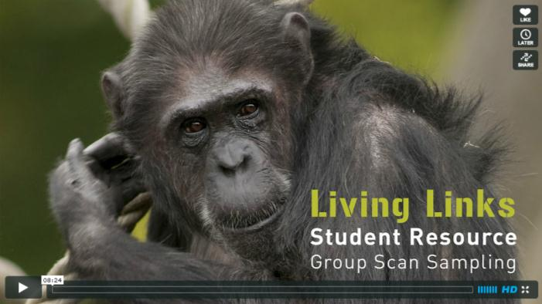
Let’s Try a Scan
SCREEN SHOT ONLY
Living Links website - http://www.living-links.org/resources/materials-for-teachers/measuring-behaviour-lesson-plan/
Vimeo - http://vimeo.com/45246079
Notes:
http://www.living-links.org/resources/materials-for-teachers/measuring-behaviour-lesson-plan/
Vimeo - http://vimeo.com/45246079
Try doing at 1 minute intervals and get the students to shout out what the group is doing, how many in what activity.
Ensure the scan is systemised by scanning from left to right.

Slide 27
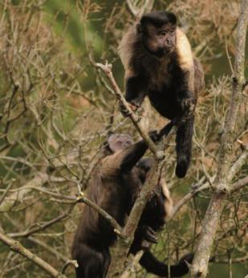
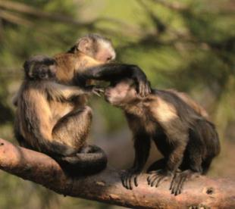
5. Select the appropriate recording methods
Ad libitum Sampling – Observer records key behaviours of interest whenever they occur.
Continuous Sampling
All occurrences of behaviour are recorded. When they start and when they stop.
Point/Instantaneous Time Sampling
Behaviour is sampled periodically at regular intervals.
Notes:
Note - Time sampling (also called point sampling, also called instantaneous sampling). Sometimes these terms are all used interchangeably.
If you let the students shout out what Popeye was doing as a play by play then you could explain that this was an ad lib and continuous way of sampling.
If you let the students shout out what the group of chimps were doing at 1 minute intervals you can explain this is an instantaneous time sampling method of scanning the group’s behaviours.
For another example of time sampling you can also go back to the Popeye video and ask them to say his behaviour at 15 or 30 sec intervals.
Discussion
Pros and cons of methods
Ad lib
Pro – good for preliminary observations
Con – no systematic restraints
Continuous sampling
Cons - very difficult on groups unless you have a team to help. Difficult to record when the animals change their behaviours very quickly (pic of monkeys chasing).
Pro - It is a very useful method as it catches all the behaviours and their durations (events and states). It is most often used when doing focal samples.
Continuous sampling can be utilised well when you have individuals that rarely go out of view or when you have large easy to follow individuals.
Point/Instantaneous time sampling
Cons (pic at bottom – this behaviour could be missed if not on the ‘point sampling time’ i.e the 1 minute mark)
– Missing behaviours (especially short event behaviours)
Provides an estimate only (not true frequencies or durations)
Not normally suitable for sequences (e.g. reciprocity)
Pros
- Instantaneous sampling gives a reasonable estimate
Larger number of categories can be recorded and simpler/less demanding than continuous recording
Large groups can be recorded systematically

Slide 28
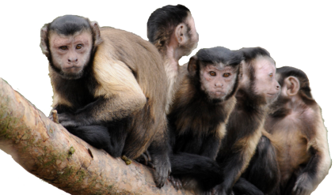
Which recording methods were used in Living together?
Focal
Continuous
Scan
Instantaneous
Ad lib
Notes:
More than one technique may be employed simultaneously.
Scan was chosen because the researchers wanted to record the whole group of monkeys on a regular basis.
Ad lib was chosen to record any behaviours of interest that may occur and be noteworthy in the analysis of the data.
They also did instantaneous sampling at 15 minute intervals

Slide 29
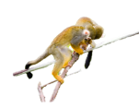
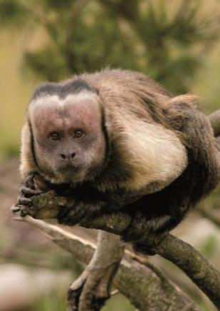
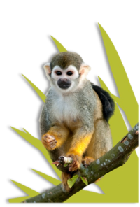
Latency, frequency & duration
Latency – Is the time (sec, min, hrs) from a specific event to the start of a behaviour.
Frequency - the number of times a behaviour is displayed per unit of time.
Duration – The length of time that a single behaviour lasts.
Notes:
Definitions from Martin and Bateson
Latency, frequency and duration – chapter 5 pg 62
Measuring behaviour video - 15-minute video of capuchin monkey behaviour
Latency – how long does it take before a squirrel monkey is able to touch the boxes (answer – 1 min 52) – Latency to approach
Frequency – use Popeye behaviours for frequency over a certain period of time.
Example - Scratches – 5 times in 5minutes, therefore frequency would be 1 scratch per minute.
Duration – Use Popeye video for continuous sampling from time 0:00 to 3:00 to get durations of three different behaviours. Ensure you represent duration information as ____ out of ____time.
Or
One easy example is duration of time interacting/touching/near the boxes
Popeye is interacting with boxes in some way for 1minute and 26 seconds out of the 3 minute time sample.

Slide 30
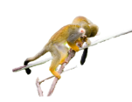
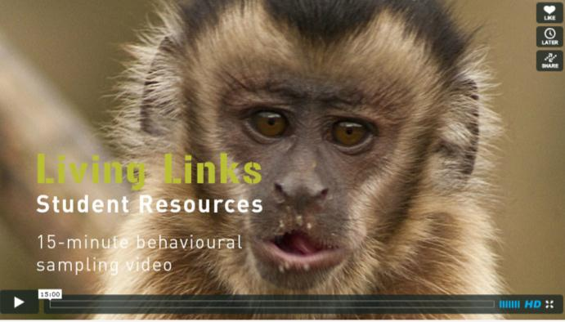
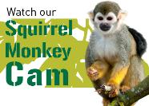
6. Practice the recording methods
Capuchin and chimpanzee videos
Extra challenge – Live Squirrel Monkey Cam
http://www.edinburghzoo.org.uk/monkeycam.html
or Live Snow Monkey Cam
http://www.highlandwildlifepark.org/snow-monkey-webcam
Notes:
Get students to create their own data sheets for practicing the recording of their data. The next slide shows an example of one.
Japanese Macaques (snow monkeys) – 22 individuals as of August 15, 2012
Now that we have learnt the ways to record the animals lets use the videos to practice the recording methods.
If the squirrel monkey cam doesn’t work from our website try the Edinburgh Zoo link (21 individuals as 07/09/2012)
Or
Use the internet browser firefox instead of internet explorer.
Snow monkey cam for HWP
http://www.highlandwildlifepark.org/snow-monkey-webcam
http://www.edinburghzoo.org.uk/monkeycam.html
Pilot study

Slide 31
7. Collect the Data Example Data sheet
EAST Wing Scan Sampling Check Sheet – 5 Capuchins (C) , 10 Squirrel Monkeys (S)
Time: Date: Weather:
Behaviour/time | Resting Cap Squir |  | Moving Cap Squir |  | Feeding Cap Squir |  | Other Cap Squir |  | Cap nearest neighbour Cap Squir |  | Squir nearest neighbour Cap Squir |  | Out of View Cap Squir
Start | | | ||||| | || | | | | | || |  | || | || | || | |||| | |||||| | |
5 min
10 min
15 min
20 min
25 min
Notes:
The aim of this data sheet is to collect data to determine whether there are differences in squirrel and capuchin monkey behaviour and to determine how often the two species are in close proximity (in association) by noting who is the closest monkey to the one being scanned.
It is very important to record the time date and weather on every data sheet.
Ask the students why this important?
Answer – All these factors effect the behaviour of the monkeys, for example if the weather is cold or rainy they are likely to be inside instead of outside, if it the end of the day they may be more likely to be sleeping if they are a diurnal species of monkey.
How to use this sheet
Scanning the monkeys from left to right you can use a tick tally system to record numbers of monkeys in which behaviour when individual ID is not necessary to your study.
There are two pieces of information to note for each monkey as it is scanned.
First – what behaviour is it doing? (Resting, moving, feeding or other, or is it out of view?
Second, which species is their nearest neighbour – another capuchin or another squirrel monkey. Put a tally in the appropriate box.
Do this for each for the 5 capuchins.
Then do this for each for the squirrel monkeys.
You can then compare the behaviour of the two species – if you wanted to see if one was more active then you’d look to see if one species was recorded as moving more and resting less than the other. But you cannot compare the raw tallies, but you must get an average individual score when in view.
You can do the same with the nearest neighbour data – and if you think about it, it is possible for these two be different (i.e a capuchin can have squirrel monkey A as a nearest neighbour but squirrel monkey A may have another squirrel monkey closest to him/her).

Slide 32
Using your behaviour categories to group data for analysis
Behaviour | Definition
Aggression | Chasing, biting, hitting or screaming at another monkey. May include threat displays, such as shaking branches or lunging at another.
Play | One monkey chases or wrestles with another, in a non-aggressive manner.
Resting alone | Lying or sitting away from the group
Resting together | Lying or sitting in contact with another monkey
Feeding | Searching for/manipulating/ingesting food
Moving alone | Locomoting across the ground or in the trees without another monkey.
Moving together | Locomoting across the ground or in the trees with another monkey in non-aggressive manner.
Type of Interaction
_
+
N
+
N
N
+
Notes:
Non – aggressive – see definition of aggression.

Slide 33
8. Analyse the data
Table - Frequency of directions of interactions between the two species
Direction | Negative | Positive | Neutral | Total
Capuchin to Squirrel Monkey Capuchin to Squirrel monkey then reversed | 14 2 | 10 8 | 13 10 | 37 20
Squirrel monkey to capuchin Squirrel monkey to capuchin then reversed | 13 4 | 4 9 | 4 6 | 21 19
In 39 hrs of mixed species observations 97 interspecific interactions were recorded.
Notes:
In the Leonardi et al 2010 study data were collected on the number and directions of interactions between the squirrel monkeys and capuchins. The types of reactions were also recorded (positive – affiliative, negative – aggressive and Neutral)
This slide shows a table of these interactions. What would you conclude by looking at these results?
Number of hours observed = 39 hrs
n = total number of interactions = 97

Slide 34
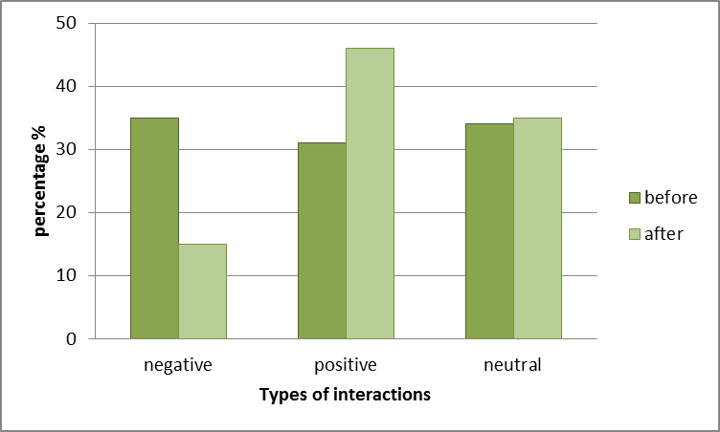
Enclosure Change Analysis
Notes:
Discuss analysis

Slide 35
7&8. Collect and Analyse the data
Collect data and create a simple activity budget for the group of chimps.
Or
Collect the data and create a simple activity budget for the capuchin Popeye.
Or
Collect the data and create a simple activity budget from the “design an ethogram” video.
Notes:
Use session 3 from the chimp video – students will use time sampling to record the chimps
Students can choose to use continuous or time sampling for the activity budget of Popeye.

Slide 36
Activity Budget
Activity Budget – is a graph or table that shows how much time an animal spends in various activities such as, sleeping, eating, climbing etc.
Notes:
Either create an activity budget for the capuchin Popeye using continuous sampling (15 minutes)
Or
Instantaneous time sampling – Frequencies – Chimp group

Slide 37
9. Draw conclusions
Hypothesis 1 - Squirrel monkeys will choose to associate with capuchins, however the capuchins will be dominant over the squirrel monkeys.
Correct – Squirrel monkeys actively choose to associate with capuchins.
Correct - Capuchins did appear to be the dominant of the two species (in most cases).

Slide 38
Conclusions
Hypothesis 2 - A change in the enclosure design will have a positive effect on the relationship between the two species.
Correct – The frequency of interaction between the species stayed the same however the proportion of positive interactions increased and negative ones decreased.
Notes:
Correct – The frequency of interactions between the species stayed the same however the proportion of positive interactions increased.
(pg 43)

Slide 39
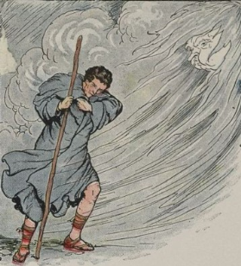
Anthropomorphism
Anthropomorphism – Applying human qualities (emotions or actions) to non-human animals or things.
Eg. The wind tried to strip the cloak off the man
Notes:
Pg. 18 – Martin & Bateson, 1993
Definition and photo – Wikipedia – photo is creative commons.
Human grin vs fear grin of a chimpanzee

Slide 40
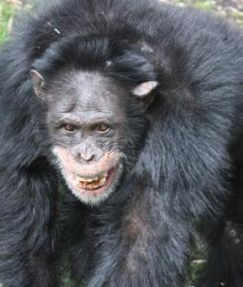
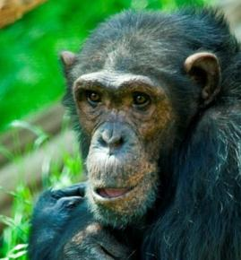
Why would anthropomorphism be bad in an animal behaviour study?
Play/Content Face
Sad Face
Fear Grin
Happy Grin
Notes:
Ask students the question – Why would anthropomorphism be bad in animal behaviour study?
Show first picture and ask, what is the chimpanzee doing? What message is he giving?
Show next pic of the person, what is she doing? What is the message?
Third picture, same questions.
Then explain…
Very similar behaviour, completely different meaning to other individuals of that species.
We smile to show we are happy, a chimp will show this type of mouth posture when they are showing fear or submission to a more dominant individual.
The third picture is a chimp exhibiting a play face/relaxed content facial expression.
And the forth picture showing a sad human facial expression. Both chimp and human have a slightly lowered bottom lip, however the message is very different.

Slide 41
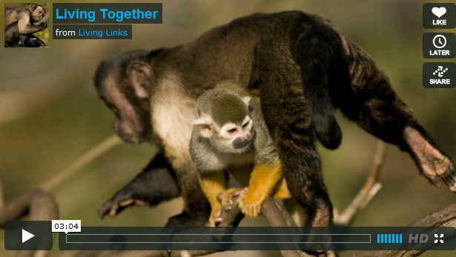
The Living Together Project Scientist
SCREEN SHOT ONLY
Living Links website - http://www.living-links.org/resources/materials-for-teachers/measuring-behaviour-lesson-plan/
Vimeo -
http://vimeo.com/7862457

Slide 42
Acknowledgements
Alaina Macri – RZSS
Dr Mark Bowler and Prof Andy Whiten – St. Andrews University
Prof Hannah Buchanan-Smith – Stirling University
Wellcome Trust
Kenny Hurst - photographer
The Zoo keepers at Edinburgh Zoo

Slide 43
For more resources visit:
http://www.living-links.org/resources
and
http://www.educationscotland.gov.uk
Notes:
Suggested running.
Have students read article before having this entire lecture.
Do background of lecture, then have students read the paper, and then talk through the ‘how to’ in the next session.
Can be broken into 3 sessions or more sessions if needed.

