Slide 1
Draw the structure of a cell membrane[4]
Haileybury Astana ib biology

Slide 2
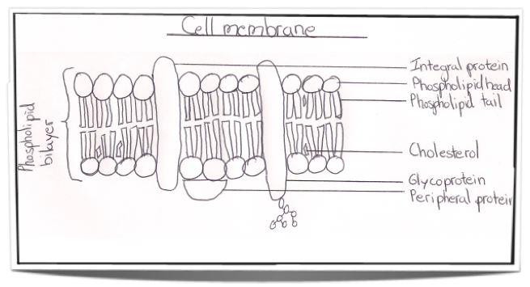
Marking scheme
Any four correctly drawn and labelled:
Phospholipid bilayer
Hydrophylic head and hydrophobic tails
Integral protein embedded in the membrane
Periferal protein on the outside of the cell membrane
Glycoprotein
Cholesterol
Extra-cellular matrix

