Slide 1
Current Electricity
Haileybury astana Year 7

Slide 2
Learning objectives
Give examples of static electricity
Interpret standard circuit symbols
Draw simple circuits

Slide 3
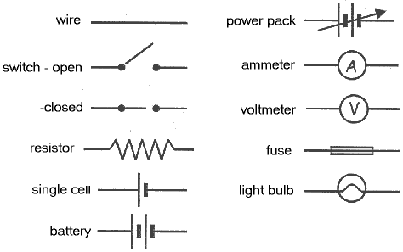
CIrcuit symbols

Slide 4
Learning objectives
Produce series and parallel circuits
Compare bulbs in series and parallel
Comment on the effect of removing one bulb from a series and parallel circuit

Slide 5
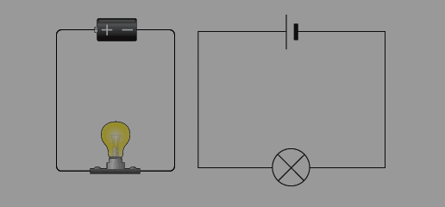
Simple circuit with one bulb
Draw the circuit diagram and make the circuit

Slide 6
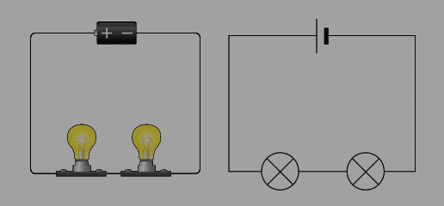
circuit with two bulbs in series
Draw the circuit diagram and make the circuit

Slide 7
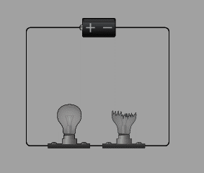
Remove one of the bulbs
Remove one of the bulbs
Question 1:
State the effect of one of the bulbs blowing!

Slide 8
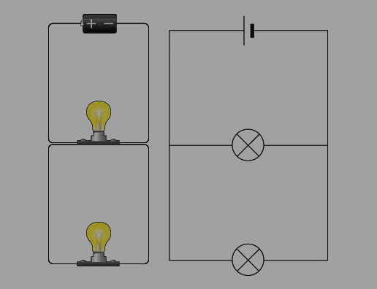
circuit with two bulbs in Parallel
Draw the circuit diagram and make the circuit

Slide 9
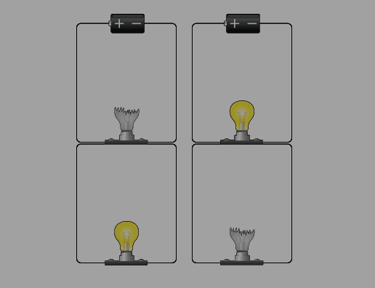
circuit with two bulbs in Parallel
Remove one of the bulbs
Question 2:
State the effect of one of the bulbs blowing!

