Slide 1
Plant classification and uses
Year 8 Science

Slide 2
Learning objectives
Classify plants into their four main groups
Identify the uses of plants

Slide 3
Binomial Nomenclature

Slide 4
Cordulegaster boltonii
Binomial names printed in italics
Genus begins with a capital letter
Species name begins with a lower-case letter
When written by hand the name should be underlined
Cordulegaster boltonii

Slide 5
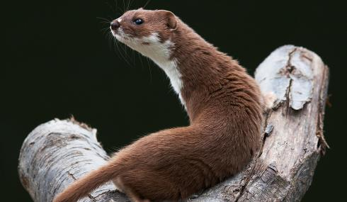
Mustela erminea
Mustela nivalis

Slide 6
What is the difference between a weasel and a stoat?

Slide 7
A weasel is weasily identified and a stoat is stoataly different!

Slide 8
Tulipa greigi

Slide 9
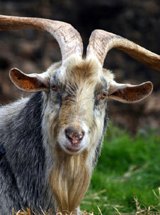
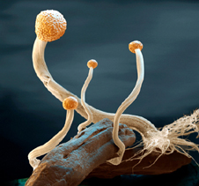
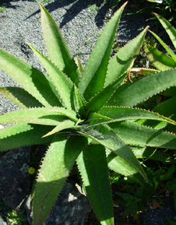
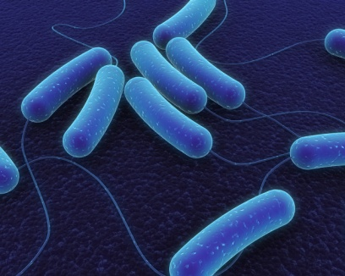
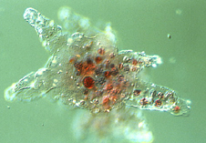
The Five Kingdoms
Animals
Fungi
Prokaryotes
Plants
Protoctists

Slide 10
Kingdom Plantae
Common Name | Features
Mosses and liverworts | No true roots Produce spores Grow in damp places
Ferns | True roots Produce spores Leaves form fonds
Conifers | Needle-like leaves ‘Naked’ seeds
Flowering Plants | Produce flowers Produce seeds within a fruit

Slide 11
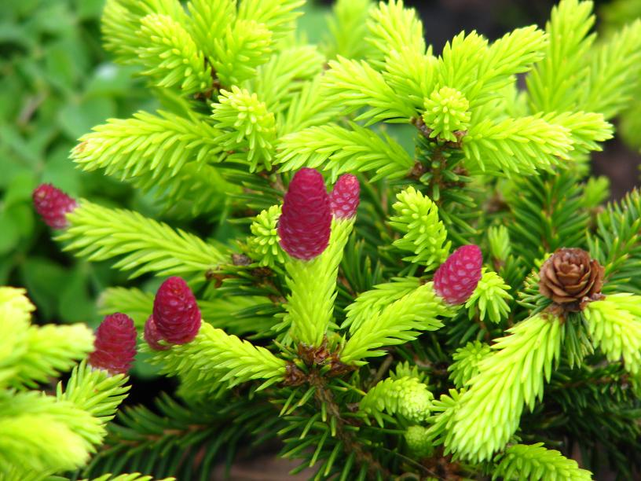
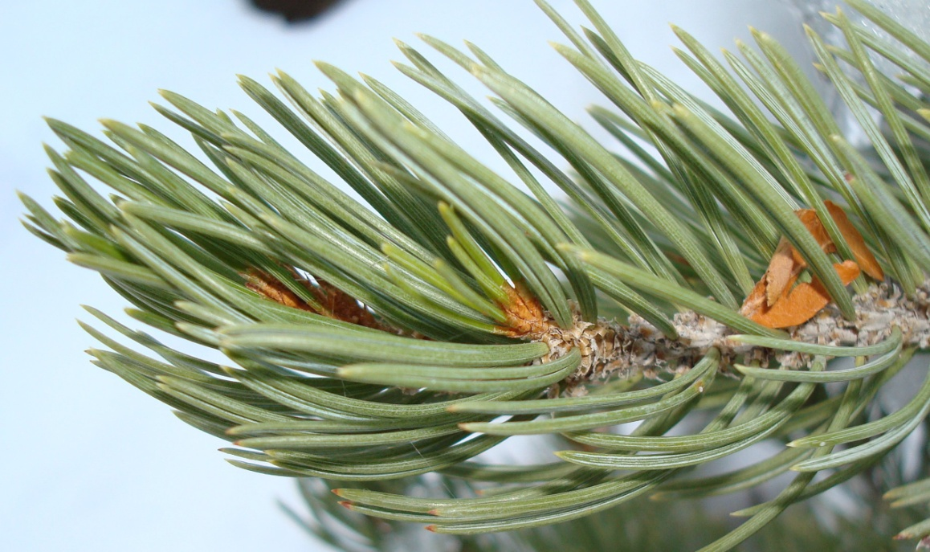
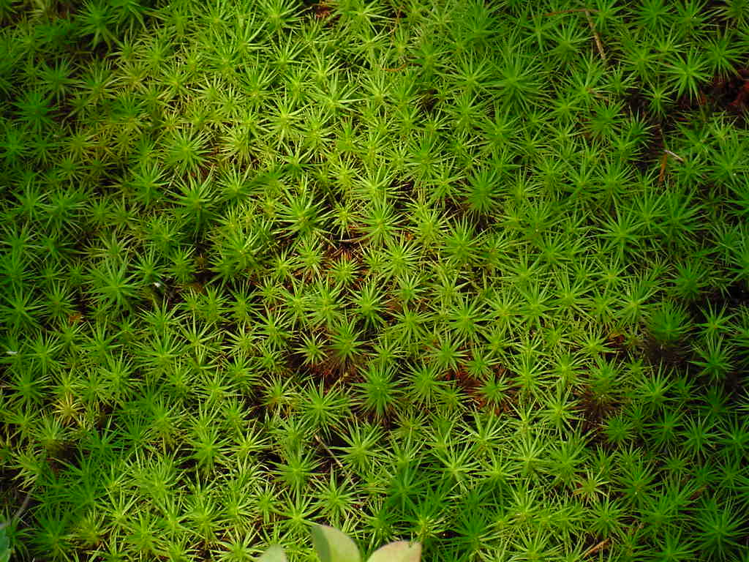
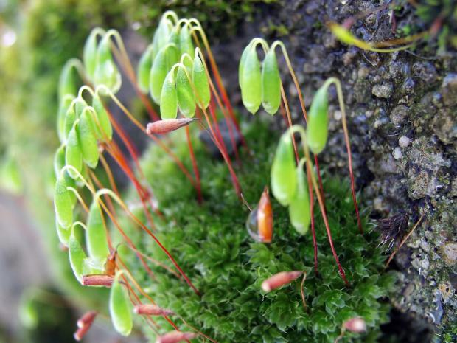
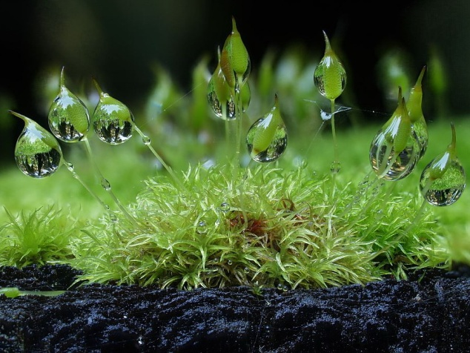
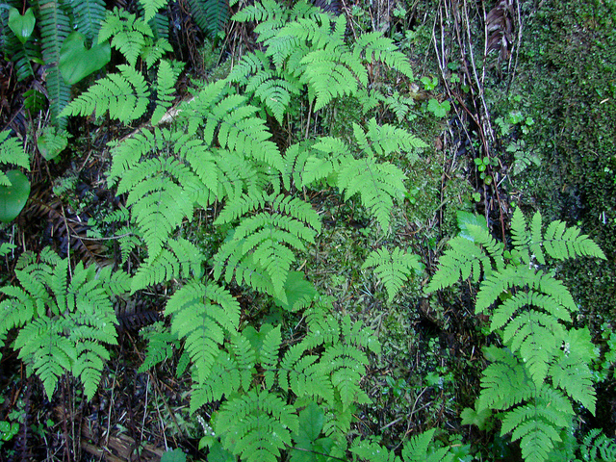
Mosses
Ferns
Conifers
Flowering plants

Slide 12
Learning objectives
List the uses of plants
Give examples of plants used by humans

Slide 13
Uses of plants
Medicines
Materials (e.g. Rubber)
Pigments
Building materials
Fuel
Food
Textiles
Paper

