Slide 1
Refraction and Reflection

Slide 2
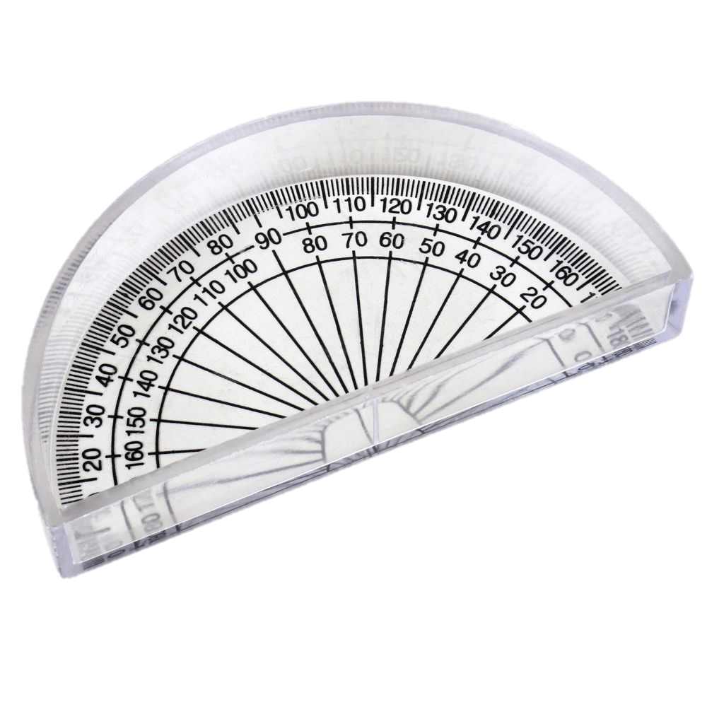
Learning objectives
Investigate the refraction of light leaving a circular glass block
Investigate the reflection of light within a circular glass block
Determine the CRITICAL ANGLE

Slide 3
Task
Follow the instructions on the sheet provided!
Circular glass block
The ray should always be aimed here!

Slide 4
Critical angle

