Slide 1
DENSITY
Haileybury Astana Year 8 Science

Slide 2
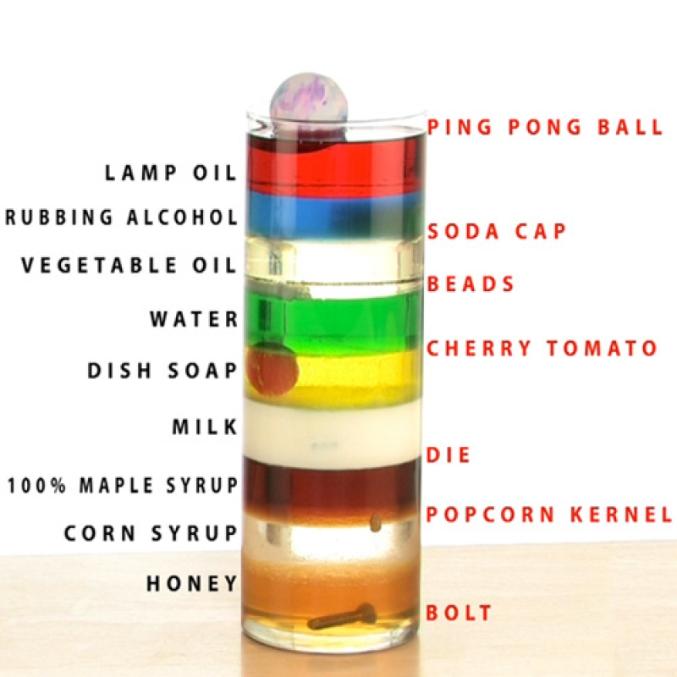
Learning objectives
Define density
Determine the density of regular blocks
Determine the density of an irregular shape

Slide 3
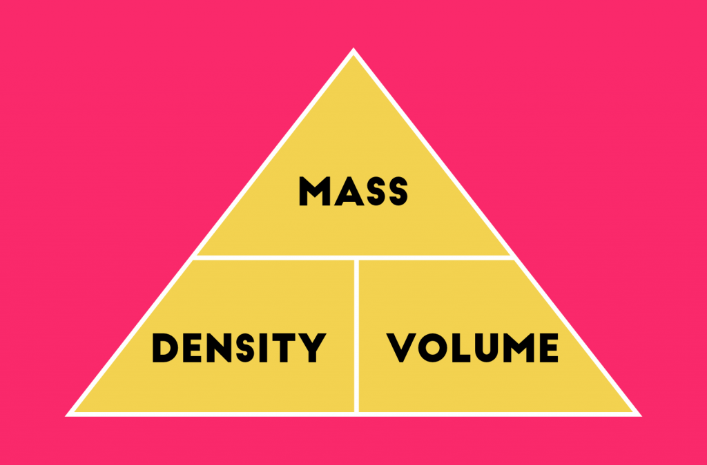
What is density?
Density is the mass per unit volume. This means that the density of any solid, liquid or gas can be found by dividing its mass in grams by its volume in cm². Density can be found using the equation:
Density = mass ÷ volume
The unit for density is g/cm³ or kg/m^{3.}

Slide 4
Determining density
material | mass | height | width | depth | volume | density
wood
steel
aluminium
rock |  | - | - | -
plasticine |  | - | - | -

Slide 5
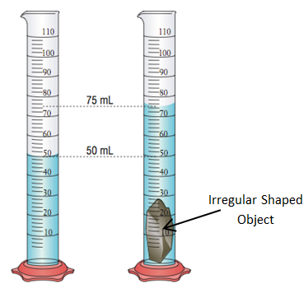
Determining the mass of an irregular object

