Slide 1
Refraction
Haileybury Astana Year 8 Science

Slide 2
What do you see?
How do we explain this phenomenon?

Slide 3
Learning Objectives
Define the refraction of light
Describe the effects of refraction
Explain refraction
Determine the refractive index of glass using two methods

Slide 4
Refraction

Slide 5
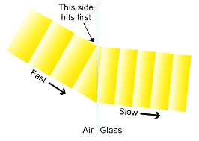
Refraction

Slide 6
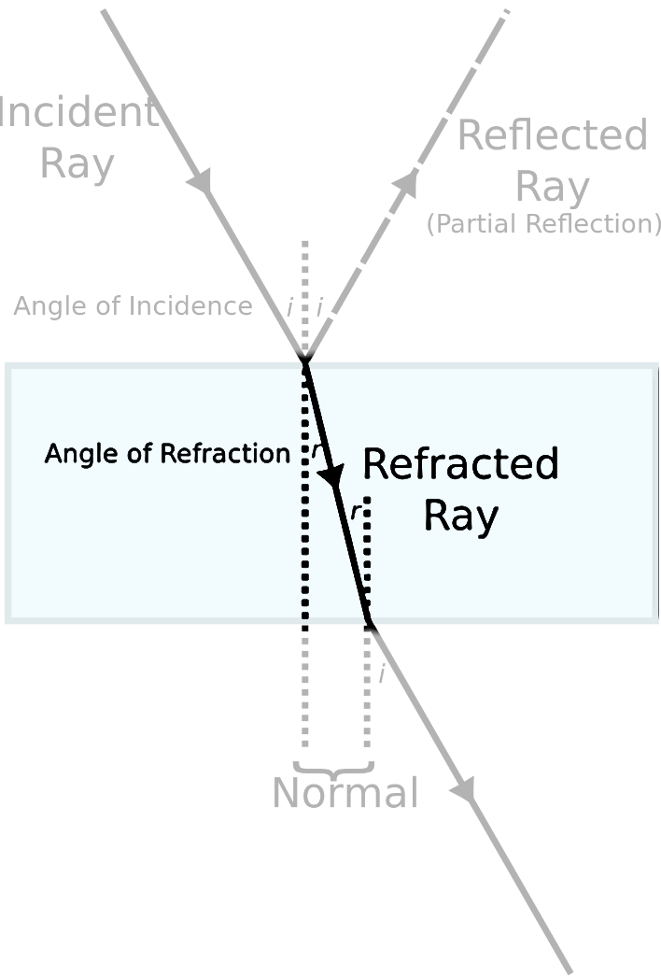
Refractive index
Refractive index = sin i
sin r

Slide 7
Refractive index
Method 2
Refractive index of glass = real depth
apparent depth
Coin
Coin

