Slide 1
ADAPTATIONS

Slide 2
ADAPTAIONS
Identify ways in which organisms are adapted to their habitats
Explain the importance of adaptations for survival

Slide 3
ADAPTAIONS
Draw a cactus including its roots
Describe the environment of a cactus
Annotate your drawing to explain how the following parts are adapted: leaves stems roots

Slide 4
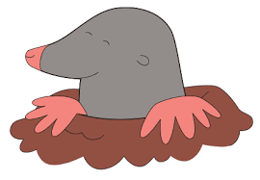
ADAPTAIONS
Draw a mole
Describe the environment of a mole.
What do they eat?
Annotate your drawing to explain how the following parts are adapted: eyes fur paws ears whiskers nose

