Slide 1
Biological Indices

Slide 2
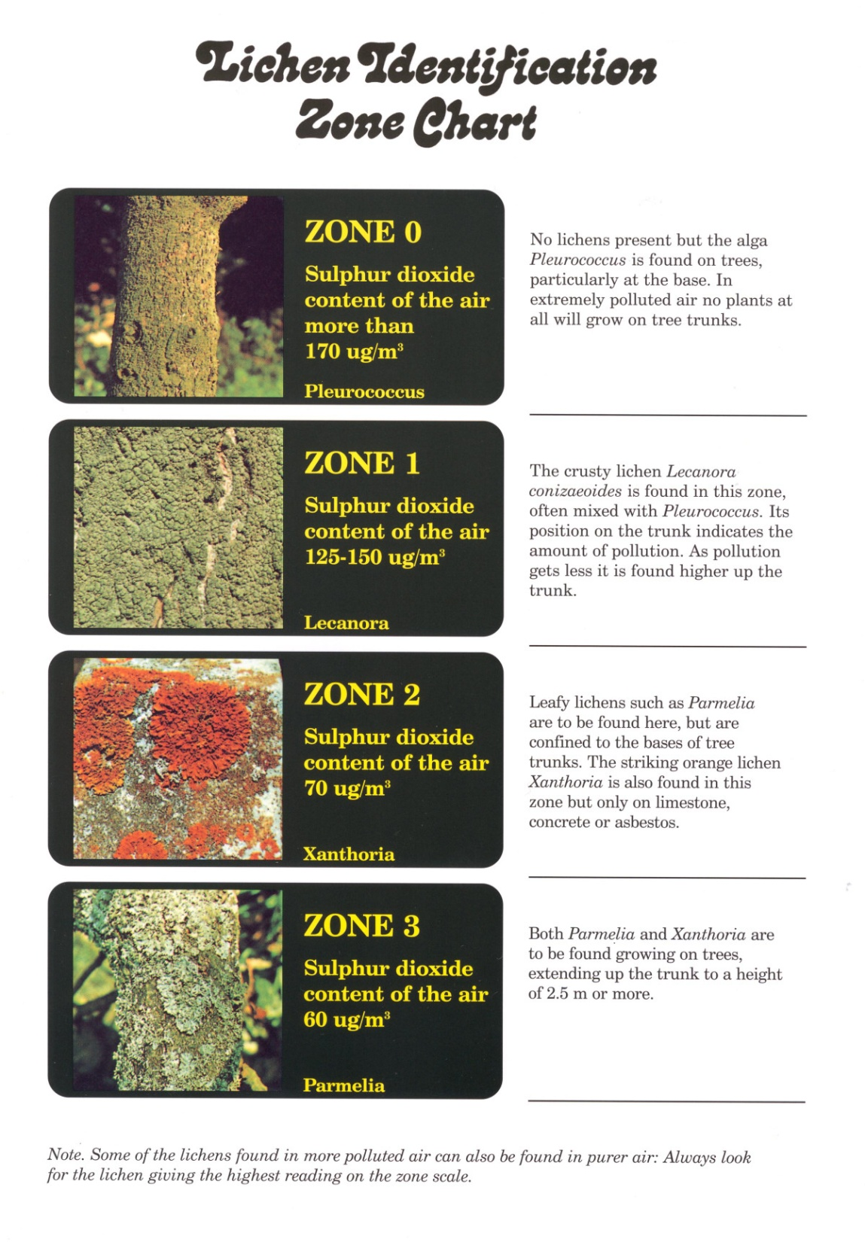
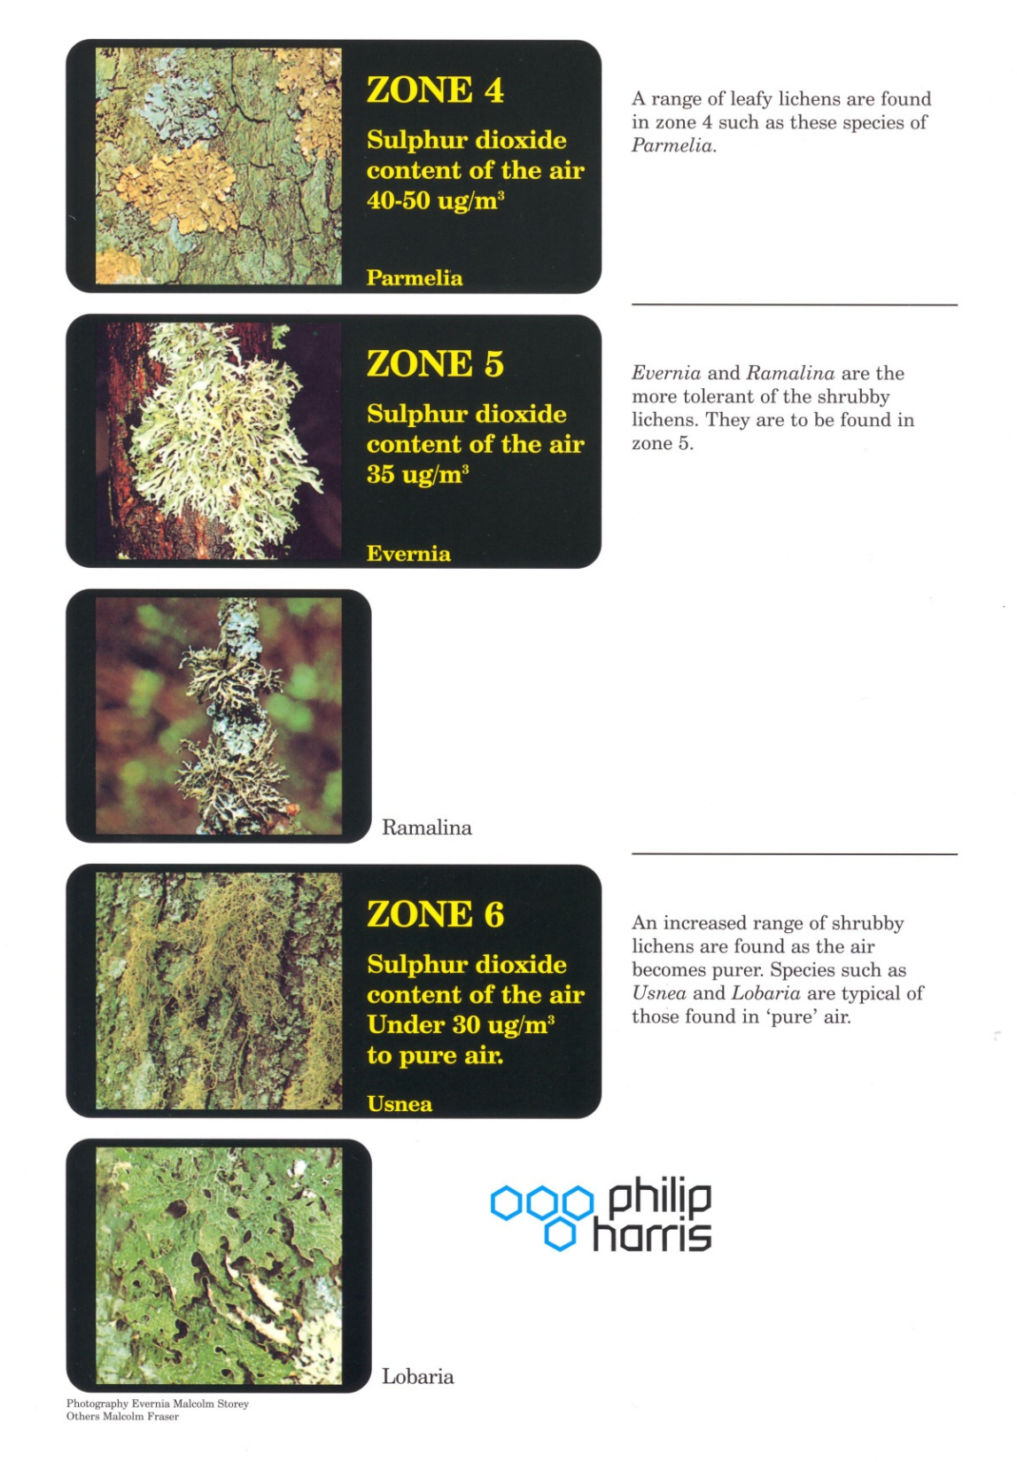

Slide 3
Using Lichens as Biological Indicators of Pollution
bushy lichens need really clean air
leafy lichens can survive a small amount of air pollution
crusty lichens can survive in more polluted air.
Different sulphur dioxide stops different types of lichens from establishing themselves on new surfaces. Old grave stones in polluted areas may have leafy and shrubby lichens growing on them.

Slide 4
Mean lichen species frequency of occurrence in urban, suburban and periurban sites.

Slide 5
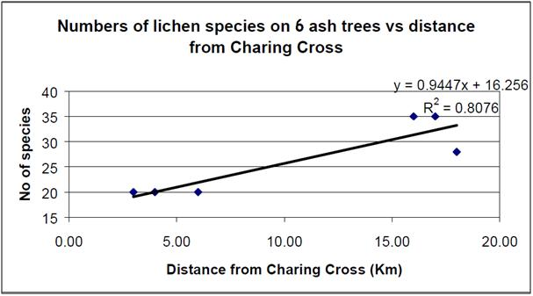
UK Air Pollution
Distance from Charing Cross on lichen epiphyte community responce (total species) on 6 Fraxinus excelsior tree points (Defra 2002).
NO₂ concentrations in the UK

Slide 6
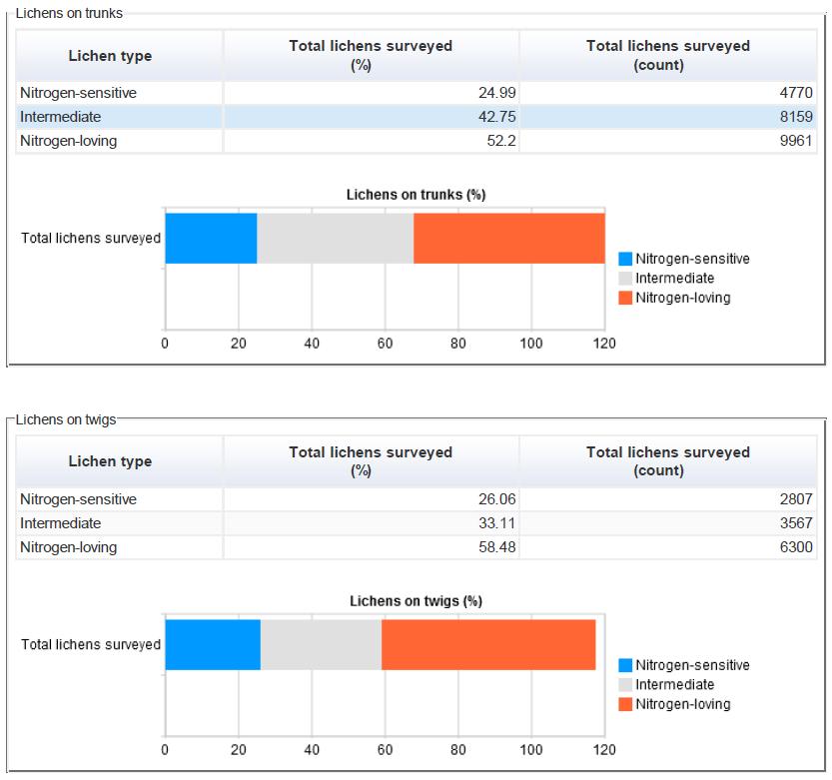
Lichens on trunks are a good indicator of past air quality. Lichens on the more recent bark of twigs are an indication of present air quality. By comparing the two, you can tell if air quality is improving or deteriorating.
For example, if you found more nitrogen-sensitive lichens on twigs than on trunks, it is likely that air quality is improving. If you identified more nitrogen-loving lichens on twigs than on trunks, then local air quality could well be deteriorating.

Slide 7
Biological indices in aquatic systems

Slide 8
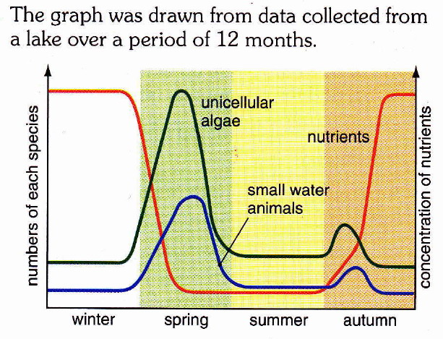
Seasonal variations in nutrients and organisms
a) Name 2 environmental factors needed for algae to grow.
b) Explain why the number of algae increased from a winter low to a spring high.
c) Explain why the population of small water animals fell in late spring.
d) Explain why the concentration of nutrients fell in the spring but rose in autumn.

Slide 9
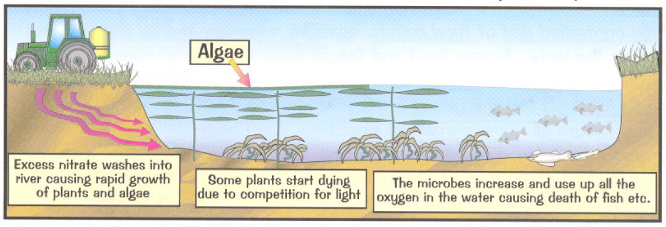
Eutrophication
The main nutrient in the fertilisers are nitrates. They make the farmer’s crops grow better but also the weeds and algae in rivers and ponds.

Slide 10
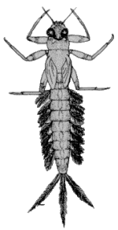
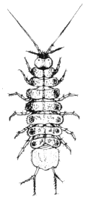
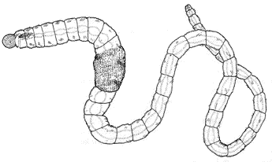
Biological Indicators
Mayfly larvae
Stonefly larvae
Heavy pollution
Some pollution
No pollution
Sludge worm
Blood worm
Little pollution
Using fertilisers
Sewage and other waste from cities
Mayfly larvae
Stonefly larvae
Water louse
Freshwater shrimp
Microbes/bacteria break down the organic waste
Effluent from farms

Slide 11
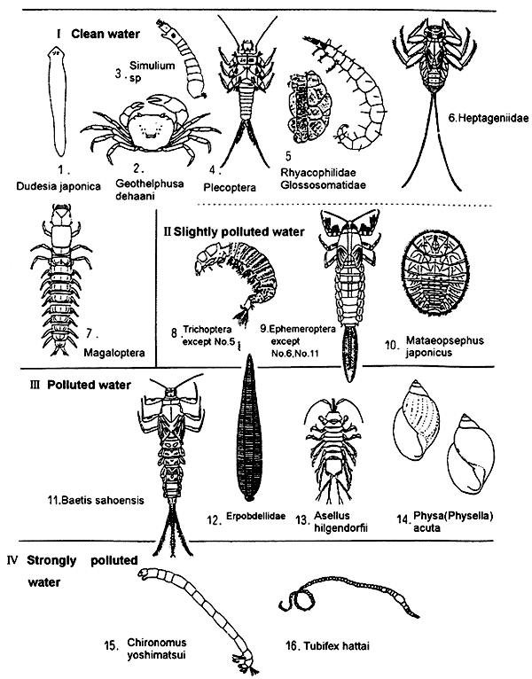
Biological indicators tell us the amount of pollution in a river without lengthy chemical analysis. Below is just a small collection of the invertebrates that may be found when kick sampling from a river.

