Slide 1
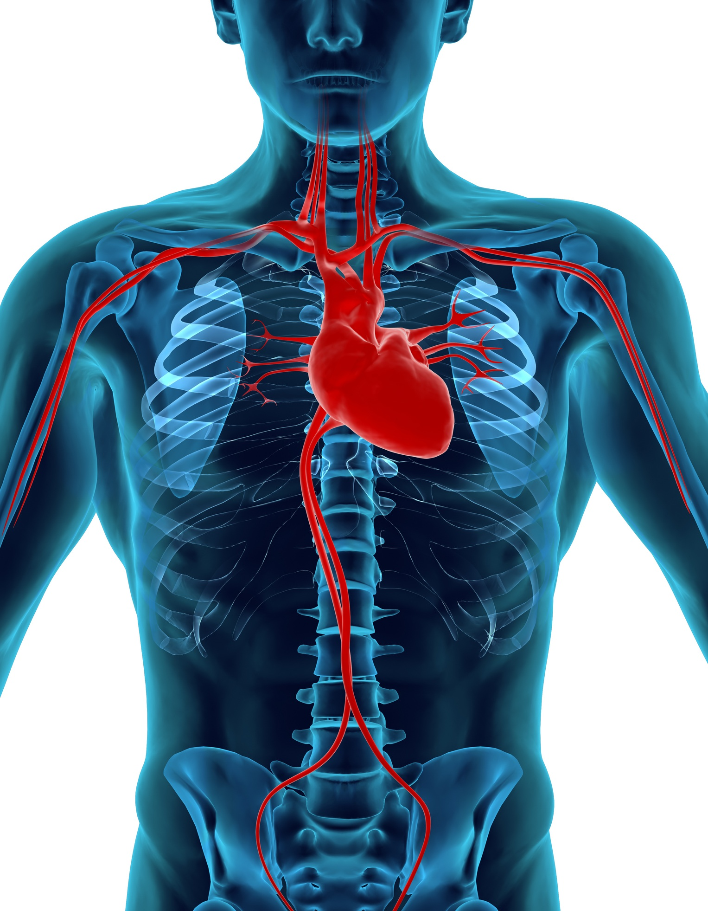
Organs and
Organ Systems
GHS S1

Slide 2
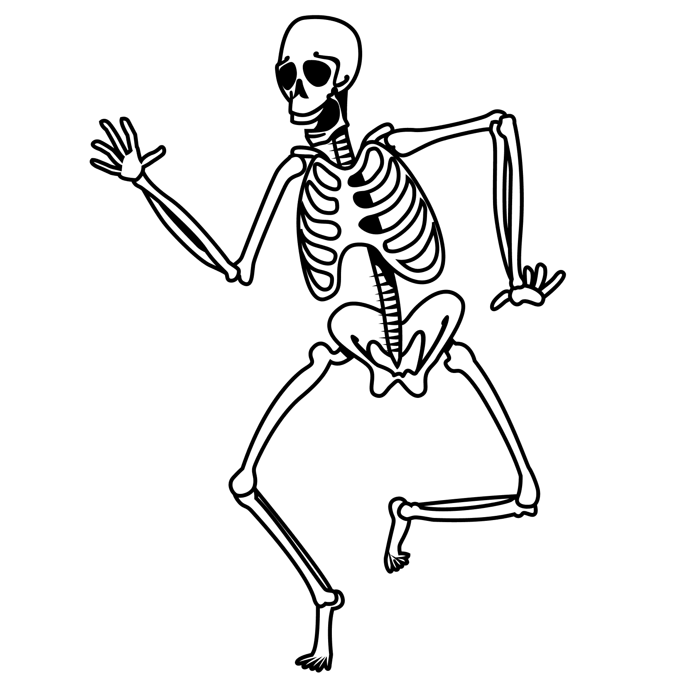
Skeleton
Protection
Support
Movement

Slide 3
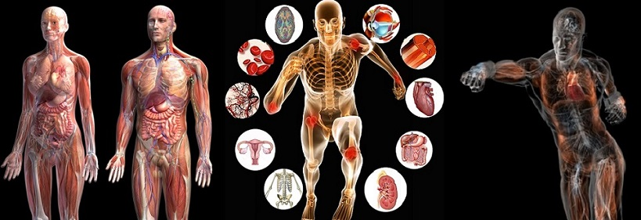
Organs

Slide 4
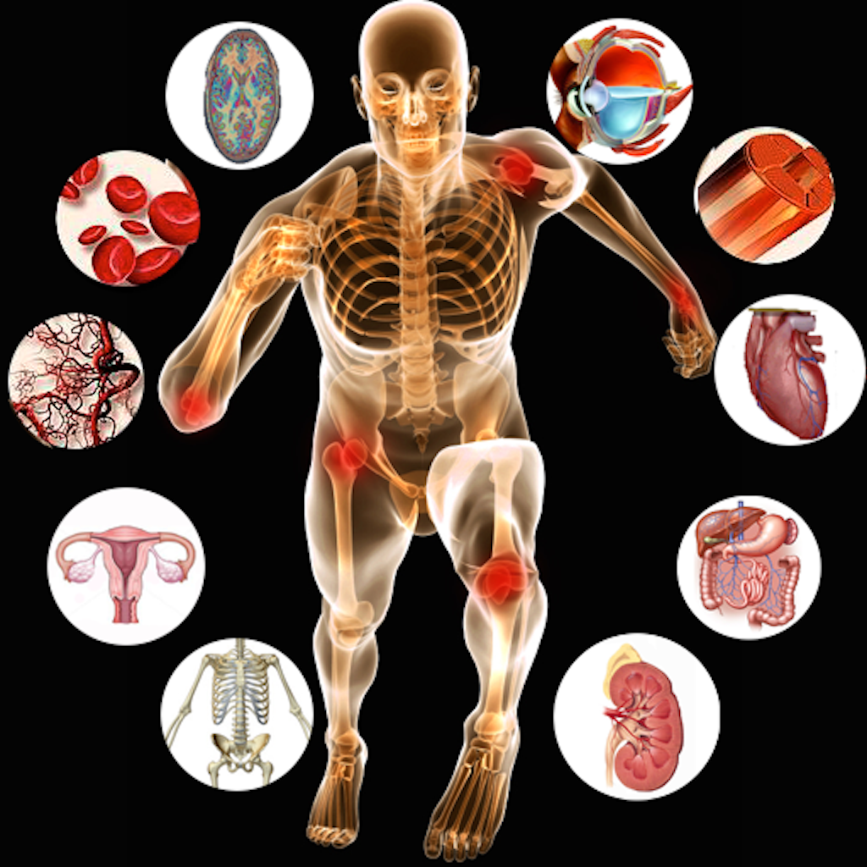
Eyes
The eye is a sense organ that contains special cells sensitive to light so we can see the world around us

Slide 5
Muscles
Muscles contract and pull on bones to make us move

Slide 6
Heart
The Heart pumps blood that provides the other organs with oxygen and food

Slide 7
Stomach and Intestines
Stomach and intestines digest food and puts it into the blood

Slide 8
Kidneys
Kidneys remove poisons from the blood and produces urine

Slide 9
Bones
Bones provide protection, support and allow movement

Slide 10
Uterus
Uterus protects the baby until it is born

Slide 11
Arteries
Arteries deliver oxygen
Veins remove waste carbon dioxide

Slide 12
Blood
Red blood cells transport oxygen
White blood cells fight disease

Slide 13
Brain
Brain processes information from our sense organs and controls our actions

