Slide 1
TRANSPIRATION

Slide 3
Transpiration – Lesson 1
Learning Intentions
By the end of this lesson I will be successful if I can:
Explain the role of stomata in controlling water loss.
Outline how stomata open and close.
List the ways in which xerophytes and halophytes control water loss.

Slide 4
Key words
Photosynthesis
Osmosis
Xylem
Lignin
Phloem
Stomata
Transpiration
Minerals
Water
Halophytes
Xerophytes

Slide 5
Leaf Structure

Slide 6
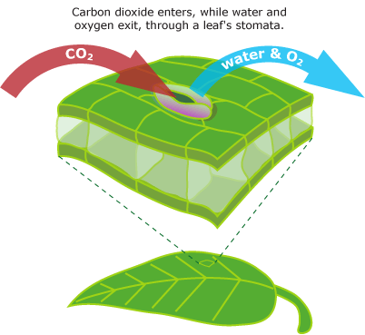
Stomata
The thicker, less elastic, inner wall doesn’t stretch as much as the rest of the cell, forcing the cell to curve.

Slide 7
Stomata

Slide 8
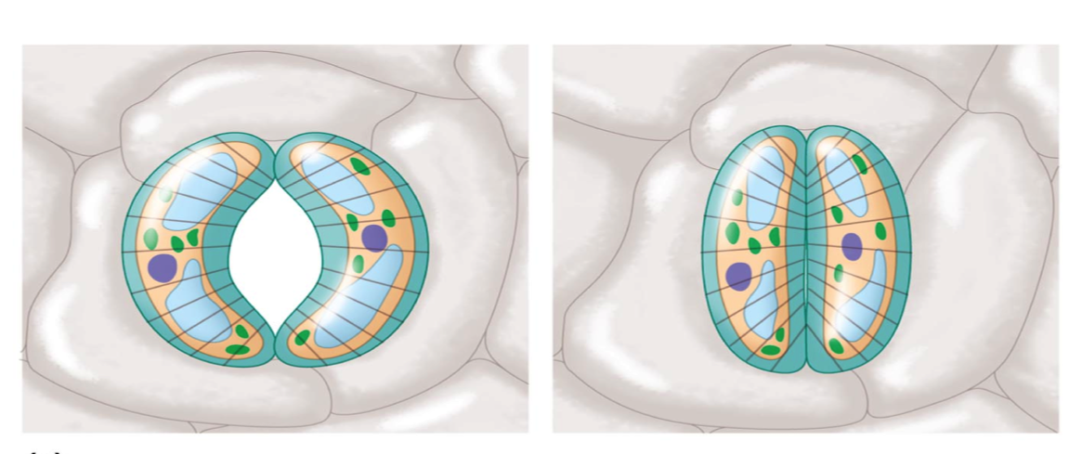
Closing of Stomata
Guard cells close by losing water.
This happens at night as they do not photosynthesise and do not need carbon dioxide.
This conserves water so the plant does not begin to wilt.

Slide 9
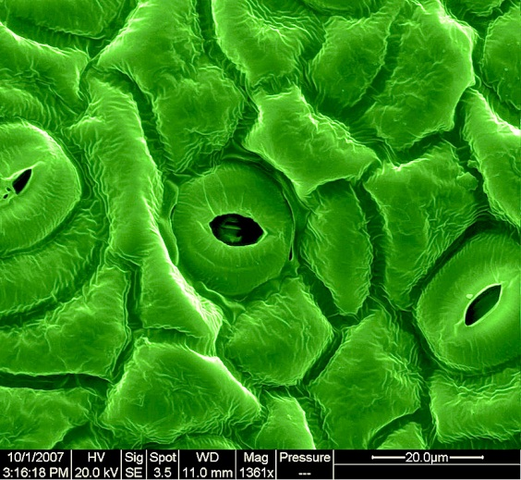
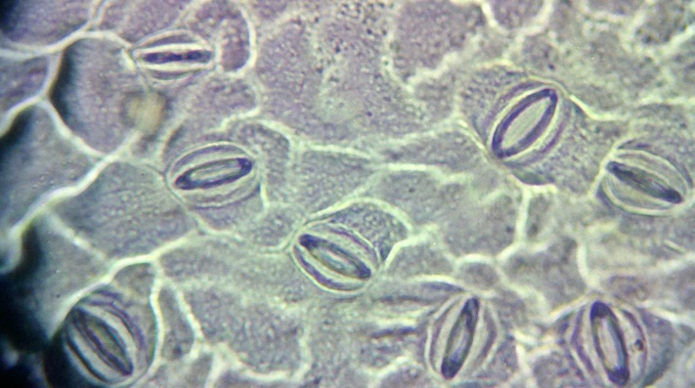
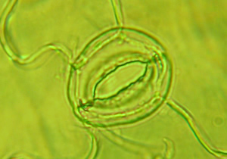
Stomata

Slide 10
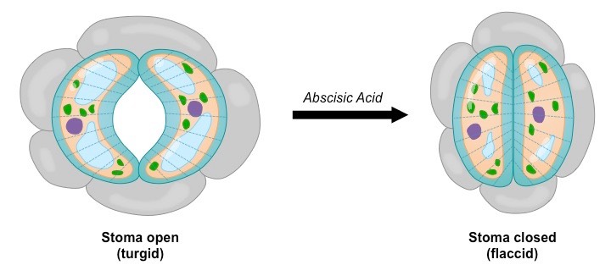
Stomata
The amount of water lost from the leaves (transpiration rate) is regulated by the opening and closing of stomata
Guard cells flank the stomata and can occlude the opening by becoming increasingly flaccid in response to cellular signals
When a plant begins to wilt from water stress, dehydrated mesophyll cells release the plant hormone abscisic acid (ABA)
Abscisic acid triggers the efflux of potassium from guard cells, decreasing water pressure within the cells (lose turgor)
A loss of turgor makes the stomatal pore close, as the guard cells become flaccid and block the opening

Slide 11
Stomata
During drought
Stomatal closing
Spongy mesophyll cells release abscicic acid (a plant hormone), which promotes stomata closing.
Potassium ions move out of the vacuole and out of the cells (by active transport).
Water moves out of the vacuoles, following potassium ions.
The guard cells shrink in size.
The stoma closes.
At night

Slide 12
Stomata
Wet periods
Stomatal opening
Potassium ions move into the vacuoles.
Water moves into the vacuoles, following potassium ions.
The guard cells expand.
The stoma opens.
During the day

Slide 13
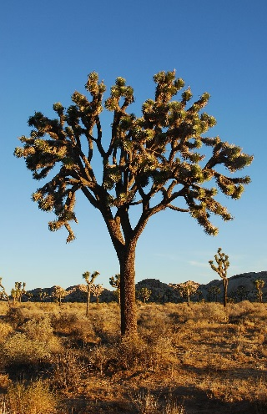
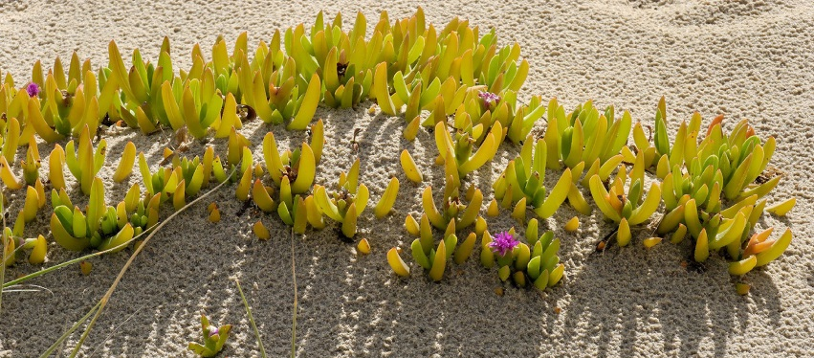
Conservation of water
Xerophytes will have high rates of transpiration due to the high temperatures and low humidity of desert environments
Halophytes will lose water as the high intake of salt from the surrounding soils will draw water from plant tissue via osmosis

Slide 14
xerophytes
Reduced leaves – reducing the total number and size of leaves will reduce the surface area available for water loss

Slide 15
xerophytes
Rolled leaves – rolling up leaves reduces the exposure of stomata to the air and hence reduces evaporative water loss

Slide 16
xerophytes
Thick, waxy cuticle – having leaves covered by a thickened cuticle prevents water loss from the leaf surface

Slide 17
xerophytes
Stomata in pits – having stomata in pits, surrounded by hairs, traps water vapour and hence reduces transpiration

Slide 18
xerophytes
Stomata in pits – having stomata in pits, surrounded by hairs, traps water vapour and hence reduces transpiration

Slide 19
xerophytes
Low growth – low growing plants are less exposed to wind and more likely to be shaded, reducing water loss

Slide 20
xerophytes
CAM physiology – plants with CAM physiology open their stomata at night, reducing water loss via evaporation

Slide 21
What is CAM physiology?
In a plant using full CAM, the stomata in the leaves remain shut during the day to reduce evapotranspiration, but open at night to collect carbon dioxide (CO₂). The CO₂ is stored as the four-carbon acid malate in vacuoles at night, and then in the daytime, the malate is transported to chloroplasts where it is converted back to CO₂, which is then used during photosynthesis. The pre-collected CO₂ is concentrated around the enzyme RuBisCO, increasing photosynthetic efficiency.

Slide 22
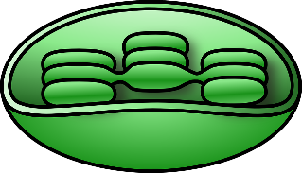
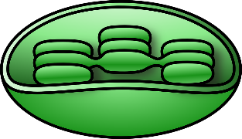
Cam Physiology
CO₂
CO₂
malate
CO₂
malate

Slide 23
Conservation of water

