Slide 1
DNA
The Molecule of Life

Slide 2
DNA
Identify the properties of DNA
Outline some of the experiments that led to Watson & Crick’s proposed structure of DNA
Draw the structure of DNA
Distinguish between DNA and RNA

Slide 3
DNA
Genetic code
Universal
Able to replicate

Slide 4
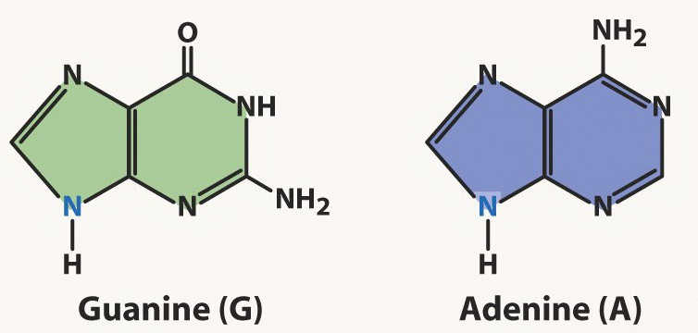
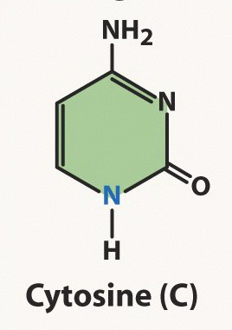
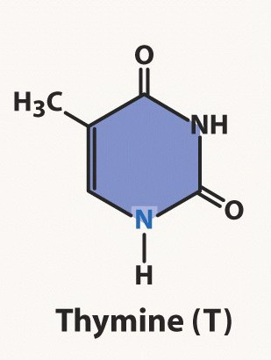
Nucleotide
Only the base differs between nucleotides:
Cytosine and Thymine are pyrimidines.

Slide 5
Griffith 1928
What conclusions can you make from this experiment?

Slide 6
Erwin Chargaff Data 1952
Organism | %A | %G | %C | %T
φX174 | 24.0 | 23.3 | 21.5 | 31.2
Maize | 26.8 | 22.8 | 23.2 | 27.2
Octopus | 33.2 | 17.6 | 17.6 | 31.6
Chicken | 28.0 | 22.0 | 21.6 | 28.4
Rat | 28.6 | 21.4 | 20.5 | 28.4
Human | 29.3 | 20.7 | 20.0 | 30.0
Grasshopper | 29.3 | 20.5 | 20.7 | 29.3
Sea Urchin | 32.8 | 17.7 | 17.3 | 32.1
Wheat | 27.3 | 22.7 | 22.8 | 27.1
Yeast | 31.3 | 18.7 | 17.1 | 32.9
E. coli | 24.7 | 26.0 | 25.7 | 23.6
The first rule holds that a double-stranded DNA molecule has percentage base pair equality: %A = %T and %G = %C.
This does not hold true for viruses which contain single stranded DNA.

Slide 7
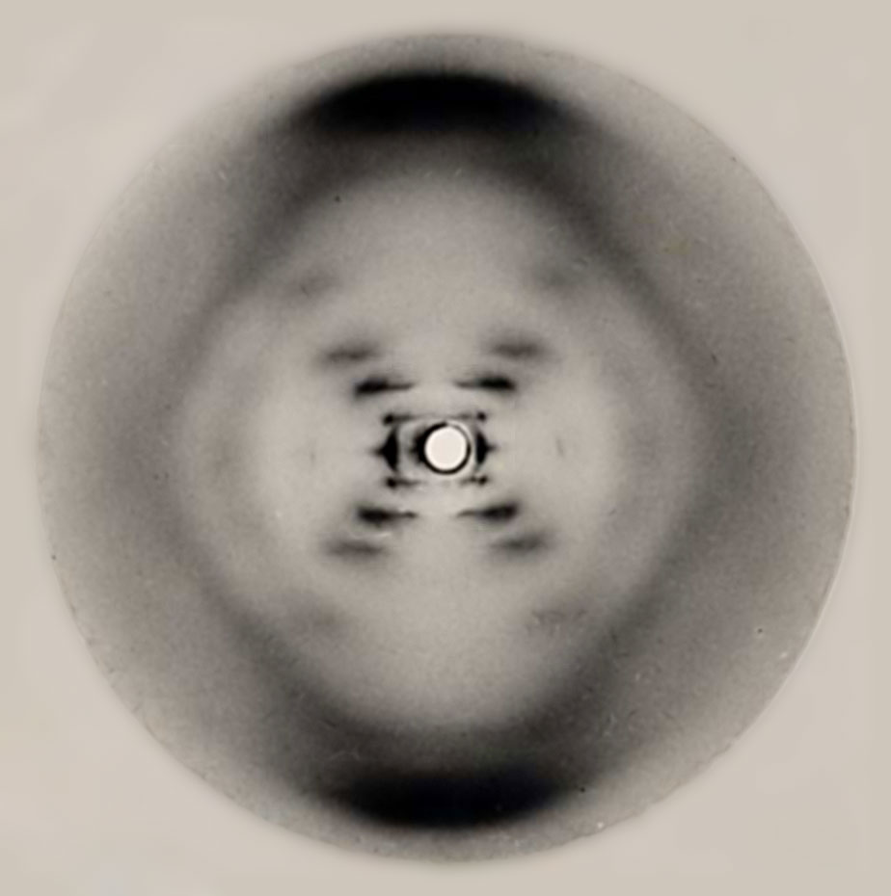
Rosalind Franklin 1953
Rosalind Franklin was best known for her work on the X-ray diffraction images of DNA. Her images confirming the helical structure of DNA were shown to James Watson and Francis Crick without her knowledge or approval. The two men later used her data in their 1953 hypothesis on the structure of DNA.

Slide 8
James Watson & Francis Crick 1953
Watson & Crick proposed a structure of DNA and published it in Nature

Slide 9
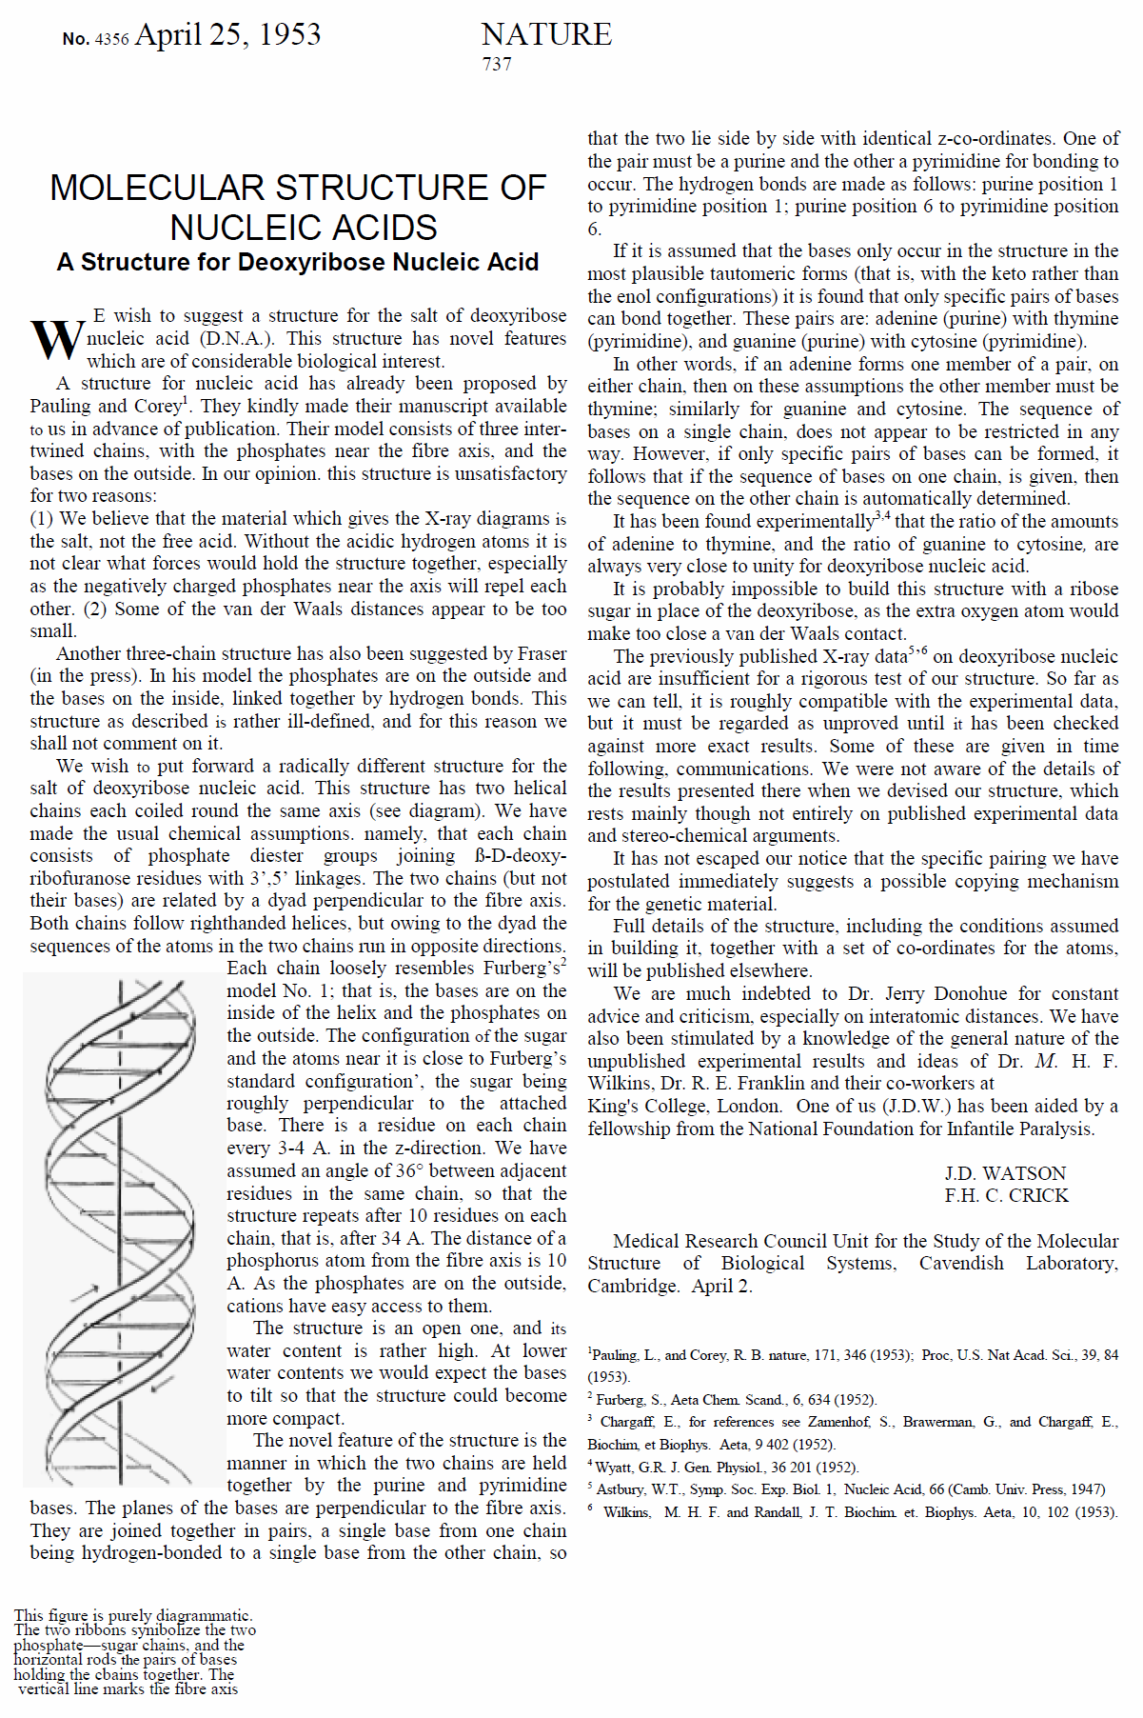

Slide 10
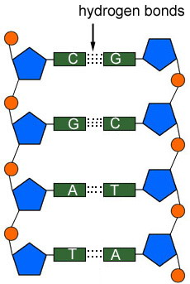
DNA double helix
Cytosine and Guanine forms 3 double bonds. Thymine and adenine form 2 hydrogen bonds. This leads to complimentary base pairing.
Thymine and cytosine would be too small to form a rung in the ladder. Adenine and guanine would be too large!
5’
3’
Phosphate
Covalent bonds
Do not use A, T, C & G as it could cost you a mark!
5’ and 3’ refer to the carbon atoms in the deoxyribose sugar
Covalent bonds are strong, hydrogen bonds are weak
Deoxyribose
The hydrogen bonds enable the DNA molecule to unzip during DNA replication
The two strands are anti-parallel
3’
The molecule is twisted into a double helix
Nitrogenous base
5’

