Slide 1
Haileybury Astana IB Biology
Immobilised Enzymes and the Production of Lactose Free Milk

Slide 2
Learning objectives
Explain the importance of immobilised enzymes
Outline the use of calcium alginate to immobilise enzymes
Explain why some people are lactose intolerant
Describe the production of lactose free milk

Slide 3
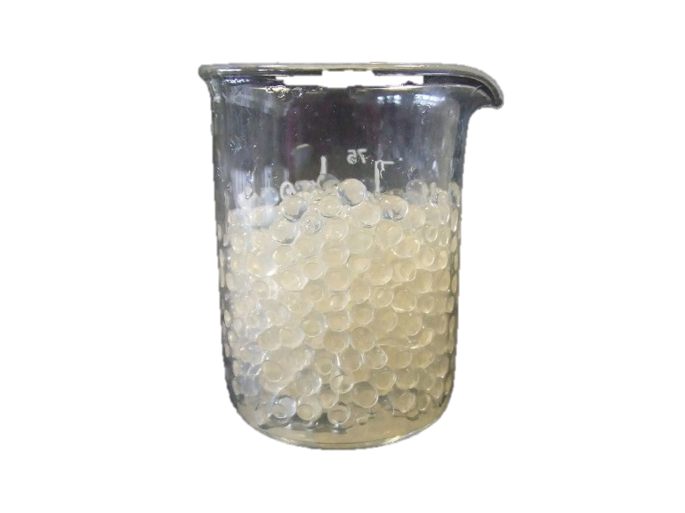
Immobilised enzymes
There are two main advantages to immobilising enzymes. The enzyme does not contaminate the product (lactose free milk). In addition, alginate beads can be packed into industrial columns to allow continuous flow processing. The enzymes are not lost in the lactose-free milk and the expensive enzymes are re-used.
In a nutshell:
The production of enzymes for industrial processes is expensive
Immobilising the enzymes means that they can be reused over and over again.

Slide 4
Immobilised enzymes
Enzymes can be immobilised:
in alginate gel beads
on reagent sticks
For example, enzymes can be immobilised in gel beads by mixing the enzyme with alginate (a type of gel), then dropping the mixture into calcium chloride solution. This produces small beads with the enzyme inside calcium alginate gel.

Slide 5
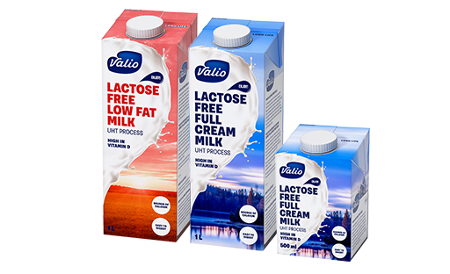
Lactose intolerance
Lactose intolerance is the inability to absorb lactose – the predominant sugar in milk – into the digestive system.
If lactose is not absorbed properly, it ferments in the colon and this can result in abdominal pain, a bloated stomach and diarrhoea
It's important to remember that lactose intolerance is not an allergy.

Slide 6
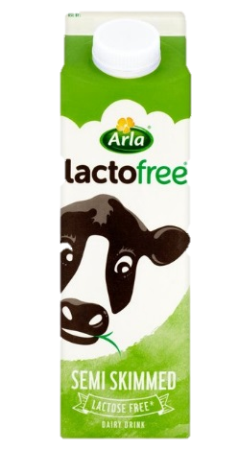
Lactose intolerance
Lactose is a disaccharide, which means that it is composed of two other sugars bound together (glucose and galactose).
In order for lactose to be absorbed, it must be split into those two smaller sugars.
This breakdown is performed by an enzyme called lactase, which is present in the lining of the small intestine.
If the levels of the lactase enzyme are low or absent, then that breakdown does not occur. The lactose reaches the colon and is fermented by bacteria in the large intestine and this can produce excess gas and stomach rumbling and leads to diarrhoea.
The production of lactose free dairy products through the use of immobilolised lactase means that people can enjoy milk products without these symptoms.

