Slide 1
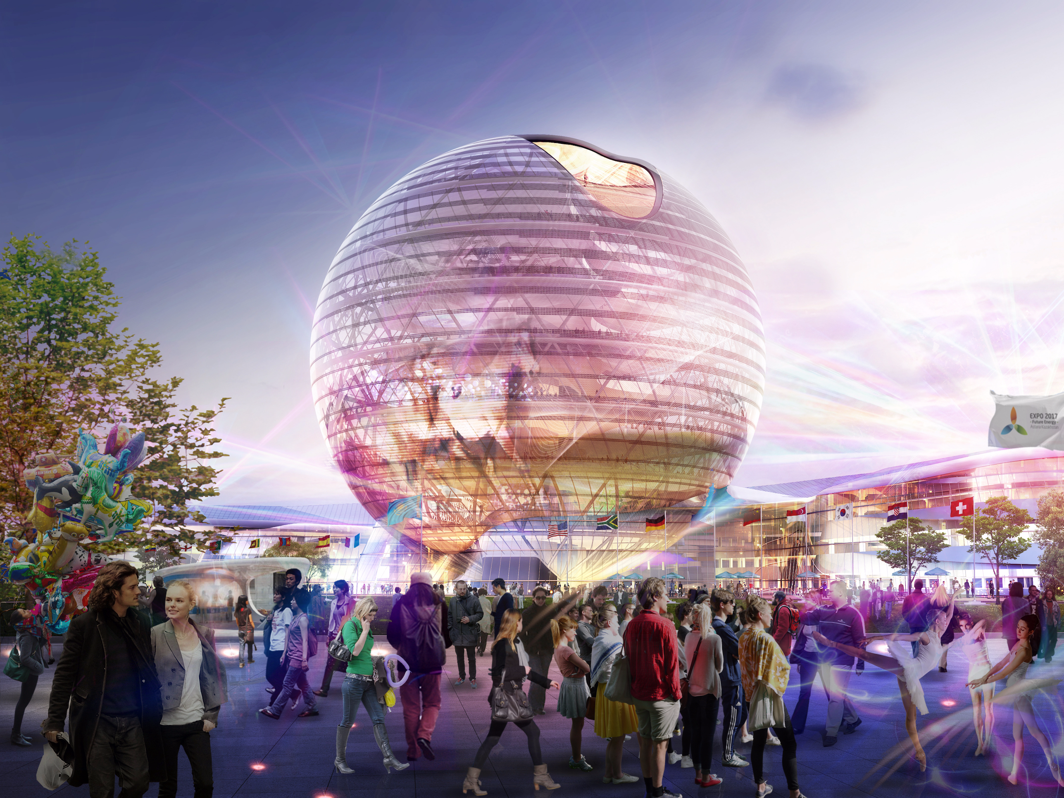
THE CARBON CYCLE
IGCSE SCIENCE

Slide 2
Learning Objectives
Outline the processes of the carbon cycle
Distinguish between organic and inorganic carbon
Explain how human activities affect the carbon cycle
Explain how changes in the concentration of carbon dioxide in the atmosphere leads to the greenhouse effect and climate change

Slide 3
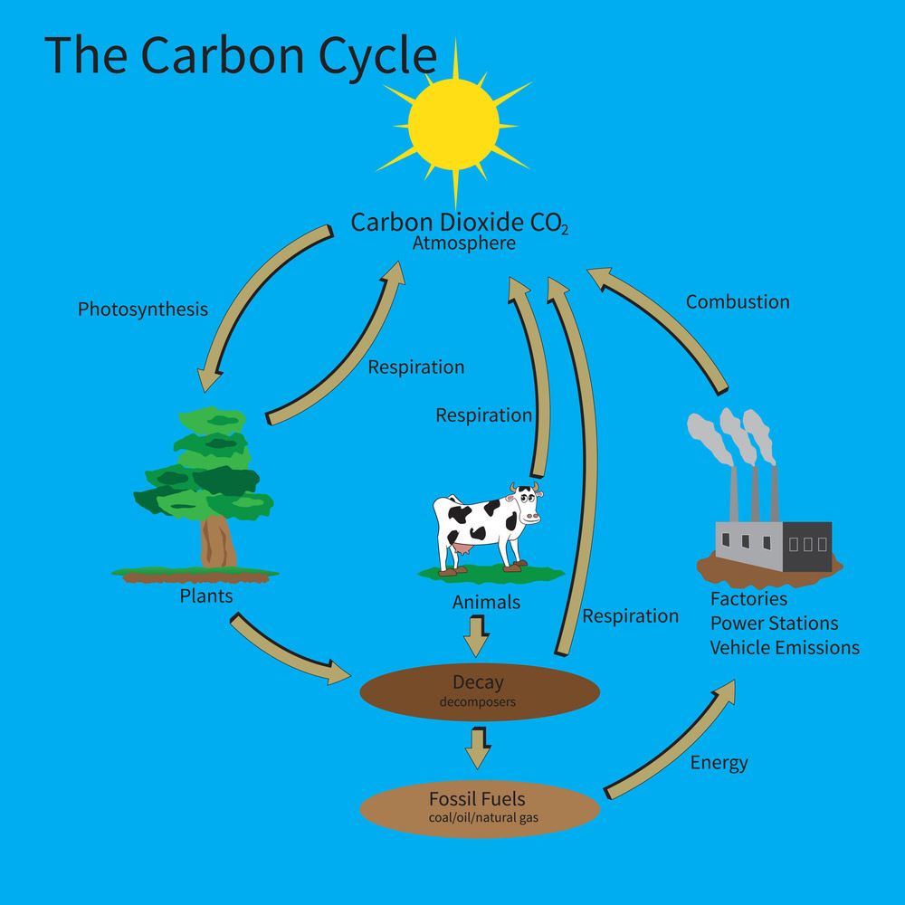
Outline the processes of the carbon cycle

Slide 4
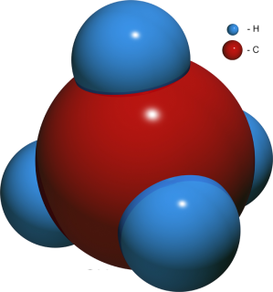
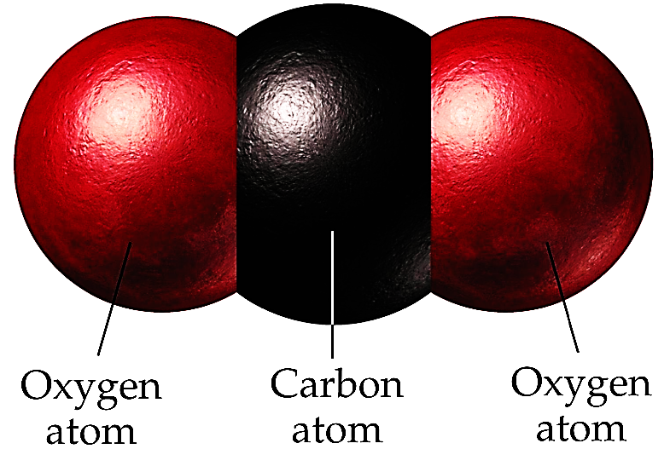
Distinguish between organic and inorganic carbon
INORGANIC
ORGANIC

Slide 5

Global Warming

Slide 6
Questions
State the difference between organic and inorganic carbon compounds.
Complete:
Carbon dioxide is an ________ carbon compound because it does not contain ______.
List the processes that add carbon dioxide to the atmosphere.
Explain why the amount of carbon dioxide in the atmosphere has increased over the last 200 years.

Slide 7
The carbon cycle
Carbon dioxide
In the air (CO₂)
photosynthesis
respiration
Combustion
(burning)
feeding
Carbon compounds in plants
Carbon compounds in animals
Fossil fuels
Coal, oil, gas, peat
decay

Slide 8



Notes:
Teacher notes
This animation can be used to introduce the major stages of the carbon cycle.

Slide 9
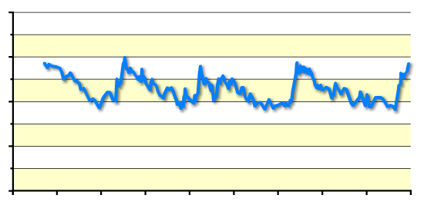
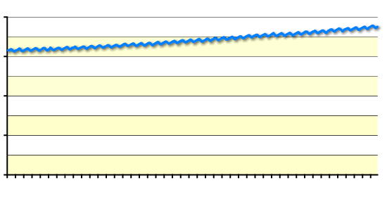
These graphs show how carbon dioxide concentrations have changed over time.
400
Around 200 years ago, carbon dioxide levels were about 280 ppm and are now about 380 ppm.
300
200
CO₂ conc. (ppm)
100
0
400
300
200
100
0
According to records, this is about 27% more than at any time in the last 400,000 years.
years before present (thousands)
400
300
200
CO₂ conc. (ppm)
100
How might this affect us?
0
1960
1980
2000
year
Notes:
Teacher notes
These graphs can be used to compare current trends in atmospheric carbon dioxide levels with historic records.
Top graph data (proxy records) from the Vostok ice core, courtesy of NOAA and WDC Paleo. Bottom graph data (instrumental records) from the Mauna Loa observatory, Hawaii, courtesy of NOAA.
Petit, JR et al. 1999. Climate and atmospheric history of the past 420,000 years from the Vostok ice core, Antarctica. Nature 399: 429-436.
The key points about the data are:
Carbon dioxide levels have naturally varied over time (top graph)
Carbon dioxide levels vary seasonally (bottom graph)
Current carbon dioxide levels are significantly higher than at any time in the last 400,000 years, according to the ice core records.
Discussion points could include:
How reliable are different data sources?
Which methods can be used to help scientist understand atmospheric conditions over a long time period?

Slide 10
Impacts of climate change
Notes:
Photo credits:
nature: US Fish and Wildlife Service. Polar bears. (http://www.fws.gov/)
wind: NASA, USA. Hurricane Katrina satellite image. (http://www.nasa.gov/vision/earth/lookingatearth/h2005_katrina.html)
food: Chad Gore. Cracked mud.
pests: Gabor Bibor. Mosquito.
coral: Rhett A Butler / mongabay.com. Great Barrier Reef, Australia. (http://mongabay.com)
Teacher notes
This activity could be used as a stimulus for a discussion of the effects of global warming.

Slide 11
Notes:
Teacher notes
Appropriately coloured cards or mini-whiteboards could be used with this classification activity to increase class participation.

Slide 12
The carbon cycle
True or false?

Slide 13
Green plants use carbon dioxide in photosynthesis.
True

Slide 14
Combustion removes carbon from the atmosphere
False – combustion releases carbon dioxide gas

Slide 15
The largest store of carbon is the atmosphere
False – more is found in marine organisms and limestone rock deposits

Slide 16
Respiration adds carbon dioxide to the atmosphere
True

Slide 17
Respiration only occurs in animals
False – both animals and plants respire

Slide 18
Decomposers remove carbon dioxide from the atmosphere
False – they respire and release carbon dioxide

Slide 19
Fossil fuels represent a huge (but decreasing) store of carbon
True

Slide 20
Increasing carbon dioxide may cause global cooling
False – scientists think it will cause global warming

Slide 21
Energy is transferred from plants to animals to decomposers
True

Slide 22
Respiration releases energy to the environment in the form of heat
True

Slide 23
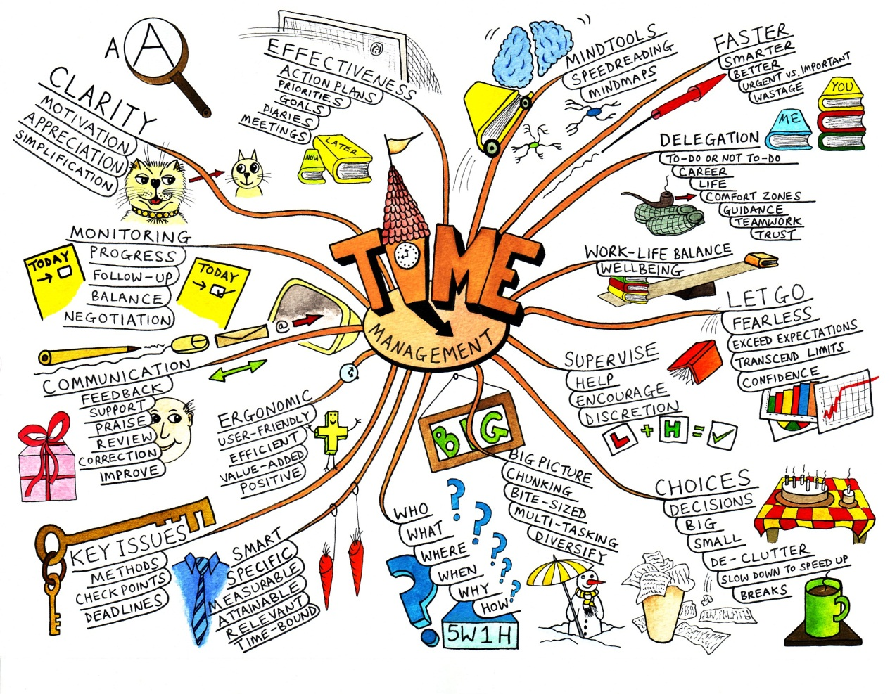
Mind map
A mind map is a diagram that links together a number of connected ideas:

Slide 24
Mind map
Produce a mind map linked to the carbon cycle
Include:
Carbon dioxide
Respiration
Deforestation
Greenhouse effect
Global warming
Fossil fuels
Drought
Famine
Photosynthesis
Decomposition

