Slide 1
HIV and AIDS
IGCSE Combined Science

Slide 2
What is HIV?
HIV stands for human immunodeficiency virus. This infection is transmitted by body fluids, often during unprotected sex, but also through cuts and injecting drugs using unsterilized needles. Immediately after infection, people often suffer mild flu-like symptoms. These pass and for a period of time infected people might not know they are infected.

Slide 3
What is AIDS?
AIDS stands for acquired immune deficiency syndrome. Months or years after the infection by HIV, the virus becomes active and attacks the patient's white blood cells. HIV at this point has resulted in AIDS.
There is no cure for HIV/AIDS although scientists are trying to find one. Currently, infected people are given antiviral drugs, which can significantly slow the development of AIDS.

Slide 4
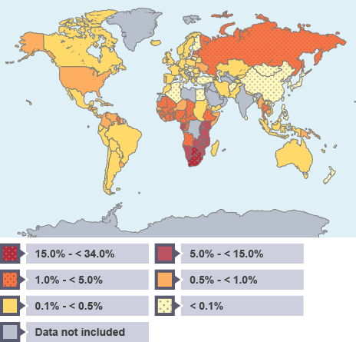
How common is it?

Slide 5
Question
What does HIV stand for?

