Slide 1
GHS S3 Science

Slide 2
Learning objectives
Define plant hormones
Outline some of the effects of plant hormones
Explain some of the observations when carrying out experiments into plant hormones
Give examples of how they are used in food production

Slide 3
Plant hormones
Plant hormones are chemicals that control the growth and development of plants.
They include chemicals called auxins that make shoots grow upwards and roots grow downwards.
Some are gaseous and released into the air. E.g bananas release ethylene which makes other fruit in the same bowl ripen faster.

Slide 4
Tropisms
Growth towards or away from a stimulus is known as a __________.
Growth of the shoots towards light is __________.
Growth of the roots downwards due to gravity is __________.
Growth towards water is ________.
Geotropism phototropism
Hydrotropism tropism

Slide 5
Learning objectives
Define plant hormones
Outline some of the effects of plant hormones
Explain some of the observations when carrying out experiments into plant hormones
Give examples of how they are used in food production

Slide 6
Auxins

Slide 7
What happens and why?
Tip covered in transparent material
Tip removed
Tip covered in opaque material
Lower part covered in opaque material
Tip covered in opaque material

Slide 8
Clinostats
This is usually done with seedlings rather than mature plants.
How would you set up a control?

Slide 9
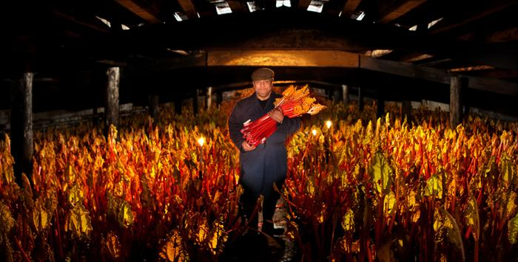
Etiolation
Forced rhubarb

Slide 10
Weed killers
Selective weed killers attack some plants but not others. This can be useful for getting rid of dandelions in a lawn without killing the grass, or getting rid of thistles in a field without killing the wheat plants. The selective weed killer contains growth hormone that causes the weeds to grow too quickly. The weed killer is absorbed in larger quantities by the weeds rather than the beneficial plants

Slide 11
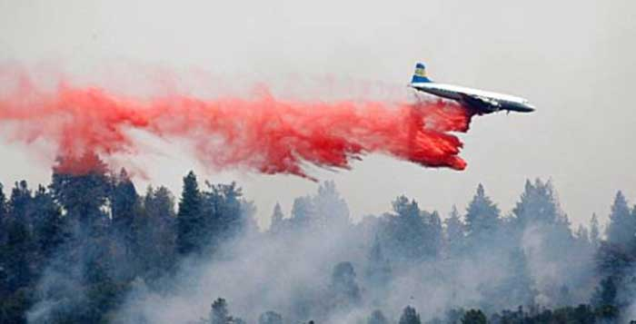
AGENT ORANGE
Plant hormones were used during the Vietnam war.
It was referred to as a DEFOLIATION spray.
It stripped the trees of leaves so that they could see the enemy.

Slide 12
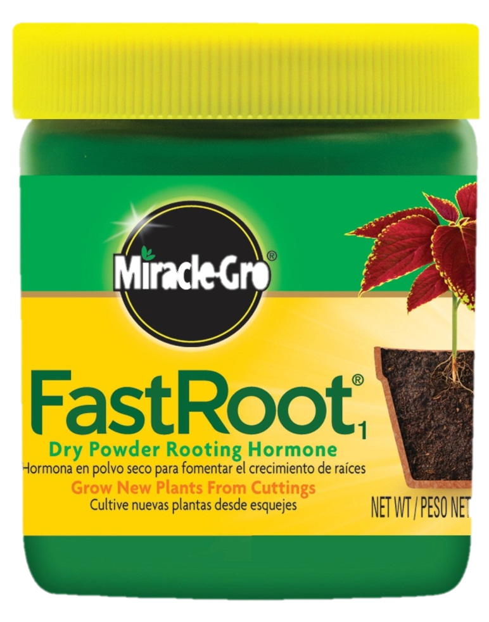
Rooting Powder
Rooting powder makes stem cuttings quickly develop roots. Rooting powder contains growth hormones.

Slide 13
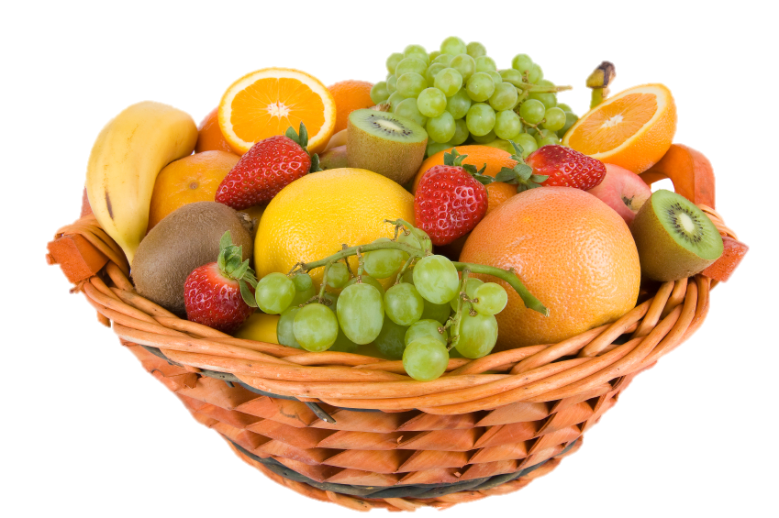
Fruit ripening
Some hormones slow the ripening of fruits and others speed it up. These hormones and their inhibitors are useful for delaying ripening during transport or when fruit is displayed in shops.

Slide 14
dormancy
Dormancy stops seeds germinating until conditions are ideal for growth. Hormones can be used to remove the dormancy of a seed so it can germinate at all times of year. Buds and flowers can also be naturally dormant. Hormones can also be used to make plants grow bushier or make them flower.

Slide 16
Quickfire questions
This A is a plant hormone that controls growth
1 POINT!

Slide 17
Quickfire questions
This A is a plant hormone that controls growth
auxins

Slide 18
Quickfire questions
This B releases large amounts of ethylene that makes fruit ripen too fast
1 POINT!

Slide 19
Quickfire questions
This B releases large amounts of ethylene that makes fruit ripen too fast
Bananas

Slide 20
Quickfire questions
This G describes the growth of roots towards gravity
1 POINT!

Slide 21
Quickfire questions
This G describes the growth of roots towards gravity
geotropism

Slide 22
Quickfire questions
This D describes a period when seeds do not germinate
1 POINT!

Slide 23
Quickfire questions
This D describes a period when seeds do not germinate
dormancy

Slide 24
Quickfire questions
Draw these three seeds after they haver germinated and label the roots and shoots
3 POINTs!

Slide 25
Quickfire questions
Shoots always grow upwards!
Roots always grow downwards!

Slide 26
Quickfire questions
List 3 stimuli that make shoots grow up and roots grow down
3 POINTs!

Slide 27
Quickfire questions
List 3 stimuli that make shoots grow up and roots grow down
Light
Gravity
water

Slide 28
Quickfire questions
Name the apparatus used to “confuse” plants about gravity
1 POINT!

Slide 29
Quickfire questions
Clinostat

Slide 30
Quickfire questions
Which crop is “forced” to grow long stems?
1 POINT!

Slide 31
Quickfire questions
Rhubarb

Slide 32
Quickfire questions
Give the term used to refer to rapid elongation of the stem when plants are placed in the dark
1 POINT!

Slide 33
Quickfire questions
Etiolation

Slide 34
Summary
weed killers
rooting powder
seedless fruit
shortening dormancy
control of ripening of fruit
defoliation during war

