Slide 1
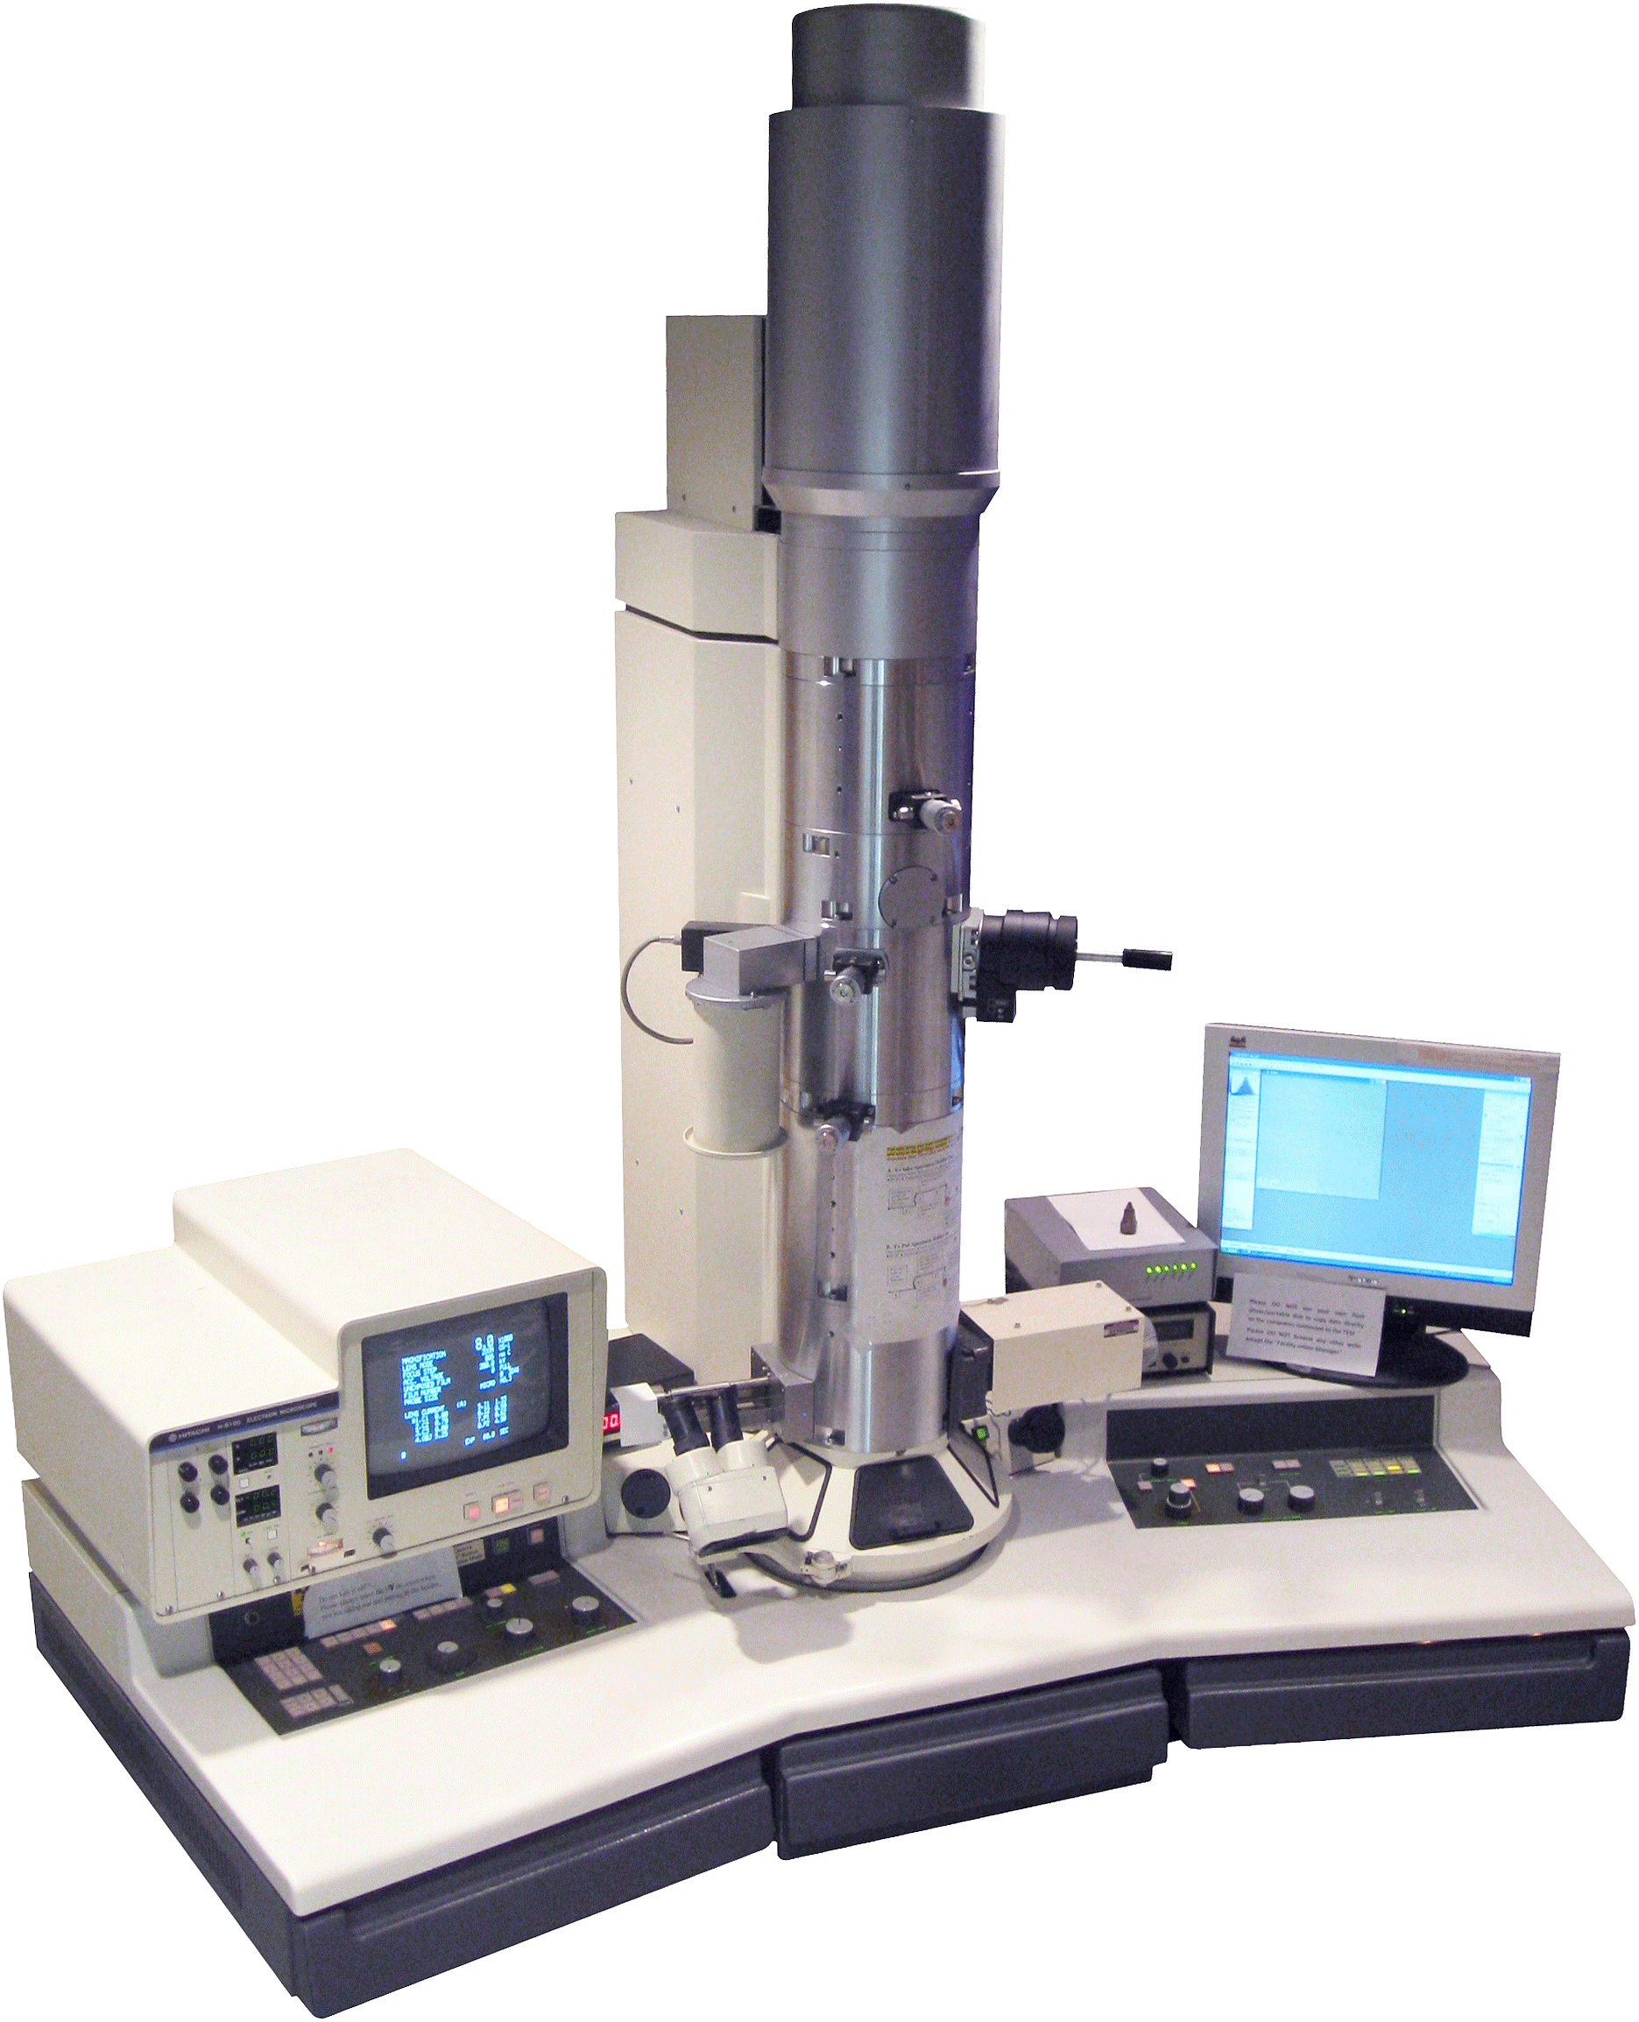
Microscopes
Their types and uses

Slide 2
Light microscope
Key:
A=ocular lens area
B=objective lens area
C and D - slide and stage opening
E=mechanical stage
F=light source

Slide 3
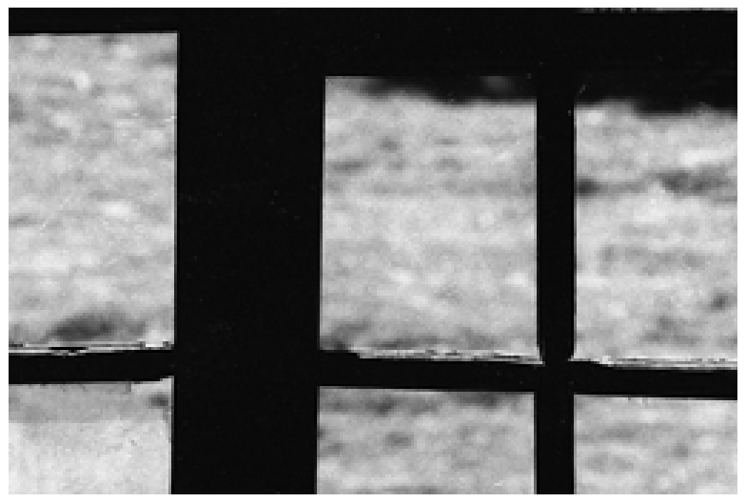
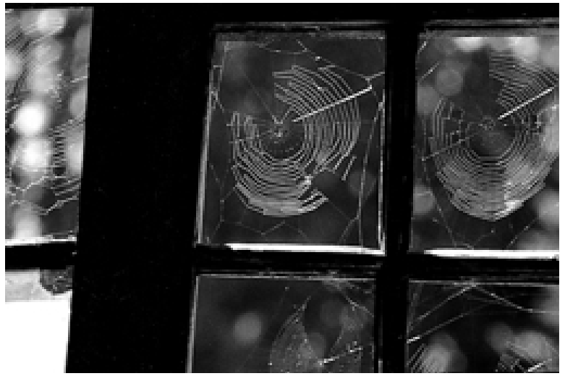
Dark Field
Darkfield microscopy is a specialized illumination technique that capitalizes on oblique illumination to enhance contrast in specimens that are not imaged well under normal brightfield illumination conditions.

Slide 4
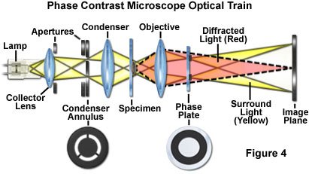
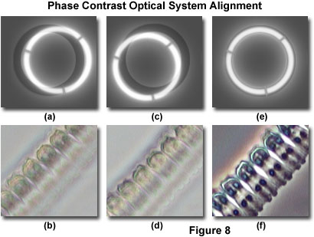
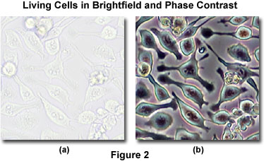
Phase Contrast

Slide 5
Electron microscope

Slide 6
Types of electron microscopes
Transmission electron microscopes pass a beam of electrons through the specimen.
Thin sections of specimen are needed for transmission electron microscopy as the electrons have to pass through the specimen for the image to be produced.
Dense areas stop the electrons and appear dark.
Electron gun
Specimen
Monitor
Sensor

Slide 7
Types of electron microscopes
Scanning electron microscopes pass a beam of electrons over the surface of the specimen in the form of a ‘scanning’ beam.
Larger, thicker structures can thus be seen under the scanning electron microscope as the electrons do not have to pass through the sample in order to form the image.
However the resolution of the scanning electron microscope is lower than that of the transmission electron microscope.
Monitor
Electron gun
Sensor
Specimen
Electrons are reflected creating a 3D image of troughs and ridges

Slide 8
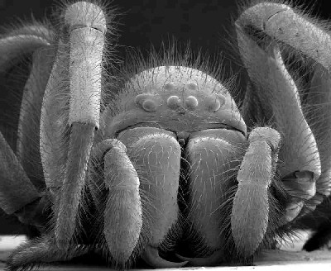
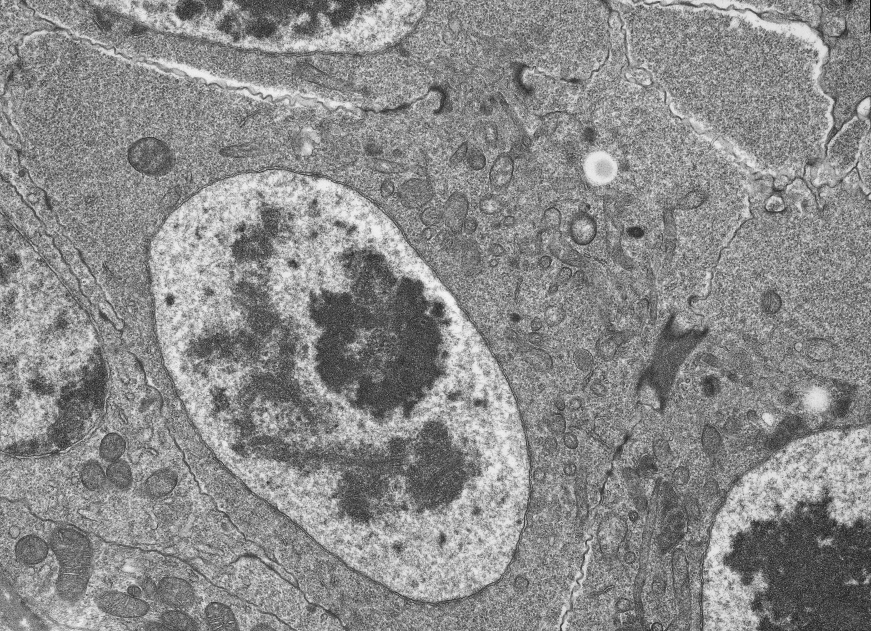
Scanning vs transmission

Slide 9
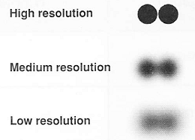
Electron microscopes
Better resolution: The ability to distinguish between two points on an image. Like pixels in a digital camera.
Greater magnification: How much bigger a sample appears to be under the microscope than it is in real life.

Slide 10
Same magnification, different resolution
Light microscope
Scanning electronmicroscope

Slide 12
What microscope to use ?
Light | Electron
Cheap to purchase (200 – 1000 $) | Expensive (over 2,000,000$)
Cheap to operate | Expensive to produce electron beams
Small and portable | Large and requires special rooms
Simple and easy preparations | Lengthy and complex preparations
Material rarely distorted by preparation | Preparation distorts material
Vacuum is not required | Vacuum is required
Natural color maintained | All images in black and white
Magnifies objects only up to 2000 times | Magnifies over 500,000 times

Slide 13
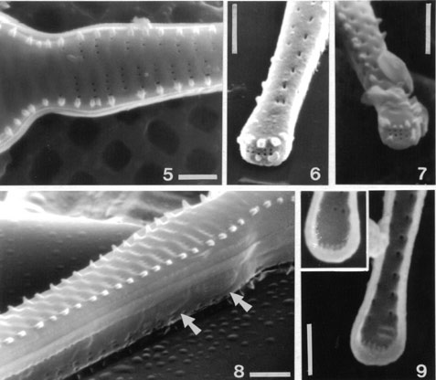
Magnification and scale bars
Magnification = Magnified size(ruler)
Real size (scale bar)
Scale bar = 10 µm

Slide 14
Determining the size of cells
Using a graticule

Slide 15
Calibration
How much is each division on the graticule worth? This depends on the magnification! Use the lowest magnification.
Graticule
We do not have a stage micrometer so we will need to use a transparent ruler where the smallest unit is in mm.
5mm = 5000µm
∴ each division on the graticule is equal to:
5000/100 = 50µm
It is easier to turn the eyepiece to align the graticule with the ruler.
At 20x magnification:

Slide 16
The values for the graticule will decrease as we increase the magnification. In the case given on the previous page:
Magnification | Calculation | Graticule value per smallest division
x20 | See previous slide | 50µm
x100 | (20/100) x 50µm | 10µm
x400 | (20/400) x 50µm | 2.5µm
Each microscope needs to be calibrated separately.

Slide 17
Determining the size of cells (onion epidermis)
Once you have calibrated the graticule, determine the length and width of an onion epidermis cell.
Measuring the length of many cells and calculating the mean will give a more reliable estimate!

