Slide 1
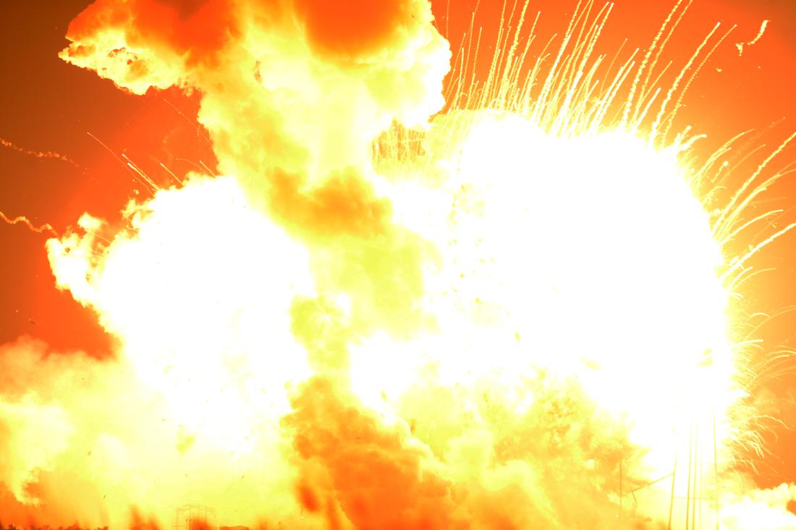
.

Slide 2
Which metal burns with a bright flame? ____________________
1. Copper
2. Iron
3. Manganese
4. Magnesium
Press the space bar to see the correct answer.

Slide 3
Which metal carbonate is the least stable? ____________________
1. Sodium
2. Magnesium
3. Copper
4. calcium
Press the space bar to see the correct answer.

Slide 4
Which gas is released during the thermal decomposition of a metal carbonate? ____________________
1. Oxygen
2. Carbon dioxide
3. Hydrogen
4. Nitrogen
Press the space bar to see the correct answer.

Slide 5
The substance used for testing for carbon dioxide is …. ____________________
1. Soda water
2. Tonic water
3. Distilled water
4. Limewater
Press the space bar to see the correct answer.

Slide 6
The name given to the corrosion of iron ____________________
1. Rusting
2. Neutralising
3. Sublimating
4. Distilling
Press the space bar to see the correct answer.

Slide 7
Dry ice is the solid form of…. ____________________
1. Dihydrogen oxide
2. Hydrogen
3. Carbon dioxide
4. Nitrogen
Press the space bar to see the correct answer.

Slide 8
Which gas relights a glowing splint? ____________________
1. Nitrogen
2. Carbon dioxide
3. Oxygen
4. Dihydrogen oxide
Press the space bar to see the correct answer.

Slide 9
Which type of fire extinguisher should be used for fires involving metals or electrical fires? ____________________
1. Dry powder
2. Foam (AFFF)
3. Water
4. Carbon dioxide
Press the space bar to see the correct answer.

Slide 10
Which is not a part of the fire triangle? ____________________
1. Oxygen
2. Heat
3. Fuel
4. Water
Press the space bar to see the correct answer.

Slide 11
The name of the gas that is tested with a lighted splint producing a squeaky pop is…. ____________________
1. Oxygen
2. Carbon dioxide
3. Hydrogen
4. Dihydrogen oxide
Press the space bar to see the correct answer.

Slide 12
An example of an unstable explosive is…. ____________________
1. Dynamite
2. Nitroglycerine
3. Semtex
4. TNT
Press the space bar to see the correct answer.

Slide 13
Which is used to make dynamite react? ____________________
1. Detonator
2. Resonator
3. Ventilator
4. Terminator
Press the space bar to see the correct answer.

Slide 14
Which word means the same as burning? ____________________
1. Decomposition
2. Pollution
3. Combustion
4. Neutralisation
Press the space bar to see the correct answer.

Slide 15
Which two substances react to produce carbon dioxide? ____________________
1. Acid and metal
2. Alkali and metal
3. Acid and limestone
4. Alkali and limestone
Press the space bar to see the correct answer.

Slide 16
Which of the above indicates a chemical reaction? ____________________
1. Change in colour
2. Dissolving
3. Melting
4. Boiling
Press the space bar to see the correct answer.

