Slide 1
Hydroponics
Growing crops without soil

Slide 2
Learning objectives
Understand how hydroponics work
List the advantages and disadvantages of hydroponics
Give examples of crops produced using hydroponics

Slide 3
Hydroponics
Hydroponics is a method of growing plants using mineral nutrient solutions, in water, without soil.

Slide 4
Nutrients
Nitrogen as ammonium or nitrates
Phosphorus as phosphates
Potassium (Potash)
NPK

Slide 5
The Wick System

Slide 6
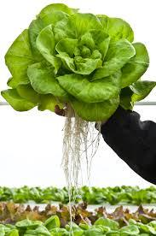
Advantages
Greenhouse conditions ensure year round growth

Slide 7
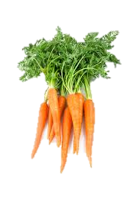
Advantages
Pests that remain in the soil after harvest are not present

Slide 8
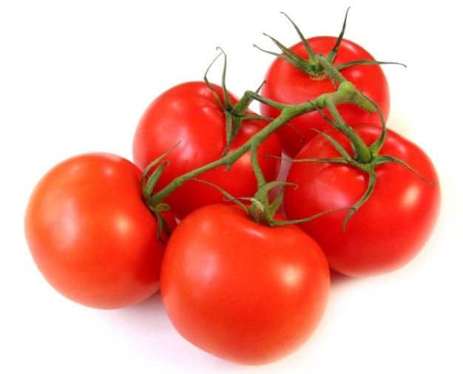
Advantages
Very clean products and less damage during harvesting

Slide 9
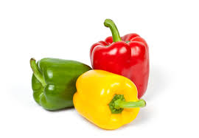
Advantages
Ensures that all the essential minerals are provided

Slide 10
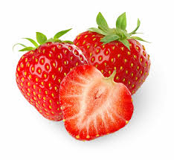
Disdvantages
Relatively high investment in greenhouses and hydroponics equipment

Slide 11
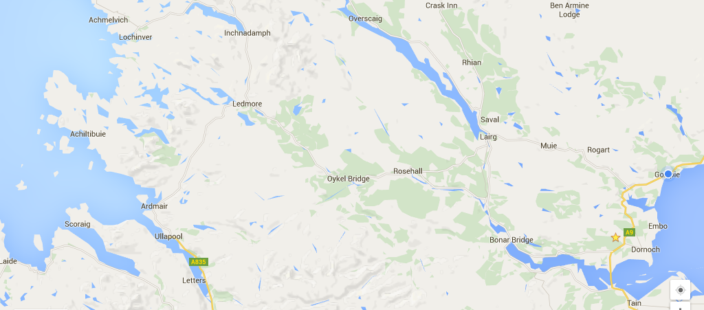
Where?
Achiltibuie

Slide 12
Questions
Draw the diagram of the hydroponics equipment on page 38 and explain how it works.
What are the advantages and disadvantages of hydroponics.
Produce a list of crops that are suitable for hydroponics.

