Slide 1
Nitrogen Cycle
GHS S3 Biology
NITROGEN 14

Slide 2
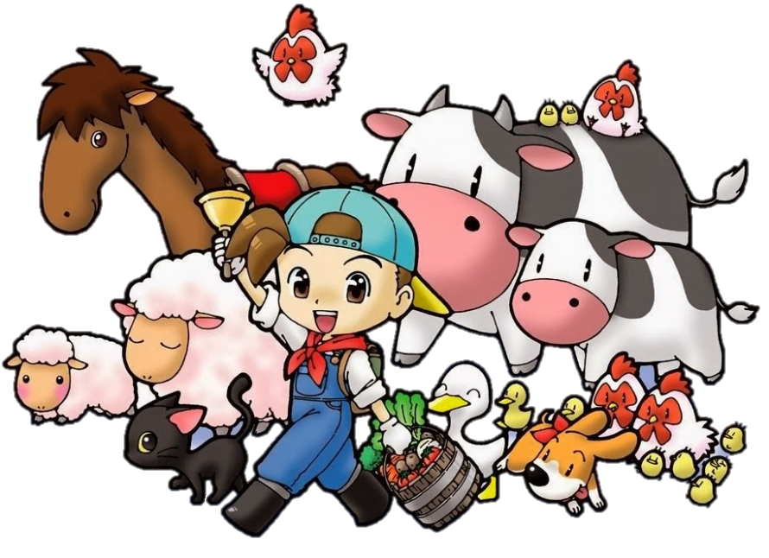
Learning Objectives
State the importance of nitrogen to living things
Outline the stages of the nitrogen cycle
Describe the human impact on the nitrogen cycle

Slide 3
Why do plants need nitrogen?
Mainly to make proteins
Also DNA
Plants without nitrogen do not grow well. In agriculture, this means a low yield.

Slide 4
The Nitrogen Cycle

Slide 5
Decompostion

Slide 6
Nitrifying Bacteria

Slide 7
Denitrifying Bacteria

Slide 8
Lightening

Slide 9
Nitrogen-fixing Bacteria

Slide 10
Fertilisers

