Slide 1
Drugs and alchohol

Slide 2
Learning objectives
Identify legal and illegal drugs
Distinguish between stimulants and depressants
Describe the effect of alcohol

Slide 3
Legal and illegal
Drugs are substances that have effects on the body.
Medicines are drugs that help people suffering from pain or disease.
Recreational drugs are taken for pleasure.
Some recreational drugs are legal, such as tobacco, alcohol and caffeine. Most other recreational drugs are illegal, such as cannabis, ecstasy and heroin

Slide 4
Stimulants
Stimulants speed up messages in the brain and along the nerves. This makes you feel more alert. Caffeine is a stimulant and is found in cola drinks, coffee and tea. It makes you feel more energetic and alert, but it can also cause insomnia (difficulty in sleeping), headaches and nervousness.
Cocaine, ecstasy and amphetamines are all illegal stimulants. They make you feel more energetic and confident, but they can damage the liver and heart. They can also cause loss of memory and concentration, and bring an increased risk of mental illness.

Slide 5
Depressaants
Depressants slow down messages in the brain and along the nerves. Alcohol is a depressant. It is found in beer, wines and spirits such as vodka. Other depressants include cannabis, heroin and solvents (eg glue and aerosols).
Here are some of the typical effects depressants have on the body:
feelings of well-being
lowered inhibition
slowed thinking
slowed muscular activity
a distorted view of the world, or hallucinations

Slide 6
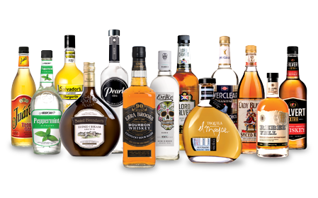

Slide 7
Produce a poster about a selected drug
Include a description of the short term and long term effects
Include statistics
Include at least one image
Use colour!

Slide 8
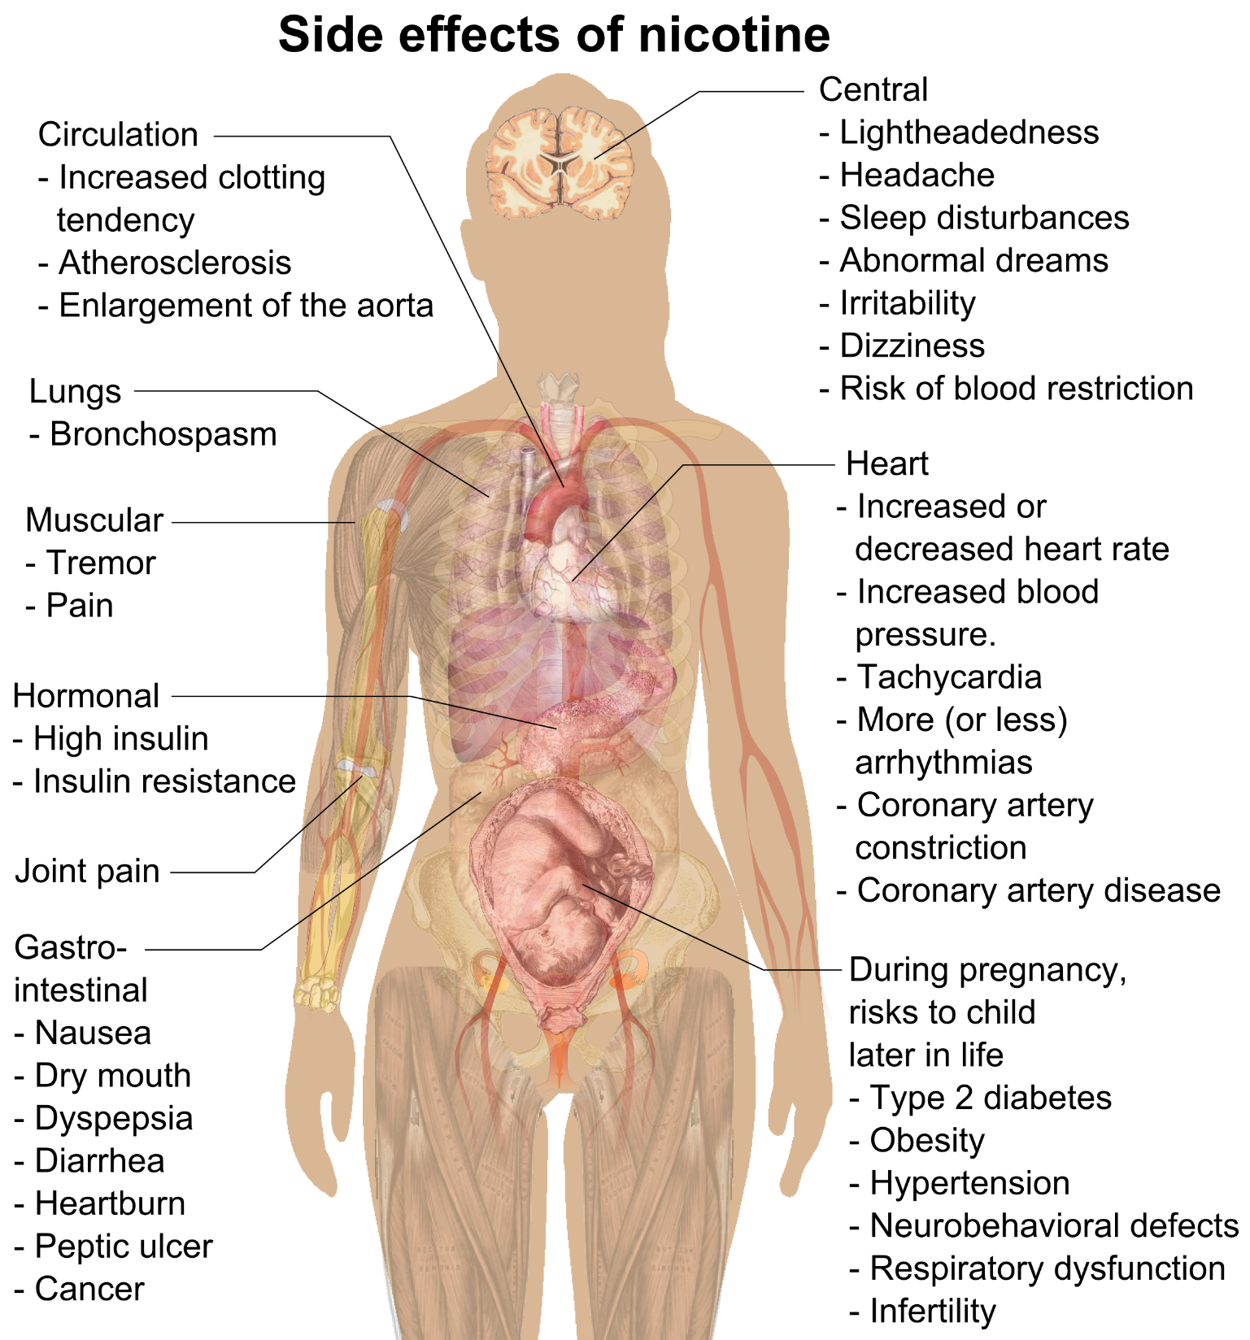
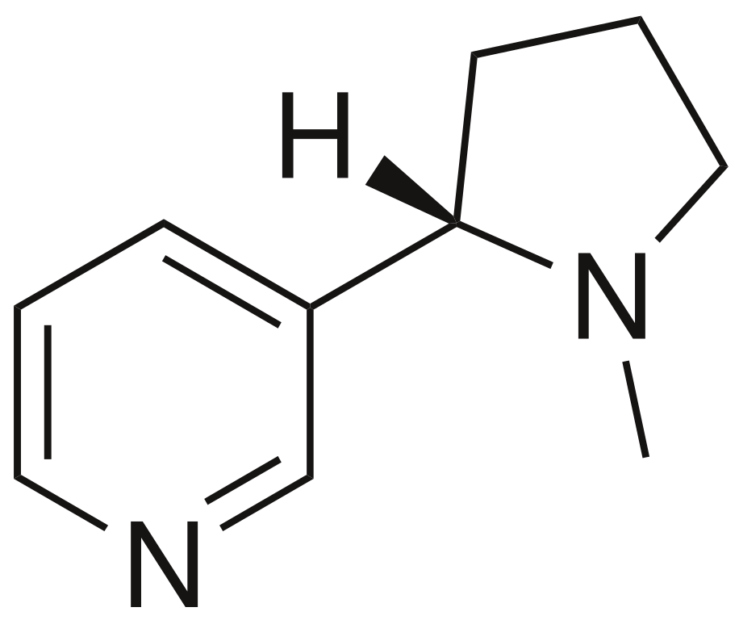
Nicotine
Nicotine is commonly consumed as a recreational drug for its stimulant effects.
It is very addictive.

