Slide 1
Red Cabbage Indicator
Year 7 Science

Slide 2
Learning objectives
Identify the pH of substances from the colour obtained using Universal Indicator
Distinguish between acids and alkalis using Litmus paper
Produce an indicator solution from red cabbage and add a variety of common acids and alkalis

Slide 3
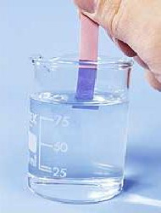
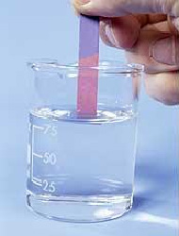
Common indicators
Universal indicator
Litmus paper

Slide 4
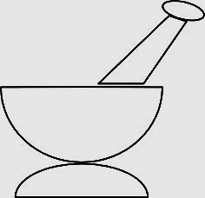
Grind some red cabbage with hot water
Wear goggles!

Slide 5
Transfer 5ml of cabbage indicator to 5 tubes using a syringe
Wear goggles!

Slide 6
Add the acids and alkalis to the cabbage indicator
Wear goggles!
Hydrochloric acid Vinegar Water Sodium bicarbonate Sodium hydroxide
Strong acid Weak acid Neutral Weak alkali Strong alkali

Slide 7
Draw the test tubes and colour
Wear goggles!
Hydrochloric acid Vinegar Water Sodium bicarbonate Sodium hydroxide
Strong acid Weak acid Neutral Weak alkali Strong alkali

Slide 8
Draw the test tubes and colour
Wear goggles!
Hydrochloric acid Vinegar Water Sodium bicarbonate Sodium hydroxide
Strong acid Weak acid Neutral Weak alkali Strong alkali

Slide 9
Quick Quiz!
1. What colour does litmus paper go when placed in acids?

Slide 10
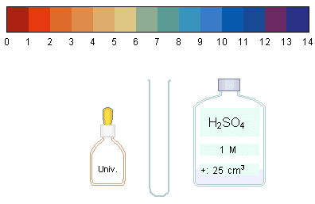
Quick Quiz!
2. What colour do you expect the Universal indicator to turn?

Slide 11
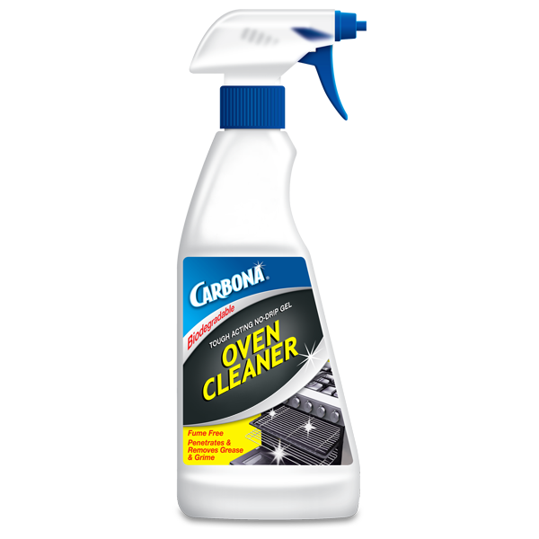
Quick Quiz!
3. What colour do you expect the Universal indicator to turn?

Slide 12
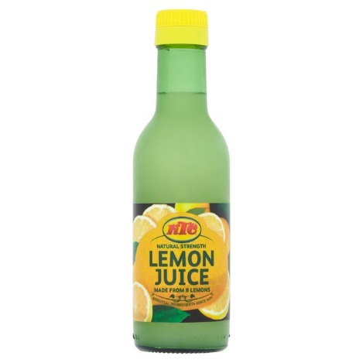
Quick Quiz!
4. Lemon juice is a weak acid. Suggest its pH

Slide 13
Quick Quiz!
5. Water is neutral. Suggest its pH

