Slide 1
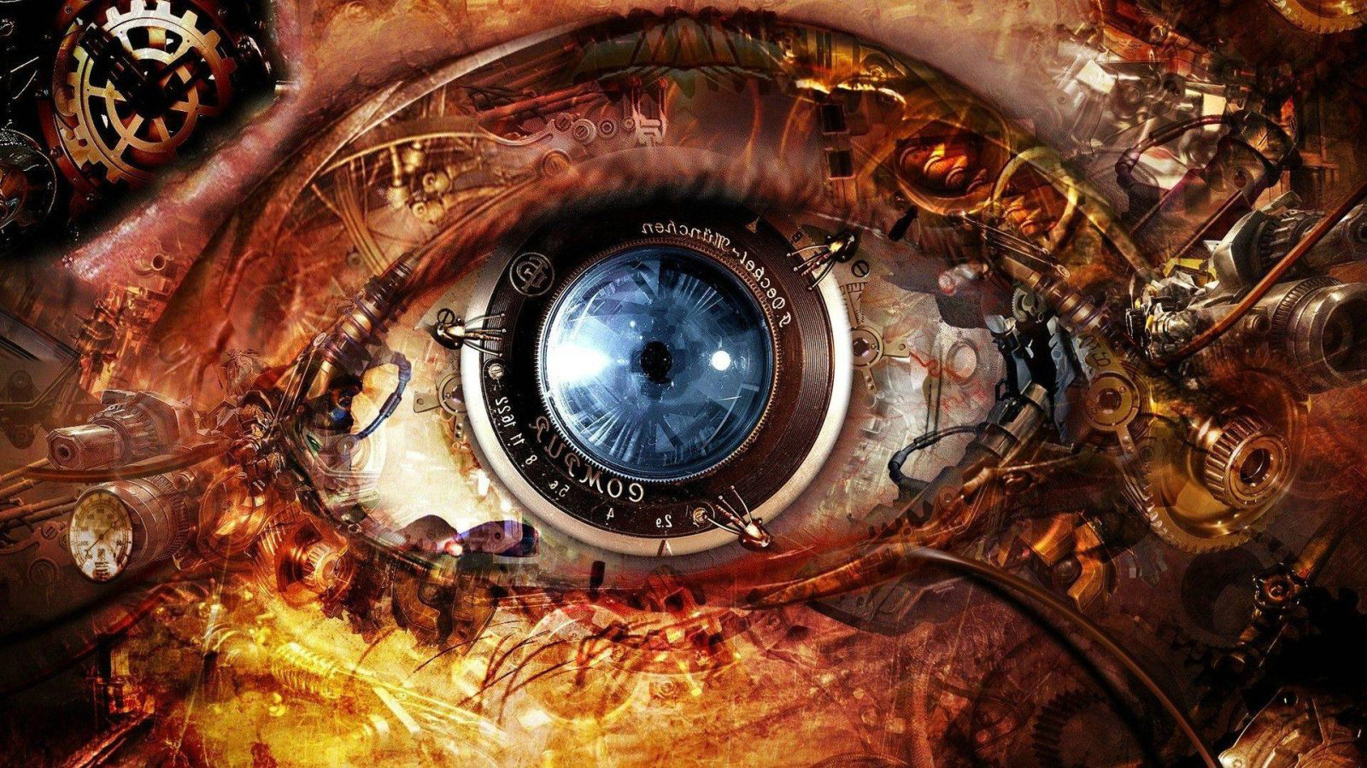
Cameras and Eyes

Slide 2
Learning Objectives
Explain how a camera works
Label the structure of the eye
State the types of cells in the retina and give their functions
Compare cameras to the eyes

Slide 3
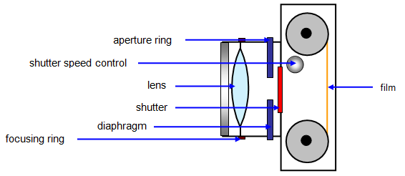
How a camera works
The image is focused on the _______ by moving the _____ backwards and forwards. The ________ controls the size of the aperture. In poor light the aperture needs to be ______ or the ______ needs to be open for longer.

Slide 4
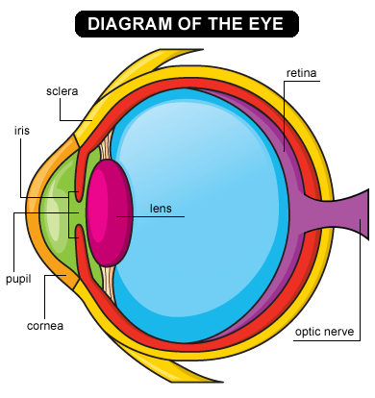
The _______ controls the amount of light that enters the eye. The _____ focuses the light onto the ______. The lens does this by changing shape. There are light sensitive _____ on the ______. _____ can detect coloured light but only work in _____ light. Rods only allow us to see in ______ but work better in ______ light.

Slide 5
Cameras and eyes
Comparison | Camera | Eye
The lens
Detects light
Controls the aperture
Diaphragm
Film or sensor
Iris
Changes shape
Retina
Moves forwards and backwards

