Slide 1
Adaptations

Slide 2
Learning objectives
Explain the importance of adaptations to the survival of a species.
Annotate a drawing of a plant or animal to show its adaptations.

Slide 3
ADAPTATIONS
Dirt does not enter small eyes (They are not blind)
Dense fur sheds dirt
Touch sensitive whiskers to find way through tunnels
Shovel-like paws for digging holes
Good sense of smell for finding food in the dark

Slide 4
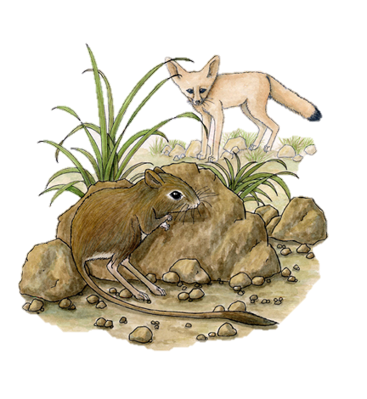
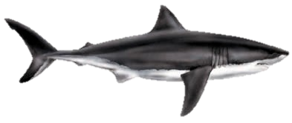
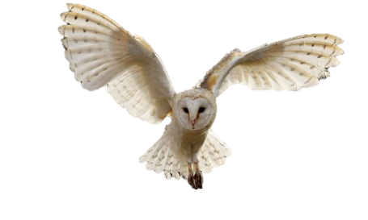
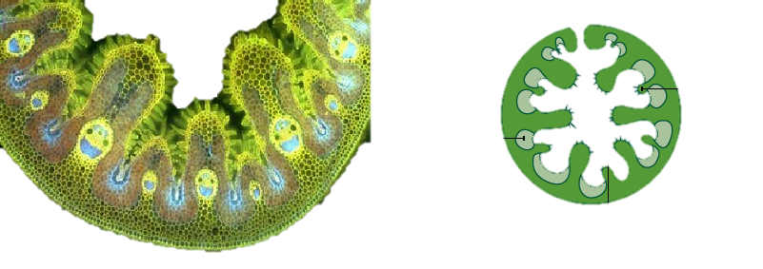
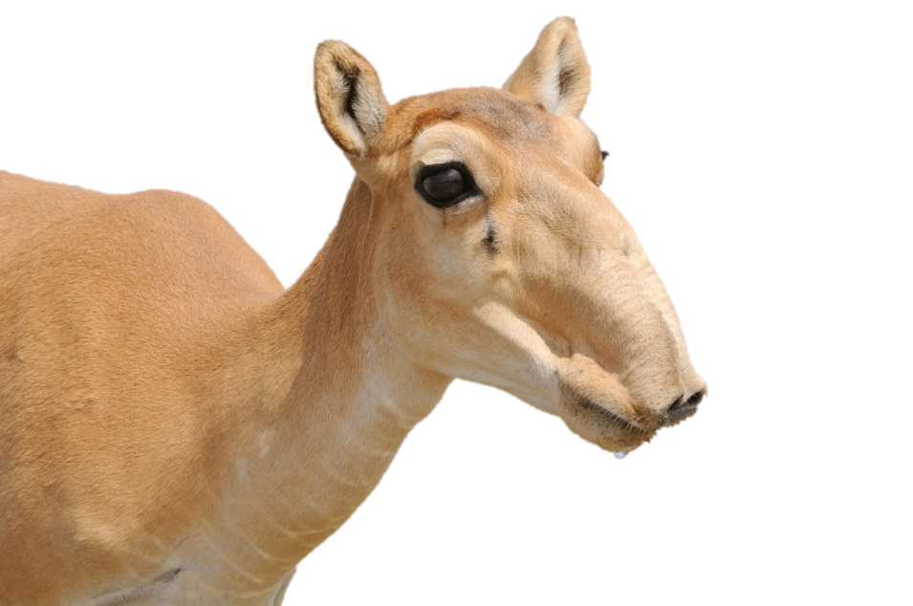
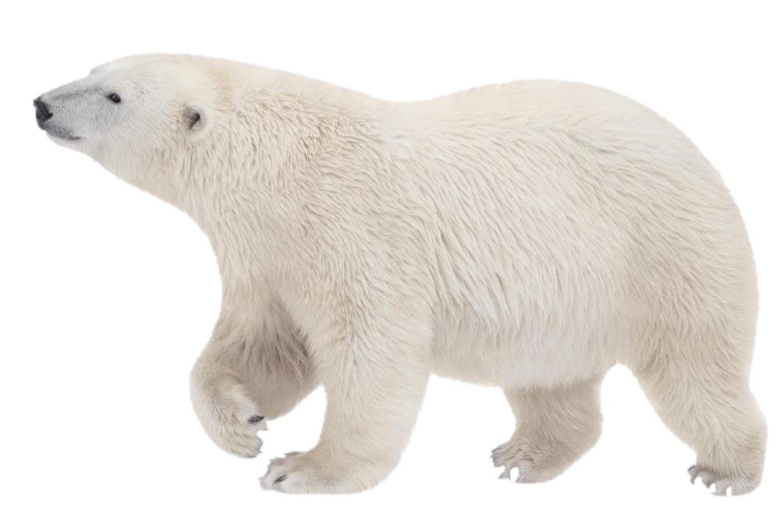
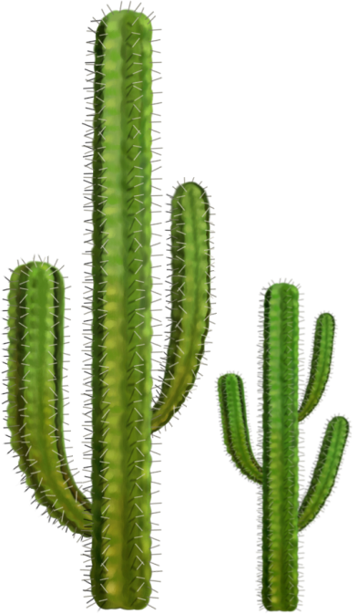
Task
Fennec fox
Shark
Kangaroo rat
Using flipchart paper, draw and annotate an animal or plant, indicating how it is adapted to its environment.
Barn Owl
Marram grass
Cactus
Polar bear
Saiga

