Slide 1
Pinhole Cameras
Haileybury Astana Year 8

Slide 2
Learning Objectives
Construct a pinhole camera
View the image of a candle using a pinhole camera
Investigate the effect of the aperture (size of the hole)
Investigate the use of a lens
Investigate the effect of multiple pinholes

Slide 3
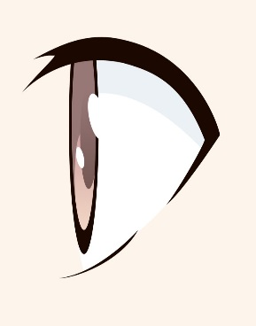
Task
Draw the image with one small hole.
Draw the image with a larger hole.
What happened when you placed a lens in front of the hole?
Describe the effect of making multiple holes.

Slide 4
Task
Draw the image with one small hole.
Draw the image with a larger hole.
What happened when you placed a lens in front of the hole?
Describe the effect of making multiple holes.
The image is clear but not very bright!

Slide 5
Task
Draw the image with one small hole.
Draw the image with a larger hole.
What happened when you placed a lens in front of the hole?
Describe the effect of making multiple holes.
The image is brighter but blurred!

Slide 6
Task
Draw the image with one small hole.
Draw the image with a larger hole.
What happened when you placed a lens in front of the hole?
Describe the effect of making multiple holes.
The image is brighter and sharp. Also it is the right way up!!

Slide 7
Task
Draw the image with one small hole.
Draw the image with a larger hole.
What happened when you placed a lens in front of the hole?
Describe the effect of making multiple holes.
Multiple holes means multiple images!!!

