Slide 2
Learning objectives
Collect data for student’s pulse rates and reaction times
Explain the importance of obtaining large amounts of data
Calculate the range of results
Determine the mean values and explain why it is more reliable

Slide 3
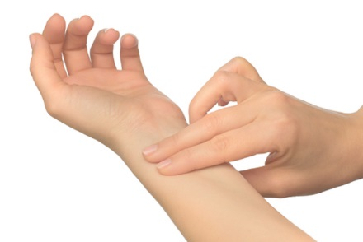
Pulse rates
Reading | Pulse rate beats/min
1
2
3
4
5
6
Range
Mean
The range = the highest value – the lowest value
The mean = readings 1 +2 + 3 + 4 + 5 + 6
6

Slide 4
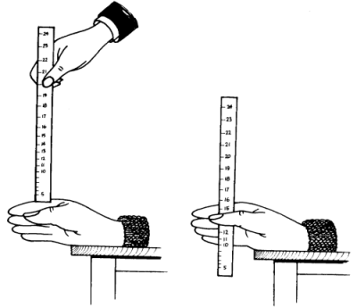
Reaction times
Reading | Reaction time using sight (s) | Reaction time using sight and touch (s)
1
2
3
4
5
6
Range
Mean
The range = the highest value – the lowest value
The mean = readings 1 +2 + 3 + 4 + 5 + 6
6

Slide 5
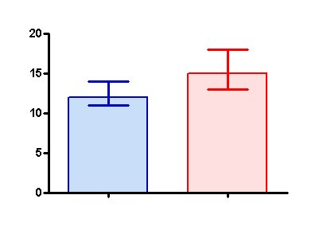
Reaction times
Reading | Reaction time using sight (s) | Reaction time using sight and touch (s)
1
2
3
4
5
6
Range
Mean
Present your results as a bar chart
Use error bars to show the range of values
Discuss your results

