Slide 1
PRESSURE

Slide 2
Pressure
Pressure is measured in Pascals (Pa)
1 Pascal = 1 Nm⁻²

Slide 3
Pressure
Force
Area
Pressure =
Why does the boy wear snow shoes?
Why do camels have spread out toes?
What are the units of force?

Slide 4
What pressure do you exert on the ground?
Weigh yourself (you can make up your weight if you want!)
Convert from kg to newtons (g=10)
Draw around your foot (do us a favour and leave your shoes on!)
Determine the area of your feet by counting the number of squares within the pencil line. Include squares that were more than half covered by your foot but not those less than half covered. These should cancel each other out to provide a valid estimate.
Calculate the pressure (in Pascals) that you exert on the ground beneath your feet.
All answers in Pa or kPa

Slide 5
What is the effect of changing the area through which a force acts while keeping the force constant?
Take a glass block and weigh it in grams.
Convert to units of force (g=10)
Measure the dimensions and calculate the areas of the sides (opposite sides have the same area).
Calculate the force (Pa) acting through the sides of different areas.
1
3
2
All answers in Pa or kPa

Slide 6
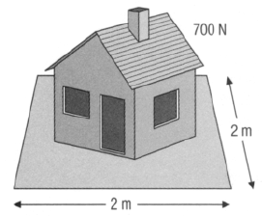
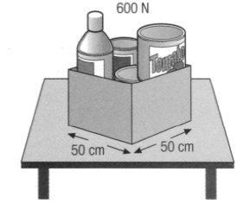
Questions
Calculate the pressure for the following situation:
A ballet dancer does a pirouette on the tip of his toe. If the dancer has a weight of 580 N and the tip of her ballet shoe measures 0.02 m by 0.01 m, what pressure does her toe exert on the stage?
Calculate the pressure for the following situation:
The base of each table leg has dimensions of
2cm x 2cm. What pressure is applied through each
table leg?
All answers in Pa or kPa

Slide 7
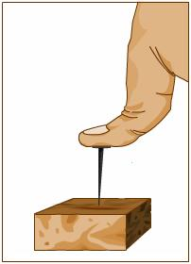
5. The man pushes the drawing pin into the wooden block with a force of 10N. The pin has an area of 0.1x0.1mm at its point. What pressure is exerted by the tip of the drawing pin?
6. A woman hits the head of the nail with a force of 100N. The area of the head is 5mm x 5mm. The tip of the nail has an area of 1mm x 1mm.
What force does the hammer blow apply:
To the hammer head?
To the wood at the base of the nail?
All answers in Pa or kPa

