Slide 1
Resistance
Year 9 Science

Slide 2
Learning Objectives
Explain the concept of resistance
Create a circuit with a variable resistor
State the effect of increasing the resistance
State the relationship between voltage, current and resistance
Apply the formula triangle

Slide 3
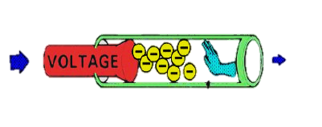
Resistance
The electrical resistance of an electrical conductor is a measure of the difficulty to pass an electric current through that conductor.
resistance

Slide 4
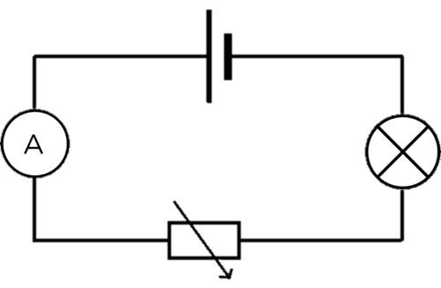
Construct the circuit below
Keep the voltage on 12V
Increase the resistance provided by the variable resistor
Copy the diagram and state the effect of increasing the resistance on both the current and the brightness of the bulb

Slide 5
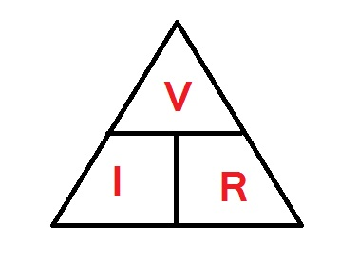
Applying Ohm’s law
Voltage (V) | Current (A) | Resistance (Ω)
12 | 3
 | 2 | 6
4 | 0.1
 | 0.2 | 5
6 |  | 10

